Slide 1





Catechism: Introduction
Going to Catechism
Lesson 1

Slide 2
Proverbs 4:10-15,18
Melody: Psalm 25
1. Listen now, o sons and daughters,
For a life that’s long and blessed.
God will be your guide in wisdom
Lead you in the way that’s best.
All God’s paths are straight and true,
Follow them, be ever humble.
When you walk you will not fall,
When you run you will not stumble
Author: Mrs. LML

Slide 3
Proverbs 4:10-15,18
Melody: Psalm 25
2. Hold on tight to God’s instruction,
Guard it, for it is your life.
Watch your footsteps, watch your pathways;
Choosing wrong will bring you strife.
But the path of righteousness –
Like a new day dawning brightly –
Is the path that you should take;
Follow it and walk uprightly
Author: Mrs. LML

Slide 4
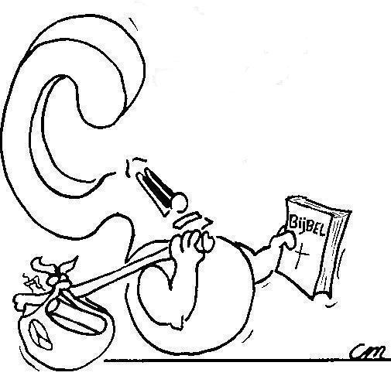

What brings you here, to catechism?
All my friends go.
I want to learn more about God
My parents make me go.

Slide 5
Why go to catechism?

My parents want my faith in God to grow
My parents made a promise to teach me about God

Slide 6
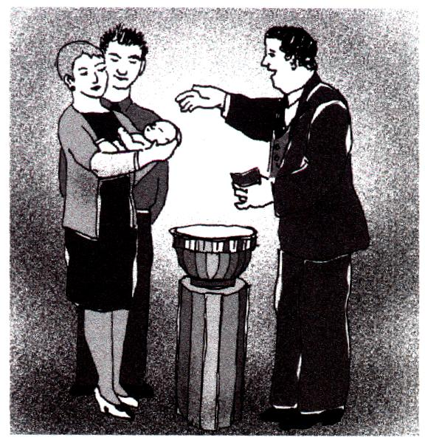
Baptism
?
1. No, because it’s all about the promises God gives.
2. Because the promises of God go from generation to generation.
3. Because the promises of God are covenantal promises, and the congregation is the covenant community, the family of God.

Slide 7

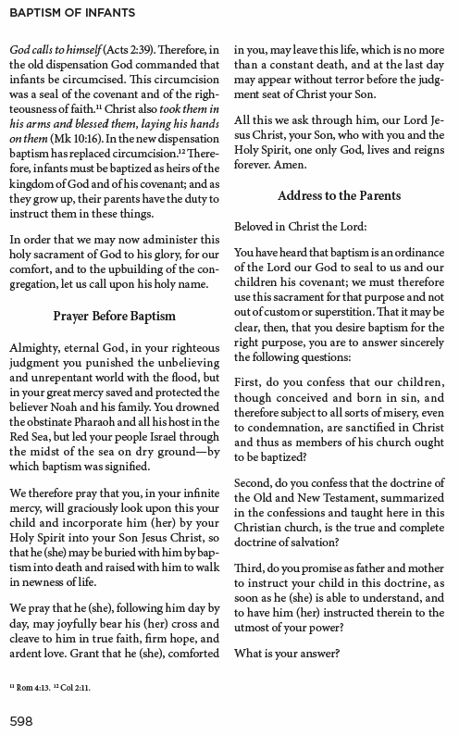

Slide 8
Baptism - an acknowledgement

NAME, I baptize you in the Name of the Father, Son and Holy Spirit
First, do you confess that our children, though conceived and born in sin, and therefore subject to all sorts of misery, even to condemnation, are sanctified in Christ and thus as members of His church ought to be baptized?
When you were baptized, it was made clear to everyone (including you!) that you belong to God.
That’s what your parents acknowledged when saying “I do” to the first question asked.

Slide 9
Baptism - a confession

NAME, I baptize you in the Name of the Father, Son and Holy Spirit
Second, do you confess that the doctrine of the Old and New Testament, summarized in the confessions and taught here in this Christian church, is the true and complete doctrine of salvation?
The church knew you belonged to God, because your parents belonged to God and had faith in God.
Your parents confessed their faith when saying “I do” to the second question asked.

Slide 10
Baptism - a promise

NAME, I baptize you in the Name of the Father, Son and Holy Spirit
Third, do you promise as father and mother to instruct your child in this doctrine, as soon as he (she) is able to understand, and to have him (her) instructed therein to the utmost of your power?
Your parents promised to teach you about God, and to have you taught by the church (and school).
That’s what your parents promised when saying “I do” to the third question asked.

Slide 11



Your parents make you go
Your parents made a promise to teach you about God
Your parents want you to grow in faith.

Slide 12


Bible Study: Psalm 78:1-7
(The Old Testament Catechism)
1. Things we have heard and known, that our fathers have told us
2. The glorious deeds of the LORD and His might, and the wonders that He has done
3. fathers - their children - the next generation - children yet unborn - in turn their children
4. Five generations
5. Set their hope in God,
Not forget His deeds
Keep His commandments
- Faith
- Knowledge
- Behaviour

Slide 13
Your parents make you go
Your parents made a promise
Your parents want you to grow in faith.

Slide 14

Your parents want you to grow in faith
As you grow older, you become more responsible for yourself:
for what you think,
for what you want,
for what you do.
What you think, want, and do, is determined by your convictions, what you believe, your faith.
God has chosen you, will you accept His choice or reject it?

Slide 15

Calling

I, …[BAPTISM NAME]…., am
called to have faith in God and serve Him.
Now fear the LORD and serve Him with all faithfulness. ... But if serving the LORD seems undesirable to you, choose this day whom you will serve...
Joshua 24:14-15

Slide 16

Growing in faith

Catechism aims to prepare you to respond to your calling.
It will help you:
to learn more about God and yourself
to grow in faith and trust in God
to live as God would have you live.

Slide 17
Your parents make you go
Your parents made a promise
Your parents want you to grow in faith.
Preaching
Family
School Catechism

Slide 18
You yourself a believer

The Lord’s Supper serves to strengthen you in your convictions once you have indicated you have faith in God’s promises
Preaching
Family
School Catechism

Slide 19
Catechism Expectations
Memory work: memorize what’s on the sheet. At the start of every lesson you will be expected to recite or write out your memory work.
Homework: do the homework. Sometimes it involves looking something up or asking your parents something. You CANNOT do it last minute!!!
Review: At the start of every lesson you will also write a review test of the previous lesson. Questions will be on what is on the worksheet you completed during the previous lesson. So look over last time’s worksheet before coming to class.

Slide 20
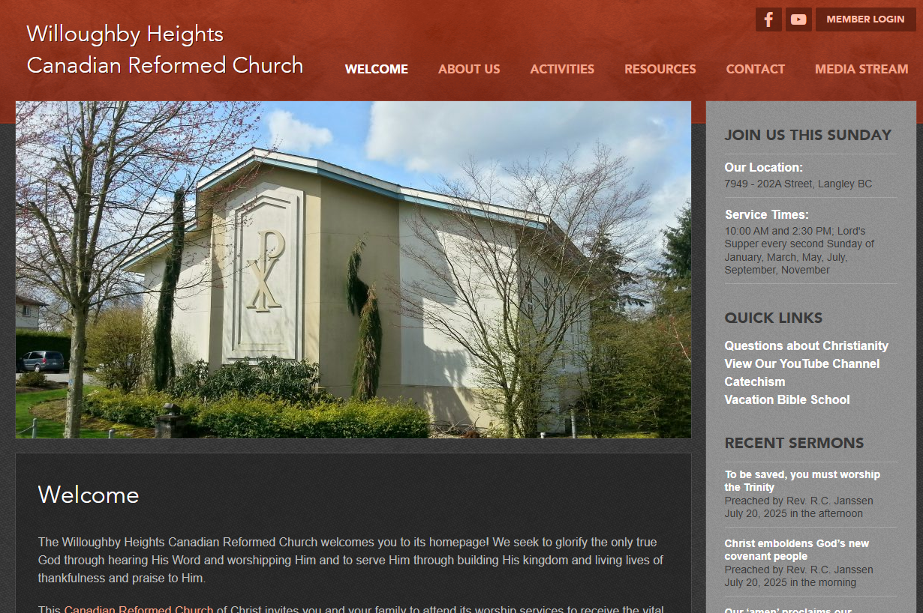
Website
If you miss a class or lose your homework, you can find all the lesson materials on our church website.
www.whcanrc.com

Slide 21

Notes:
Heidelberg Catechism Rap - https://www.youtube.com/watch?v=AXpAoIZPzOA (4:18)

