Slide 1
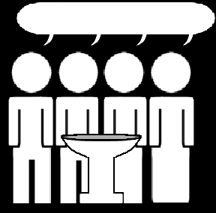
Catechism
The Profession of Faith
Lesson 2
Belonging to Jesus

Slide 2
Hymn 64:1,2
What is in life and death my only aid,
my comfort when I am by troubles swayed?
I am not mine but Christ’s, who fully paid
for all my sins and saved me.
His precious blood for my offences gave he,
freed me from all the devil’s pow’r and slavery,
for in the book of life God did engrave me,
and me his own he made.

Slide 3
Hymn 64:1,2
My faithful Saviour keeps me in his care;
without my Father’s will cannot a hair
fall from my head; he shall for me prepare
a heav’nly habitation.
All things must serve to further my salvation.
His Holy Spirit brings me consolation;
he makes me willing now with dedication
in hope his yoke to bear.

Slide 4
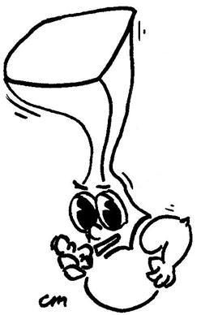
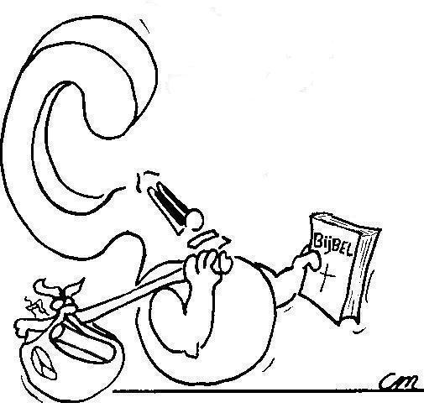

Faith is being convinced that God’s promises are true and trusting God will do as He has promised

What is faith?

Slide 5
Faith and to believe

The English words faith and to believe belong to each other.
Faith is the noun and to believe is the verb.
Someone’s faith is said to consist of a set of beliefs.
When it comes to the Bible, to believe and to have faith mean exactly the same thing.
FAITH = TO BELIEVE
Did you know...
Hebrew has no equivalent for the English word faith.
The word that comes closest is amen.
(Hebrew is the language in which the OT was written)

Slide 6
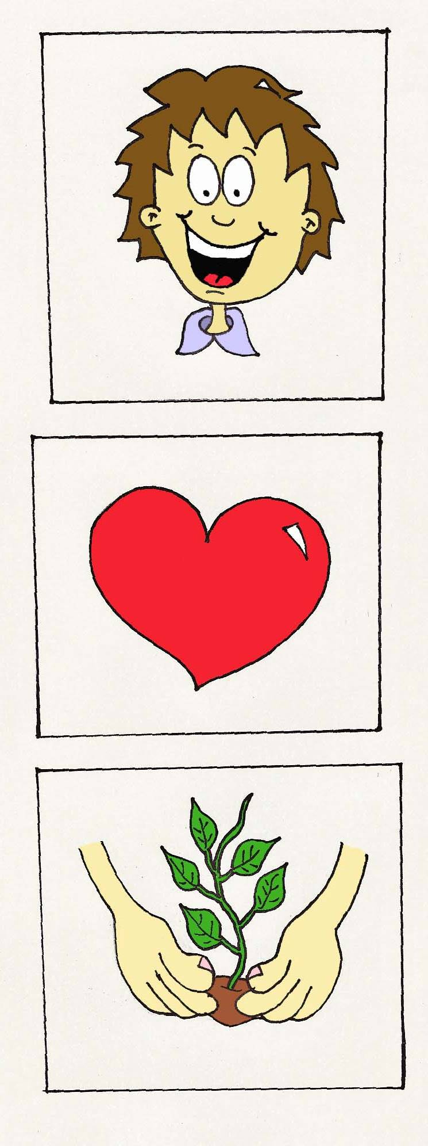
Believers and unbelievers

Believers Unbelievers
Hold what God says Reject what God
to be true says as a lie
Trust God will give Think they have to
all they need take care of
themselves
Try to please God Do whatever they
in all they do feel like doing

Slide 7
Some differences
Believers Unbelievers
God made this world Everything began
in 6 days a BIG bang
The Lord will give I’ve got to find the
health best doctor there is
Go to church on Party all weekend
Sunday

Slide 8
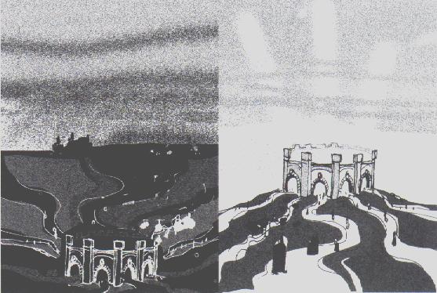
The BIG difference
Believers belong to the Lord Jesus Christ.
Unbelievers belong to Satan.

Slide 9

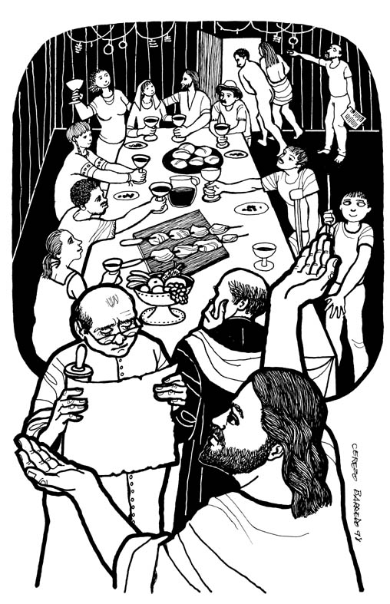
Bible Study: Matthew 22:1-14
1. Those who had been invited did not come.
2. They were selfish and even rebellious.
3. As many as the servants could find.
4. One person had no wedding garment
  At a wedding, the host would provide these.
  So the man had no excuse for not having
  them on! He, too, was selfish.
5. He got eternal punishment.
6. The people of Israel
7. The heathens
8. A hypocrite

Slide 10
Before the Fall into Sin
?
God
+
mankind
(Adam & Eve)
Satan
Why is this drawn this way?
God’s kingdom is one of light and life
Satan’s kingdom is one of darkness and death
In Paradise, man was with God

Slide 11
Right after the Fall into Sin
?
God
Satan
+
mankind
Why is it now drawn this way?
When man fell into sin he chose to leave God and His kingdom.
By default man became part of Satan’s kingdom.

Slide 12

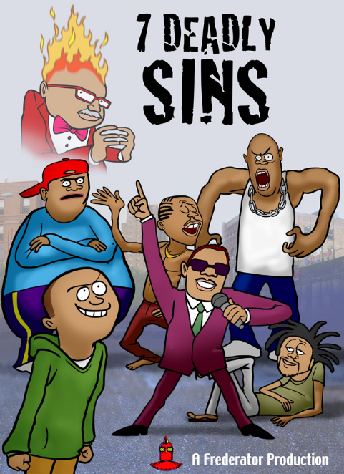
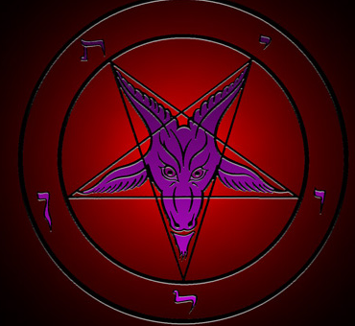
Ever since the Fall into Sin
There has been sin and misery in the world
All people are sinful
The devil is the prince of this world (John 12:31).

Slide 13
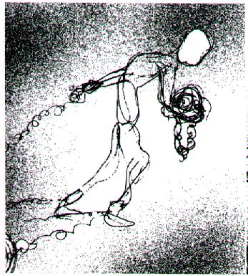
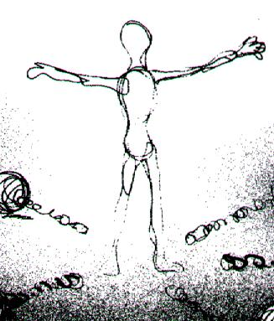
God sets free
The penalty for sin is death.
This penalty was undergone by Jesus Christ.
Whoever belongs to Jesus Christ, belongs to God.
Satan has nothing to say about you anymore!

Slide 14
Following the Fall into Sin
?
God
+
Jesus Christ &
believers
Satan
+
unbelievers
Why is it now drawn this way?
Satan tries to get people from God.
God gets people from Satan.
Those who belong to Jesus are protected from Satan.

Slide 15
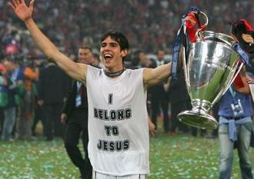
How can you tell you belong to Jesus?
I belong to a Christian family and I’m glad I do
I have been baptized, I feel secure.
I go to Church and it gives me a good feeling.
I try my best to please God by fighting sin
I pray to God, because I need God in my life
...

