Slide 1
Catechism
The Need for Faith
Lesson 3
Misery

Slide 2
Psalm 51:1
O gracious God, be merciful to me,
and in your love, your infinite compassion,
blot out my sins, remove all my transgressions.
O God, have mercy. Listen to my plea!
From every taint of evil wash me clean,
and from my guilt and misery relieve me.
For I am deeply conscious of my sin,
and all day long my misdeeds haunt and grieve me.

Slide 3

Misery
Cancer is a horrible disease. You can’t really tell by yourself that you have it. You may have symptoms - aches and pains of various sorts - but you won’t know what causes them. It’s a disease where, at first you don’t even feel the symptoms.
You need a doctor to tell you what’s going on.

Slide 4
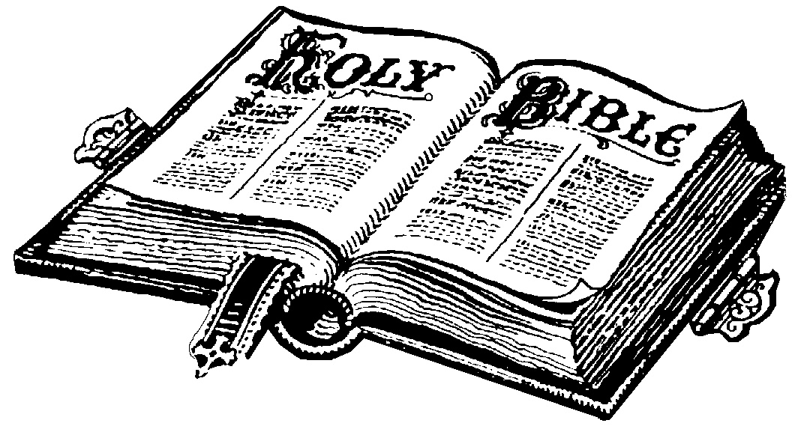
Misery
Eternal death is a horrible perspective. You can’t really tell by yourself that you are going there. You may see symptoms - frustrations, loneliness, evil - but you won’t know what causes them. It’s a condition where, at first you don’t even feel the symptoms.
You need God to tell you what’s going on.

Slide 5
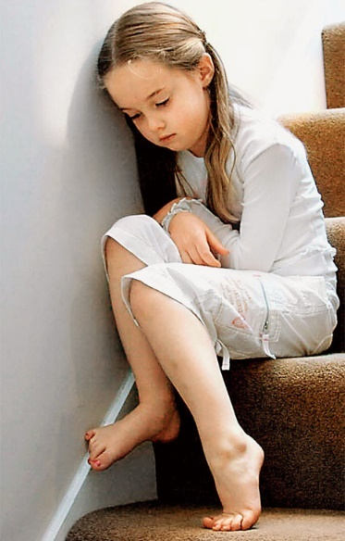


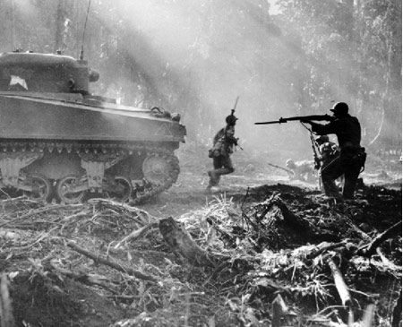
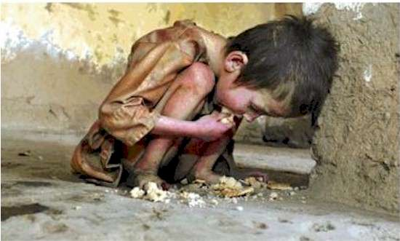
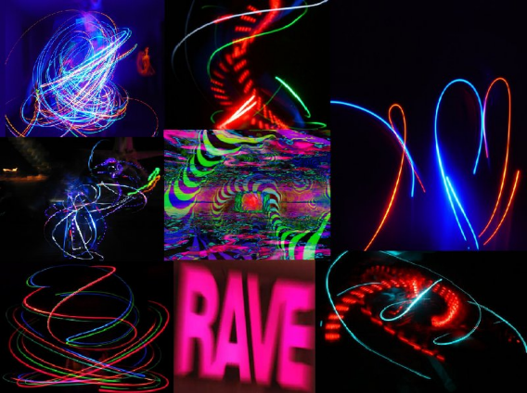
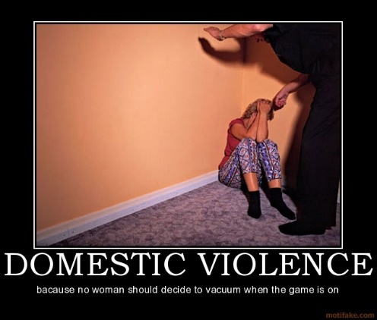
The only way to know

The only way to truly know what our problem is as human beings is to find out from God.
We need to listen to God.
God speaks to us in the Bible.

Slide 6
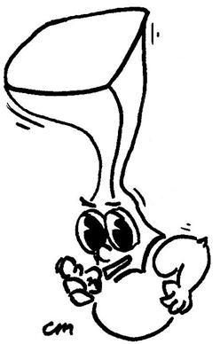
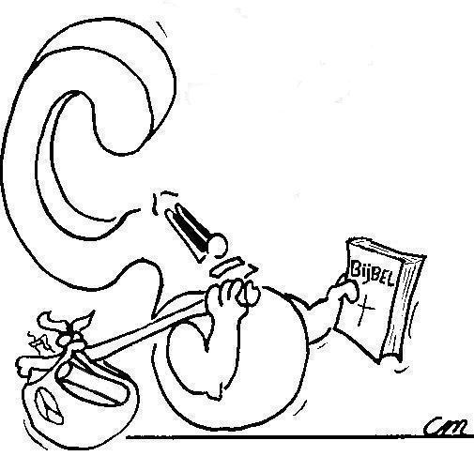

From the law of God, the Bible.
From where do we know our misery?

Slide 7
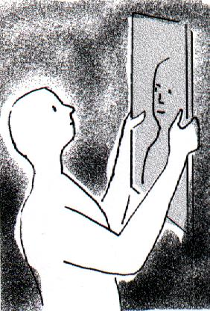
Like a mirror

The law of God is like a mirror.
You look in a mirror and discover what you look like.
You look into God’s law and discover what your life is like.

Slide 8
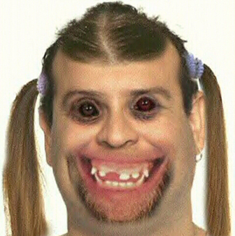
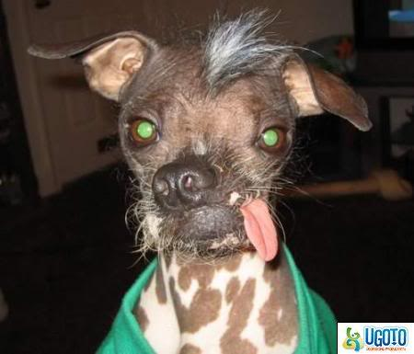
Like a mirror
If you consider yourself ugly, you don’t enjoy looking in a mirror.
You’ll avoid it as much as you can.
You may even hate mirrors!

Slide 9
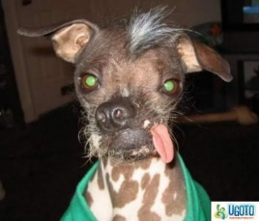
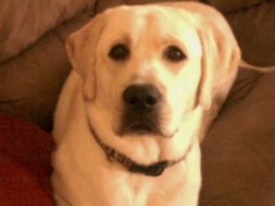
Like a mirror

Because we are sinful we don’t like the law.
It reminds us of our sin.
But without the law, we wouldn’t even know we are sinners.
But praise God!
We can go from ugly to goodlooking.
We can go from sinner to saint!

Slide 10

Where on the scale would you put yourself?
Totally Perfectly
sinful good
0 1 2 3 4 5 6 7 8 9 10

Slide 11

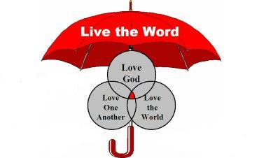
Bible Study: Matthew 22:34-40
1. A Pharisee who was also a lawyer
2. Which is the great commandment in the law?
3. Love
4. God and our fellow human beings.
5. Yes they are, because it says love neighbours as you love yourself.
6. The whole Bible

Slide 12
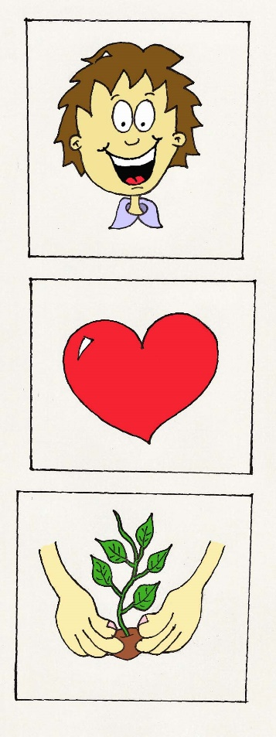
Misery

Do you know how to live right?
Do you want to live right?
Do you live right?

Slide 13
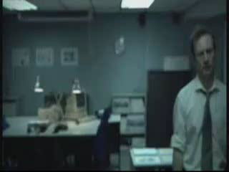
Sin leads to misery

Slide 14
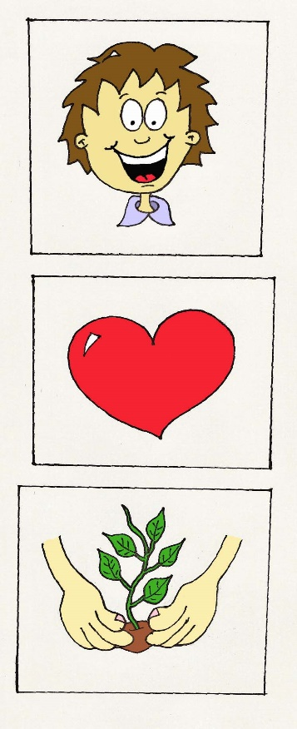
Our Real Misery

Our misery is not so much the bad things we experience in life.
Our misery is our lost condition.
I must do good but I don’t
God is angry
I must want to do good but I don’t
God is more angry
I don’t even know of myself what the good is which I must do!
God is absolutely angry

Slide 15

Where are we at?

In the Bible
Love is other-centredness
Hatred is self-centredness
After the Fall into Sin all human beings by nature love themselves ahead of God and ahead of their neighbours.

Slide 16
Where on the scale should you put yourself?
Totally Perfectly
sinful good
0 1 2 3 4 5 6 7 8 9 10

