Slide 1
Catechism
The Need for Faith
Lesson 4 – LD 3
How It Went Wrong

Slide 2
Hymn 28:3
From sin our flesh could not abstain;
sin held its sway unceasing.
The task was hopeless and in vain;
our guilt was e’er increasing.
None can remove sin’s poisoned dart
or purify our guileful heart,
so deep is our corruption.

Slide 3

Where are we at?
In the Bible
Love is other-centredness
Hatred is self-centredness
Today, all human beings by nature love themselves ahead of God and ahead of their neighbours.
Why is that? Is that simply how we are? Whose fault is this?

Slide 4
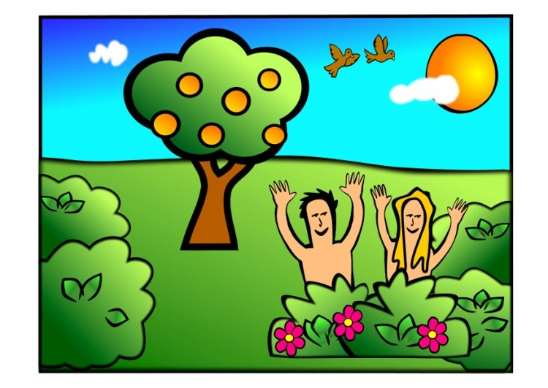
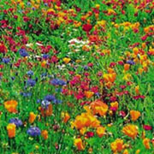
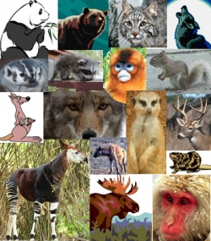
Man: a unique creature

Plants & animals were created “after their own kind”
Man was created “in the image and likeness of God”
Reason: God had a special job for man

Slide 5
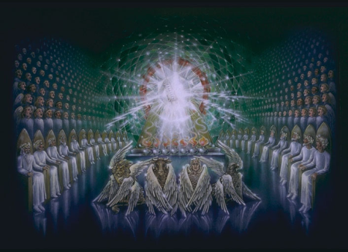
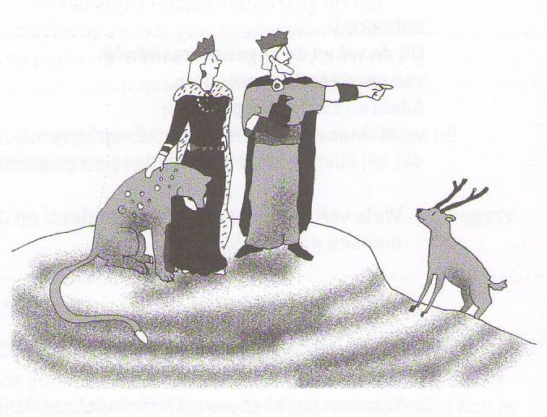
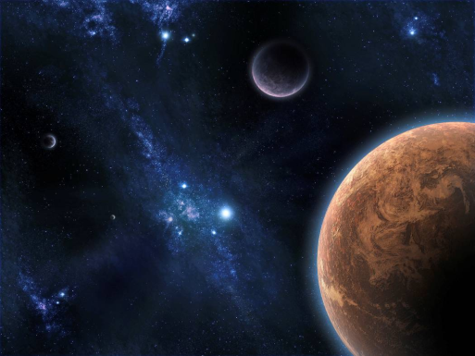
Man’s position

God is king
(Ruler Supreme)
⇓
Man is vice-regent
(Ruler on behalf of God)
⇓
Creation is subject
(That which is ruled)

Slide 6
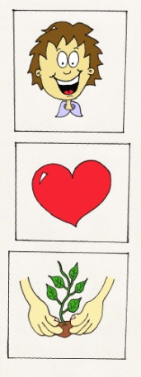
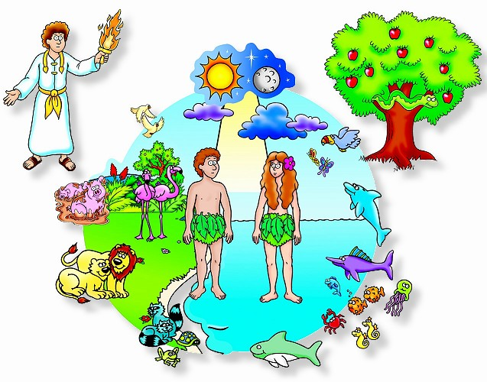
Man: perfectly good
Because man was created to be God’s representative on earth, God gave man:
- A mind that is able to learn and understand creation and manage it properly
- A will desiring to do as God requests
- Insight into good and evil, in order to always do what is right

Slide 7
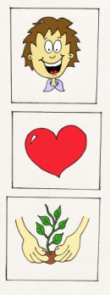
Not God’s fault
So: The origin of our fallen nature does not lie with God.
For God created us good and in His image.
Did God, then, create man so wicked and perverse?
No, on the contrary, God created man good and in His image, that is, in true righteousness and holiness, so that he might
rightly know God his Creator,
heartily love Him
and live with Him in eternal blessedness
to praise and glorify Him.

Slide 8

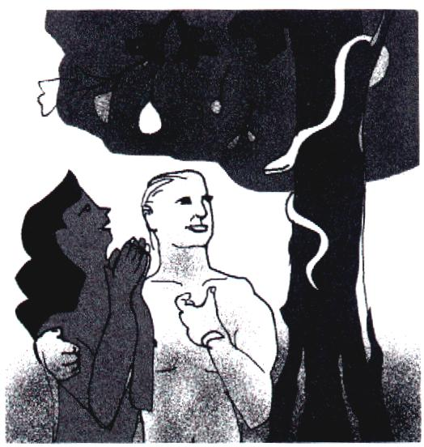
Bible Study: Genesis 3:1-13

Slide 9
Bible Study: Genesis 3:1-13
1. Of course God did not say to the man and the woman that ALL trees were forbidden.
2. It tried to sow doubt in the woman’s mind.
3. “You shall not touch it”
4. Worse
5. (a) They will not die
(b) They would become like God [they already are], and they can never become God themselves.
6. Not eat of the fruit and call the woman to order.
7. They felt shame for each other, they were afraid of God, and they shifted the blame

Slide 10
The Plunge into Sin
?
1. Do you put your trust in God or in someone else?
2. At bottom sin is about humans being a law unto themselves, instead of being God’s image and obeying Him.

Slide 11
Not a myth

Many religions regard their stories of origin as myths. Not so true Christianity.
The Plunge into Sin was an historical event.
Adam and Eve were real people.
They were the only people back then.
The tree was real.
The snake was real.
Why is it so important to accept
the Plunge into Sin as an historical
event?

Slide 12
Not God, but we are the reason
Many religions will blame the gods for evil. But through the Bible God tells us quite clearly that is a lie. We ourselves let evil, and thus misery, enter this creation.
From where, then, did man’s depraved nature come?
From the fall and disobedience of our first parents, Adam and Eve, in Paradise.
For there our nature became so corrupt that we are all conceived and born in sin.

Slide 13
The disappointment of God

God had created us humans unique.
We were to serve God, and thus be blessed by Him and enjoy life.
But we went and did our own thing rather than God’s, and we are still like that today.
Small wonder God is disappointed. That’s why He placed us under a curse.
At bottom, God’s curse is, letting us do what we want.
And by nature we are selfish, wanting to be gods to ourselves.
If we are left to ourselves, this world becomes a place of evil and misery (see Gen. 6:5)

Slide 14
Totally corrupt

We are so self-centred that of ourselves we would never do what God wants us to do.
Only if God changes us, will we be able to do good.
And if God has changed you,
you are, in reality, no longer totally corrupt,
but already have a small beginning of obedience!
But are we so corrupt that we are totally unable to do any good and inclined to all evil?
Yes, unless we are regenerated by the Spirit of God.

