Slide 1





Catechism: Introduction
Going to Catechism
Lesson 1

Slide 2
Proverbs 4:10-15,18
Melody: Psalm 25
1. Listen now, o sons and daughters,
For a life that’s long and blessed.
God will be your guide in wisdom
Lead you in the way that’s best.
All God’s paths are straight and true,
Follow them, be ever humble.
When you walk you will not fall,
When you run you will not stumble
Author: Mrs. LML

Slide 3
Proverbs 4:10-15,18
Melody: Psalm 25
2. Hold on tight to God’s instruction,
Guard it, for it is your life.
Watch your footsteps, watch your pathways;
Choosing wrong will bring you strife.
But the path of righteousness –
Like a new day dawning brightly –
Is the path that you should take;
Follow it and walk uprightly
Author: Mrs. LML

Slide 4
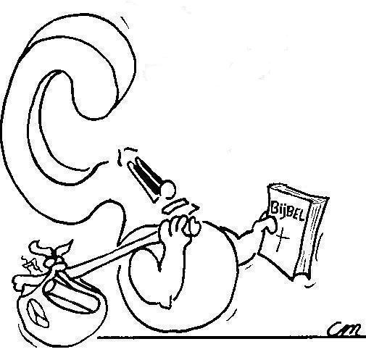

What brings you here, to catechism?
All my friends go.
I want to learn more about God
My parents make me go.

Slide 5
Why go to catechism?

My parents want my faith in God to grow
My parents made a promise to teach me about God

Slide 6
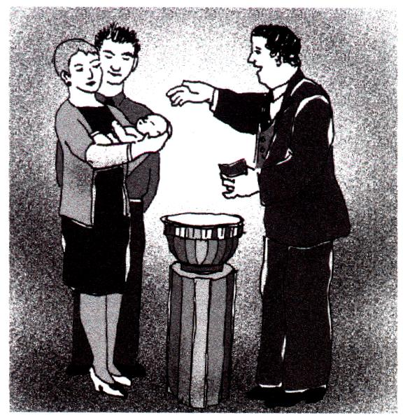
Baptism
1. No, because it’s all about the promises God gives.
2. Because the promises of God go from generation to generation.
3. Because the promises of God are covenantal promises, and the congregation is the covenant community, the family of God.

Slide 7

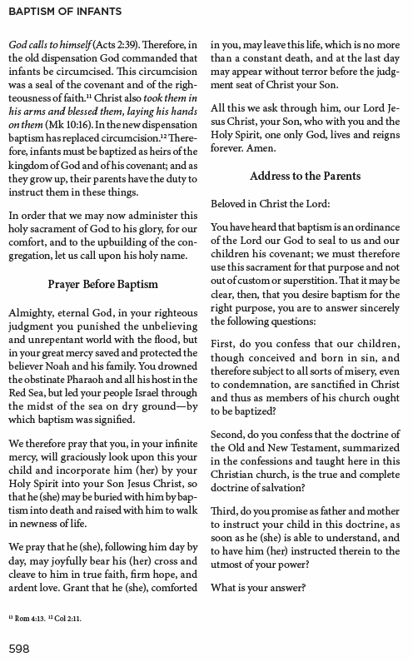

Slide 8
Baptism - an acknowledgement

NAME, I baptize you in the Name of the Father, Son and Holy Spirit
First, do you confess that our children, though conceived and born in sin, and therefore subject to all sorts of misery, even to condemnation, are sanctified in Christ and thus as members of His church ought to be baptized?
When you were baptized, it was made clear to everyone (including you!) that you belong to God.
That’s what your parents acknowledged when saying “I do” to the first question asked.

Slide 9
Baptism - a confession

NAME, I baptize you in the Name of the Father, Son and Holy Spirit
Second, do you confess that the doctrine of the Old and New Testament, summarized in the confessions and taught here in this Christian church, is the true and complete doctrine of salvation?
People knew you belonged to God, because your parents belonged to God and had faith in God.
Your parents confessed their faith when saying “I do” to the second question asked.

Slide 10
Baptism - a promise

NAME, I baptize you in the Name of the Father, Son and Holy Spirit
Third, do you promise as father and mother to instruct your child in this doctrine, as soon as he (she) is able to understand, and to have him (her) instructed therein to the utmost of your power?
Your parents promised to teach you about God, and to have you taught by the church (and school).
That’s what your parents promised when saying “I do” to the third question asked.

Slide 11



Your parents make you go
Your parents made a promise
Your parents want you to grow in faith.

Slide 12

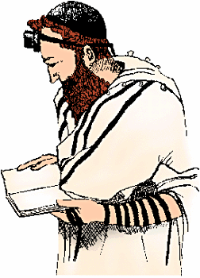
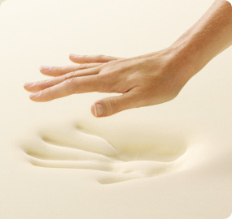
Bible Study: Deuteronomy 6:1-9
v.1b: that you may do them in the land to which you are going over, to possess it
v.2a: that you may fear the LORD your God, you and your
son and your son’s son
2. Be careful to do them
3. Know what have you to do AND do it!
4. Upon your heart.
5. Teach them diligently
6. Always and everywhere
7. Foreheads, arms, doorframes
and gates

Slide 13
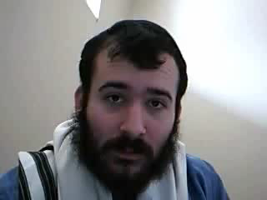
How to put on Tefillin
Notes:
2:22

Slide 14
Your parents make you go
Your parents made a promise
Your parents want you to grow in faith.

Slide 15

Your parents want you to grow in faith
As you grow older, you become more responsible for yourself:
for what you think, head
for what you want, heart
for what you do. hands
What you think, want, and do, is determined by your convictions, your faith.
God has called you
Wi Will you trust Him?

Slide 16

Calling

I, …[BAPTISM NAME]…., am
called to have faith in God and serve Him.
Now fear the LORD and serve Him with all faithfulness. ... But if serving the LORD seems undesirable to you, choose this day whom you will serve...
Joshua 24:14-15

Slide 17

Growing in faith

Catechism aims to prepare you to respond to your calling.
It will help you:
to learn more about God and yourself
to grow in faith and trust in God
to live as God would have you live.

Slide 18
Not neutral

Catechism is not neutral. As you have been created by God, you ought to decide to follow God in faith. But you are to decide that.
Note how Joshua phrased the choice Israel had:
Now fear the LORD and serve Him with all faithfulness. ... But if serving the LORD seems undesirable to you, choose this day whom you will serve...
Joshua 24:14-15
Command
Choice

Slide 19
Your parents make you go
Your parents made a promise
Your parents want you to grow in faith.
Preaching
Family
School Catechism

Slide 20
You yourself a believer

The Lord’s Supper serves to strengthen you in your convictions once you have indicated you have faith in God’s
promises
Preaching
Family
School Catechism

Slide 21
Expectations
Memory work: memorize what’s on the sheet. At the start of every lesson you will be expected to recite or write out your memory work.
Homework: do the homework. Sometimes it involves looking something up or asking your parents something. You CANNOT do it last minute!!!
Review: At the start of every lesson you will also write a review test of the previous lessons. Questions will be on what is on the worksheet completed during the lesson. So look over last time’s worksheet before coming to class.

Slide 22
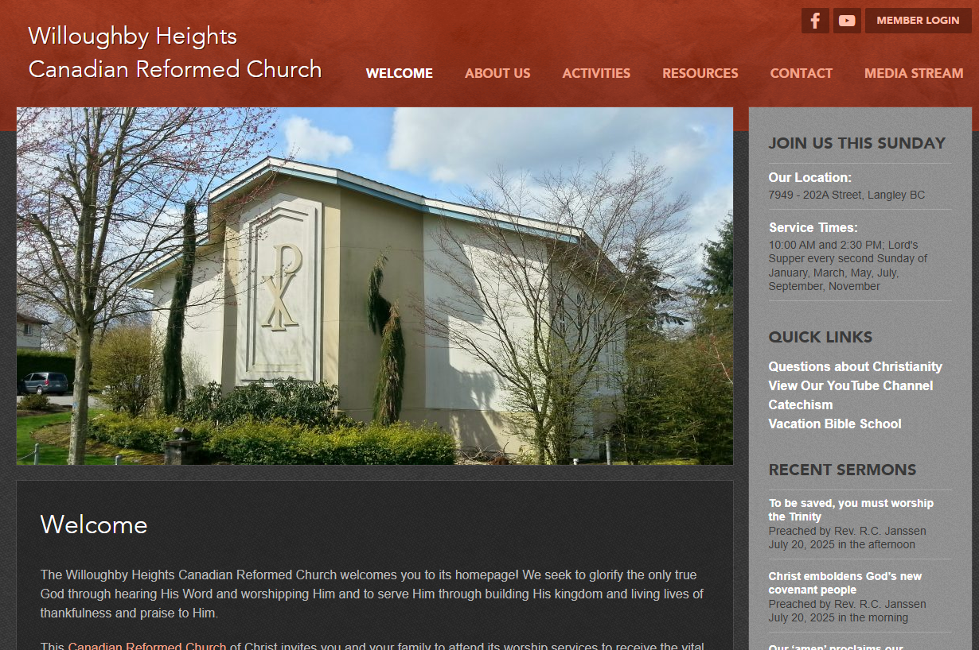
Website
If you miss a class or lose your homework, you can find all the lesson materials on our church website.
www.whcanrc.com

Slide 23

Notes:
Heidelberg Catechism Rap - https://www.youtube.com/watch?v=AXpAoIZPzOA (4:18)

