Slide 1
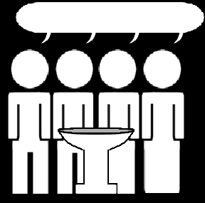
Catechism
The Profession of Faith
Lesson 2 – LD 1
Belonging to Jesus

Slide 2
Hymn 64:1,2
What is in life and death my only aid,
my comfort when I am by troubles swayed?
I am not mine but Christ’s, who fully paid
for all my sins and saved me.
His precious blood for my offences gave he,
freed me from all the devil’s pow’r and slavery,
for in the book of life God did engrave me,
and me his own he made.

Slide 3
Hymn 64:1,2
My faithful Saviour keeps me in his care;
without my Father’s will cannot a hair
fall from my head; he shall for me prepare
a heav’nly habitation.
All things must serve to further my salvation.
His Holy Spirit brings me consolation;
he makes me willing now with dedication
in hope his yoke to bear.

Slide 4
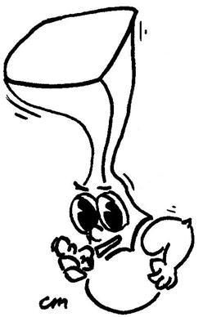
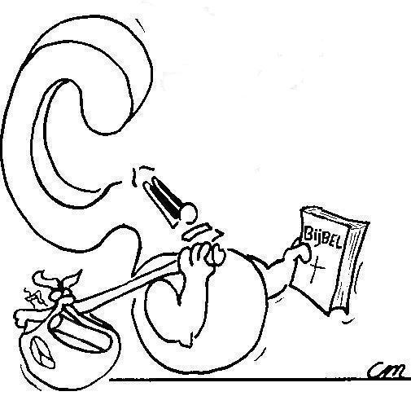

Faith is being convinced that God’s promises are true and trusting God will do as He has promised

What is faith?

Slide 5
Faith and to believe

The English words faith and to believe belong to each other.
Faith is the noun and to believe is the verb.
Someone’s faith is said to consist of a set of beliefs.
In the Bible, to believe and to have faith mean the same thing.
FAITH = TO BELIEVE
Did you know...
Hebrew has no equivalent for the English word faith.
The word that comes closest is amen.
(Hebrew is the language in which the OT was written)

Slide 6
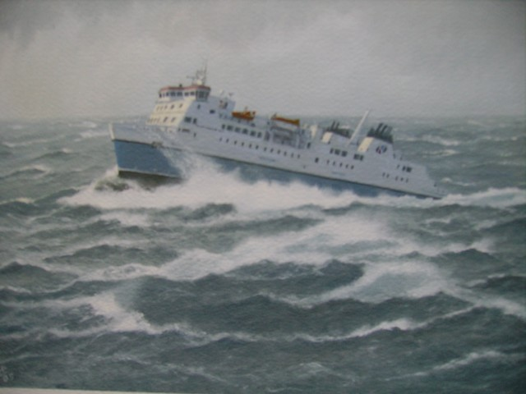
Faith in a captain

Slide 7
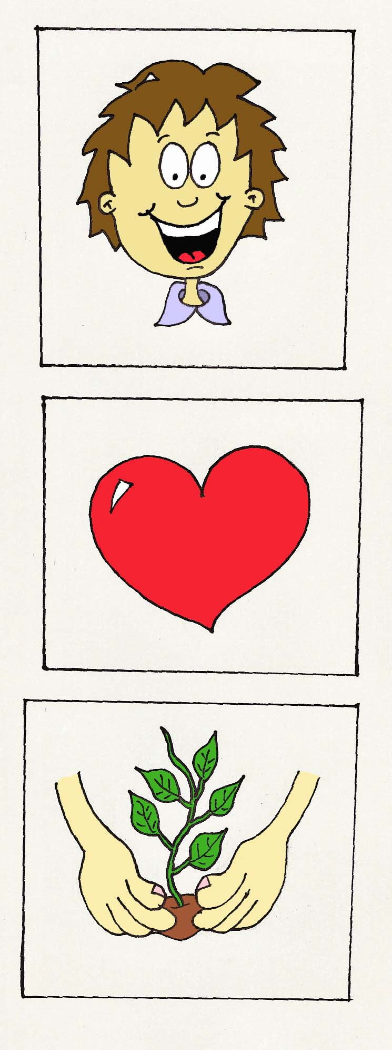
Believers and unbelievers

Believers Unbelievers
Hold what God says Reject what God
to be true says as a lie
Trust God will give Think they have to
all they need take care of
themselves
Try to please God Do whatever they
in all they do feel like doing

Slide 8
Some differences
Believers Unbelievers
God made this world Everything began
a BIG bang
The Lord will give I’ve got to find the
health best doctor there is
Go to church on Party all weekend
Sunday

Slide 9
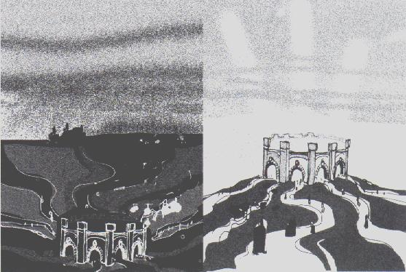
The BIG difference

Believers belong to the Lord Jesus Christ.
Unbelievers belong to Satan.

Slide 10

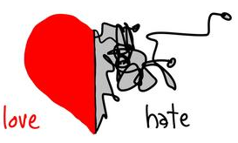
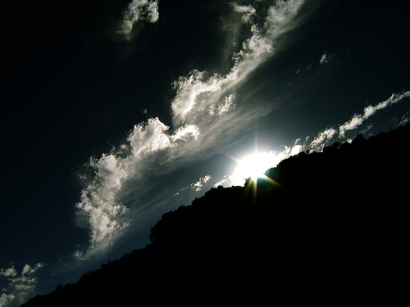
Bible Study: 1 John 2:3-11
1. If we keep Christ’s commands.
2. Because the Lord has always commanded love and loyalty.
3. It is true in Christ. I.e. we have been given Christ as a prime example of that love and loyalty.
4. The Word of God
5. One’s sinful desires

Slide 11
Before the Fall into Sin
?
God
+
mankind
(Adam & Eve)
Satan
Why is this drawn this way?
God’s kingdom is one of light and life
Satan’s kingdom is one of darkness and death
In Paradise, man was with God

Slide 12
Right after the Fall into Sin
?
God
Satan
+
mankind
Why is it now drawn this way?
When man fell into sin, he chose to leave God and His kingdom. By default man became part of Satan’s kingdom.

Slide 13


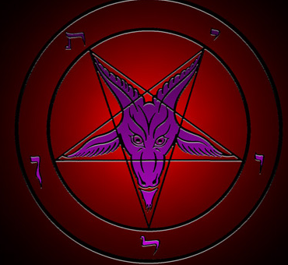
Ever since the Fall into Sin
There has been sin and misery in the world
All people are sinful
The devil is the prince of this world (John 12:31).

Slide 14
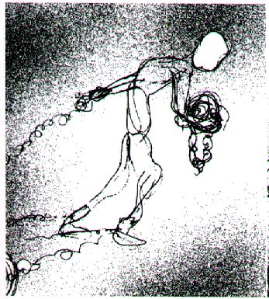
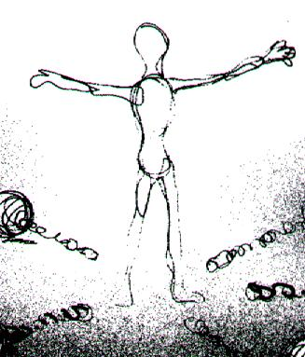
God sets free
The penalty for sin is death.
This penalty was undergone by Jesus Christ.
Whoever belongs to Jesus Christ, belongs to God.
Satan has nothing to say about you anymore!

Slide 15
Following the Fall into Sin
?
God
+
Jesus Christ &
believers
Satan
+
unbelievers
Why is it now drawn this way?
Satan tries to get people from God, God gets people from Satan.
Those who belong to Jesus are protected from Satan.

Slide 16
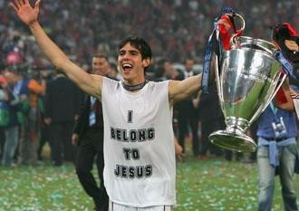
How can you tell you belong to Jesus?
I belong to a Christian family and I’m glad I do
I have been baptized, I feel secure.
I go to Church and it gives me a good feeling.
I try my best not to displease God by sinning
I pray to God, because I need God in my life
...

Slide 17

Questions for discussion
1. Satan influences people through bad friends and through their own evil desires
2. God has unbelievers hear the Gospel of Salvation and opens their hearts by the Holy Spirit.
3. Belonging to Jesus.
  - Then you know why you exist
  - Then you can have peace and feel secure
  - Then you will live eternally, doing good

