Slide 1
Catechism The Need for Faith
Lesson 3 – LD 2
Misery

Slide 2
Psalm 51:1
O gracious God, be merciful to me,
and in your love, your infinite compassion,
blot out my sins, remove all my transgressions.
O God, have mercy. Listen to my plea!
From every taint of evil wash me clean,
and from my guilt and misery relieve me.
For I am deeply conscious of my sin,
and all day long my misdeeds haunt and grieve me.

Slide 3


Misery
Cancer is a horrible disease. You can’t really tell by yourself that you have it. You may have symptoms - aches and pains of various sorts - but you won’t know what causes them. It’s a disease where, at first you don’t even feel the symptoms.
You need a doctor to tell you what’s going on.

Slide 4

Misery
Eternal death is a horrible perspective. You can’t really tell by yourself that you are going there. You may see symptoms - frustrations, loneliness, evil - but you won’t know what causes them. It’s a condition where, at first you don’t even feel the symptoms.
You need God to tell you what’s going on.

Slide 5
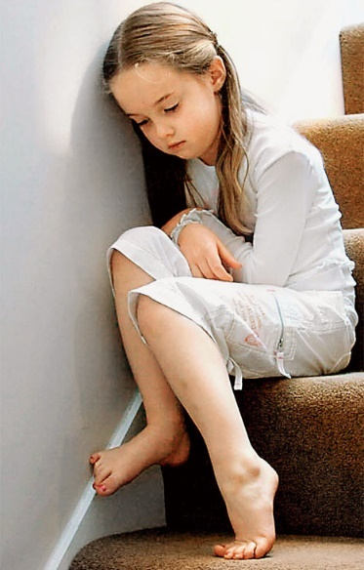


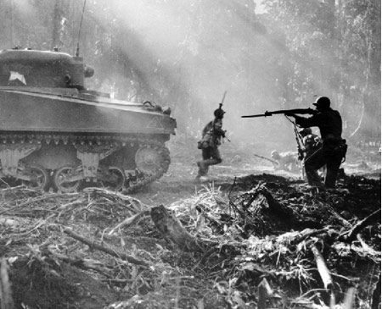
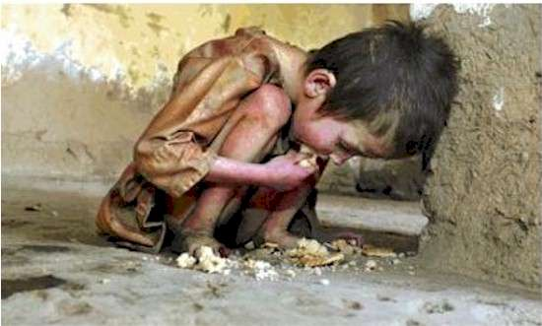
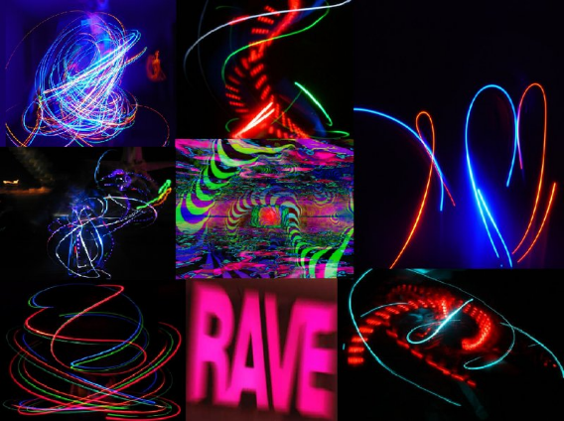

The only way to know

The only way to truly know what our problem is as human beings is to find out from God.
We need to listen to God.
God speaks to us in the Bible.

Slide 6
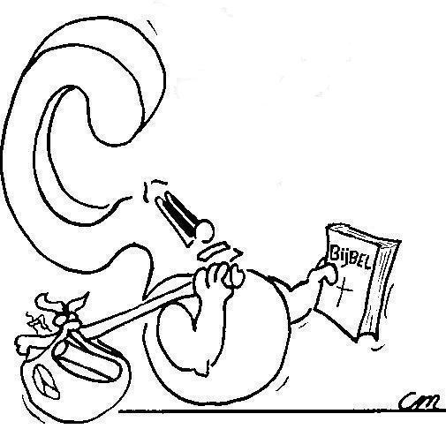
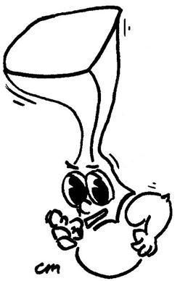

From the law of God, the Bible.
From where do we know our misery?

Slide 7
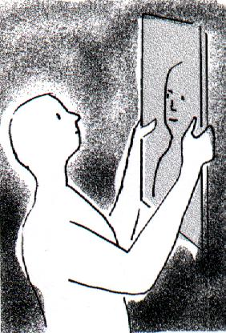
Like a mirror

The law of God is like a mirror.
You look in a mirror and discover what you look like.
You look into God’s law and discover how your life is.

Slide 8
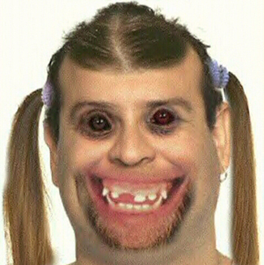
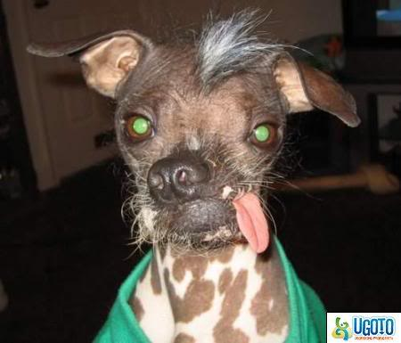
Like a mirror
If you consider yourself ugly, you don’t enjoy looking in a mirror.
You’ll avoid it as much as you can.
You may even hate mirrors!

Slide 9
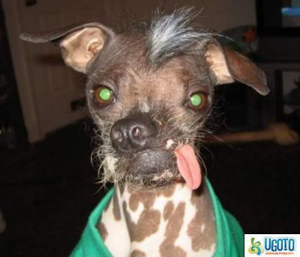
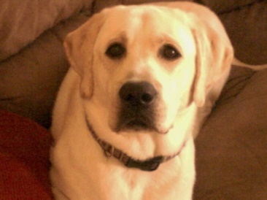
Like a mirror

Because we are sinful we don’t like the law.
It reminds us of our sin.
But without the law, we wouldn’t even know we are sinners.
But praise God!
We can go from ugly to goodlooking.
We can go from sinner to saint!

Slide 10

Where on the scale would you put yourself by nature?
Totally Perfectly
sinful good
0 1 2 3 4 5 6 7 8 9 10

Slide 11


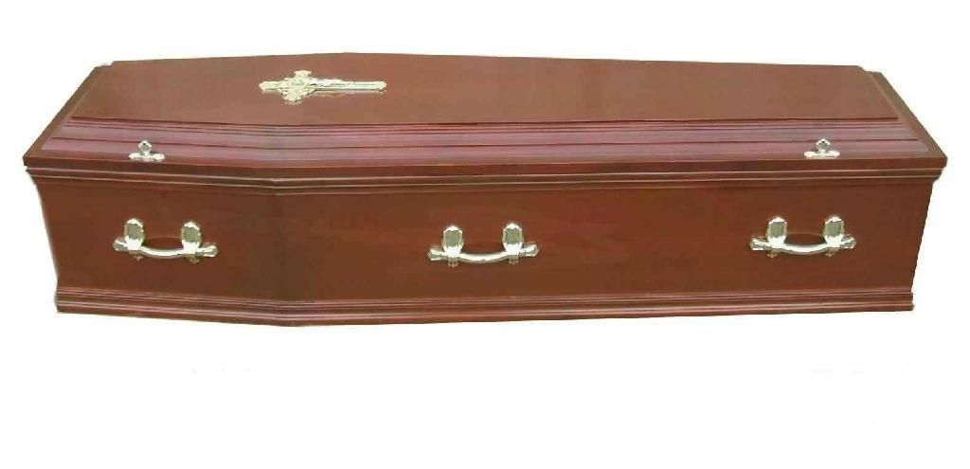
Bible Study: Ephesians 2:1-3
1. Dead in their trespasses and sins
2. When they followed Satan and the ways of the world
3. We all (the Jews too!)
4. Children of wrath

Slide 12
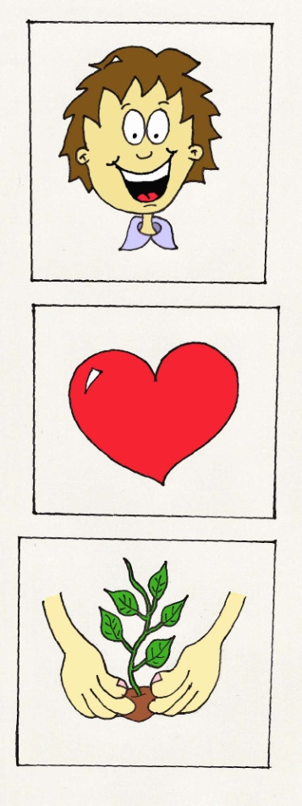
Misery
Do you know how to live right?
Do you want to live right?
Do you live right?

Slide 13

Our Real Misery

Our misery is not so much the bad things we experience in life.
Our misery is our lost condition.
I must do good but I don’t
God is angry
I must want to do good but I don’t
God is more angry
I don’t even know of myself what the good is which I must do!
God is absolutely angry

Slide 14

Where are we at?

In the Bible
Love is other-centredness
Hatred is self-centredness
After the Plunge into Sin, all human beings by nature love themselves ahead of God and ahead of their neighbours.

Slide 15
Where on the scale should you put yourself by nature?
Totally Perfectly
sinful good
0 1 2 3 4 5 6 7 8 9 10

Slide 16
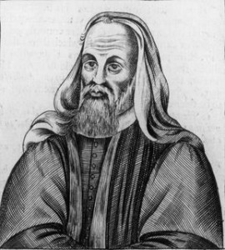

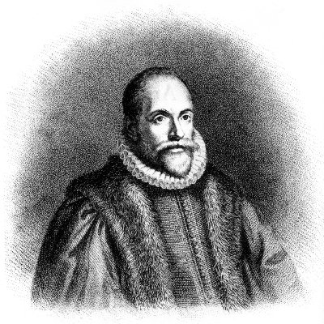
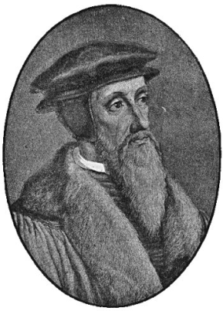
How good, how bad?

People are basically good. They become bad by following bad examples.
People are basically an equal mixture of good and bad. Life is about the balance.
People are basically quite bad. But they can still want to believe in God.
People are basically totally depraved, no good in them at all.
Pelagianism
Daoism
Arminianism
Calvinism

Slide 17
Canons of Dort III/IV:1-3
1. Man deprived himself of all God’s gifts and became wicked and perverse in every way.
2. By the propagation of a perverted nature.
3. Totally unable to do any good and inclined to all evil.

Slide 18
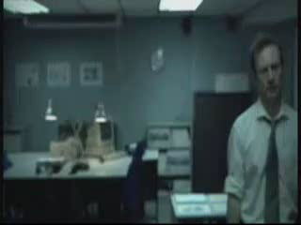
Sin leads to misery

