Slide 1
Catechism
The Need for Faith
Lesson 4 – LD 3
How It Went Wrong

Slide 2
Hymn 28:3
From sin our flesh could not abstain;
sin held its sway unceasing.
The task was hopeless and in vain;
our guilt was e’er increasing.
None can remove sin’s poisoned dart
or purify our guileful heart,
so deep is our corruption.

Slide 3

Where are we at?
In the Bible
Love is other-centredness
Hatred is self-centredness
Today, all human beings by nature love themselves ahead of God and ahead of their neighbours.
Why is that? Is that simply how we are? Whose fault is this?

Slide 4
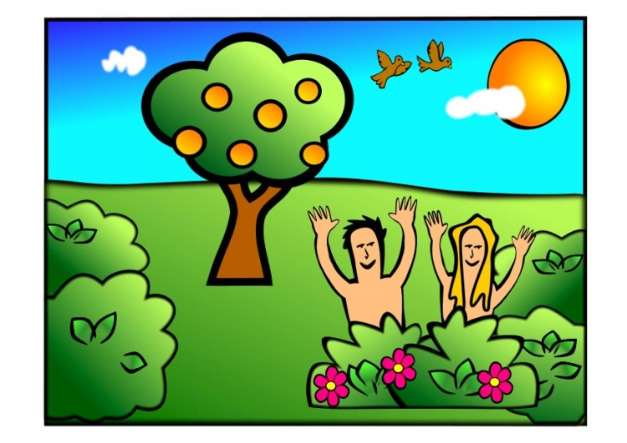
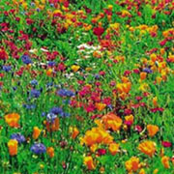
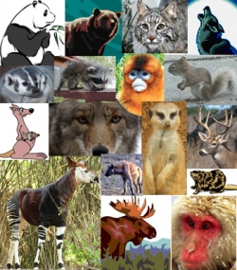
Man: a unique creature

Plants & animals were created “after their own kind”
Man was created “in the image and likeness of God”
Reason: God had a special job for man

Slide 5
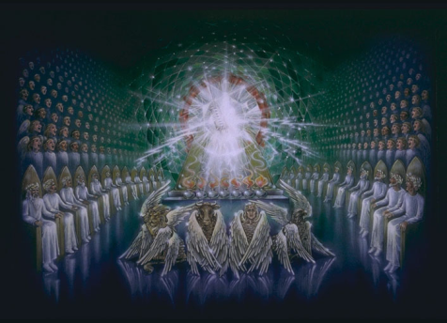
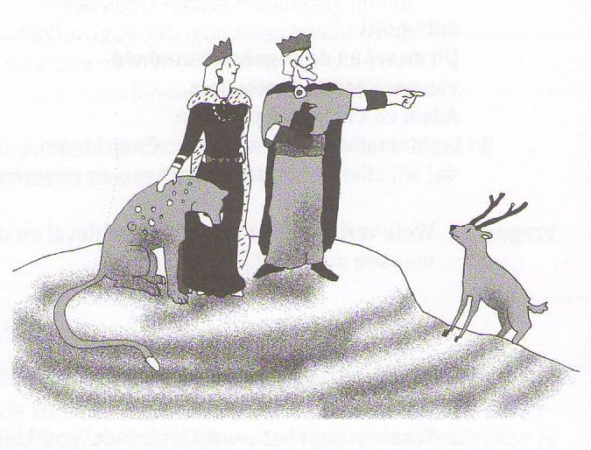
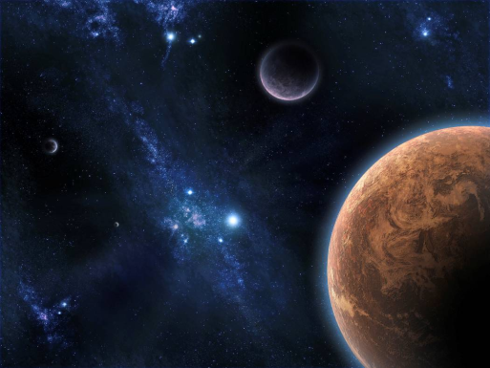
Man’s position

God is king
(Ruler Supreme)
⇓
Man is vice-regent
(Ruler on behalf of God)
⇓
Creation is subject
(That which is ruled)

Slide 6
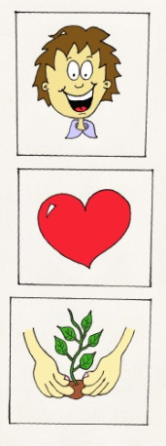
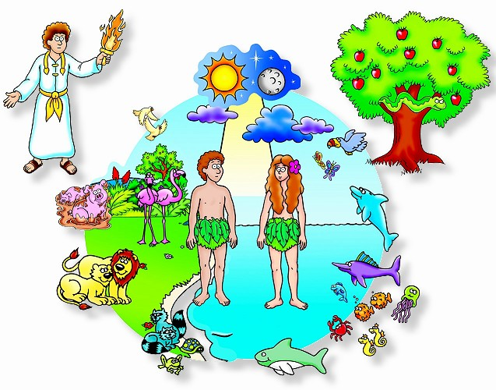
Man: perfectly good
Because man was created to be God’s representative on earth, God gave man:
- A mind that is able to learn and understand creation and manage it properly
- A will desiring to do as God requests
- Insight into good and evil, in order to always do what is right

Slide 7
Man: loving and loyal

There are more sides to being the image of God.
Another is that we are to be as God is.
God is a loving and loyal God.
We are to be loving and loyal too,
towards God above all else
to fellow human beings like to ourselves.
♥ forever

Slide 8
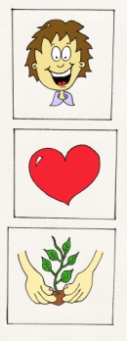
Not God’s fault
So: The origin of our fallen nature does not lie with God. For God created us good and in His image.
Did God, then, create man so wicked and perverse?
No, on the contrary, God created man good and in His image, that is, in true righteousness and holiness, so that he might
rightly know God his Creator,
heartily love Him
and live with Him in eternal blessedness
to praise and glorify Him.

Slide 9

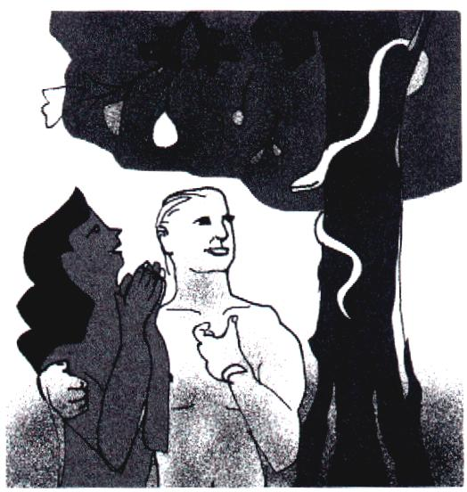
Bible Study: Genesis 3:1-13

Slide 10
Bible Study: Genesis 3:1-13
1. Of course God did not say the man and the woman that ALL trees were forbidden.
2. It tried to sow doubt in the woman’s mind.
3. “You shall not touch it”
4. Worse
5. (a) They will not die
(b) They would become like God [they already are], and they can never become God themselves.
6. Not eat of the fruit and call the woman to order.
7. They felt shame for each other, they were afraid of God, and they shifted the blame

Slide 11
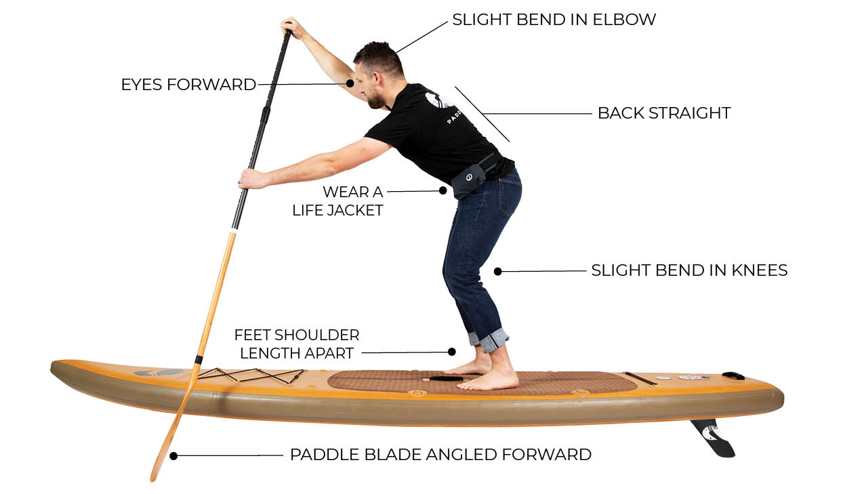
Plunge or Fall?
Generally we refer to the start of human sin as the Fall into Sin. That’s the language of the Catechism and Canons of Dort.
The Belgic Confession, however, uses the word “plunge”.
Article 16: “We believe that, when the entire offspring of Adam plunged into perdition and ruin by the transgression of the first man…”
When you “fall” it’s accidental.
When you “plunge” it’s more
graphic and involves purpose.

Slide 12
The Plunge into Sin
?
1. Do you put your trust in God or in someone else: Satan, yourself.
2. Instead of being a true representative of God, man tries to be “himself”, be “god” to himself.
3. Through the plunge into sin of Adam, all people are sinful.

Slide 13
Sinfulness
It is not helpful to speculate on how sin spreads to all men.
That it does, is clear from the Bible.
There is a communal side to it: Adam represented all human beings that would ever exist.
There is a physical side to it: because we are born of human parents, we inherit their nature.
Therefore, just as sin came into the world through one man, and death through sin, and so death spread to all men because all sinned
Romans 5:12

Slide 14
The Tree of Knowledge of Good and Evil

The tree stands symbol for the fact that evil and good are determined by God, not by man.
Eating of that tree is symbolic for wanting to be like God: deciding for yourself what is good and what is evil.

Slide 15
Not God, but we are the reason
Many religions will blame the gods for evil. But throughout the Bible God tells us quite clearly that’s a lie. We ourselves let evil, and thus misery, enter this creation.
From where, then, did man’s depraved nature come?
From the fall and disobedience of our first parents, Adam and Eve, in Paradise.
For there our nature became so corrupt that we are all conceived and born in sin.

Slide 16
Totally corrupt
We are so self-centred that of ourselves we would never do what God wants us to do.
Only if God changes us, will we be able to do good.
And if God has changed you, you are, in reality, no longer totally corrupt, but already have a small beginning of obedience.
But are we so corrupt that we are totally unable to do any good and inclined to all evil?
Yes, unless we are regenerated by the Spirit of God.

Slide 17
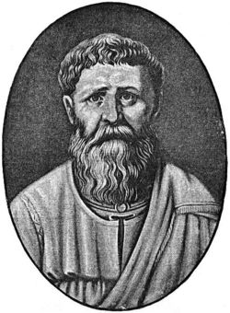
Augustine said
In Paradise man was able not to sin.
Had man made the correct choice, man would have become not able to sin.
As man made the wrong choice, man became not able not to sin.
(Get it?)

Slide 18
The disappointment of God

God had created us humans unique.
We were to serve God, and thus be blessed by Him and enjoy life.
But we went and did our own thing rather than God’s, and we are still like that today.
Small wonder God is disappointed. That’s why He placed us under a curse.
At bottom, God’s curse is, letting us do what we want. And by nature we are selfish, wanting to be gods to ourselves. If we are left to ourselves, this world becomes a place of evil and misery (see Gen. 6:5)

