Slide 1


Catechism
Profess and Defend Your Faith
Lesson 1

Slide 2
Proverbs 4:10-15,18
Melody: Psalm 25
1. Listen now, o sons and daughters,
For a life that’s long and blessed.
God will be your guide in wisdom
Lead you in the way that’s best.
All God’s paths are straight and true,
Follow them, be ever humble.
When you walk you will not fall,
When you run you will not stumble
Author: Mrs. LML

Slide 3
Proverbs 4:10-15,18
Melody: Psalm 25
2. Hold on tight to God’s instruction,
Guard it, for it is your life.
Watch your footsteps, watch your pathways;
Choosing wrong will bring you strife.
But the path of righteousness –
Like a new day dawning brightly –
Is the path that you should take;
Follow it and walk uprightly
Author: Mrs. LML

Slide 4


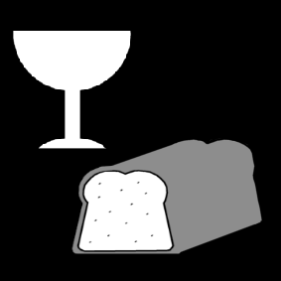


Why go to catechism?
Your parents made a promise
Your parents want you to grow in faith.
You want to grow in faith.

Slide 5
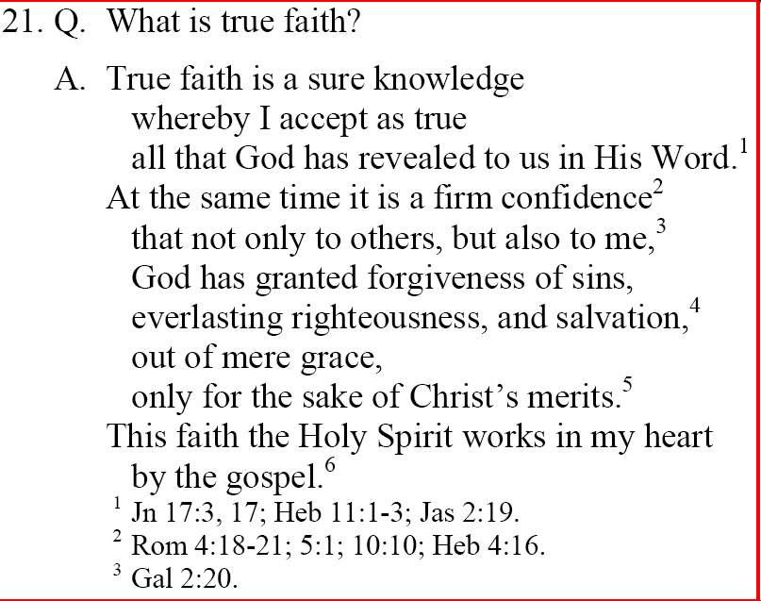

What is faith?
Now faith is the assurance of things hoped for, the conviction of things not seen.
Hebrews 11:1
Faith has three sides to it:
- a rational side: knowledge, insight
- an emotional side: confidence, trust
- a practical side: behaviour

Slide 6

Faith in faith (believing)
OR
Faith in God?

Slide 7

Faith in faith or God?
Notes:
5:07

Slide 8
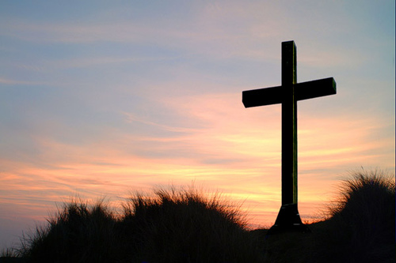
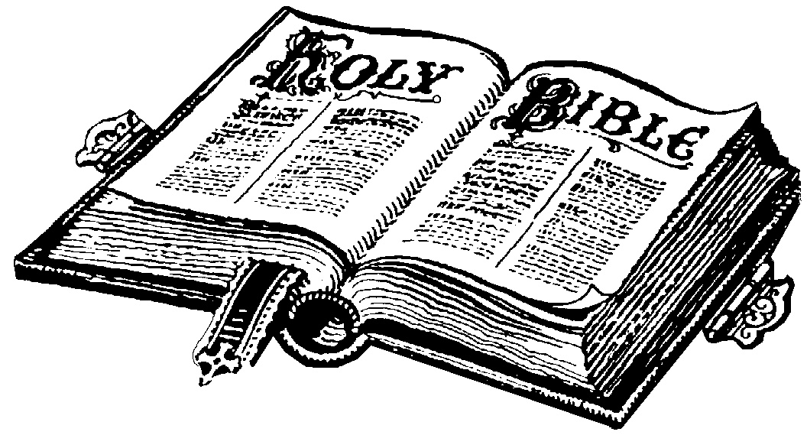
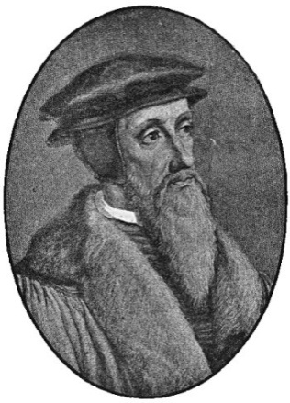
Faith has a focus

The faith professed in the Willoughby Heights Canadian Reformed Church is
- Christian: focuses on Christ
- Protestant: draws on Scripture alone
- Reformed: proclaims God’s sovereignty
and grace

Slide 9
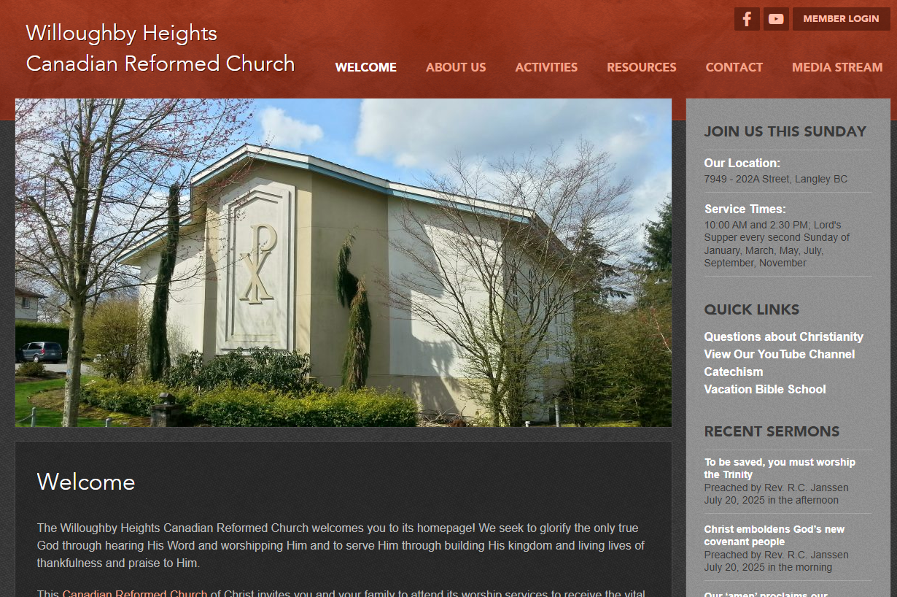
Website
If you miss a class or lose your homework, you can find all the lesson materials on our church website.
www.whcanrc.com

Slide 10
Profession of Faith - 2025-2026
Starting point: all communicant members catechized in Willoughby Heights will have had at least 6 years of catechism instruction
Those wishing to profess their faith may do so as early as in their sixth year of instruction
The profession of faith course is focused purely on profession of faith, not on instruction
As a rule, profession of faith takes place on a Sunday prior to a Sunday we celebrate the Lord’s Supper on.

Slide 11
Profession of Faith - 2025-2026
The course generally exists of 6 one-hour classes, at a time and place that works for all taking & teaching the course
  For example: if all taking the course attend CCHS, we could run the class from 3 to 4pm right after school
There’s a limit of 5 people per class
If only one person signs up for a class, you may need to bring a friend who is willing to take the course too.
Professing implies defending: apologetics…

Slide 12
This year
September – December: apologetics
January – February/March: the church (Belgic Confession 27-32)
  Includes the church order
March – April: Various Topics (e.g. infant baptism)
If there’s a topic you’d like a lesson on, let me know (via email is best)

Slide 13
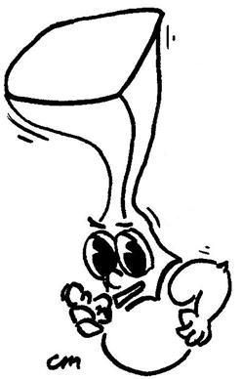
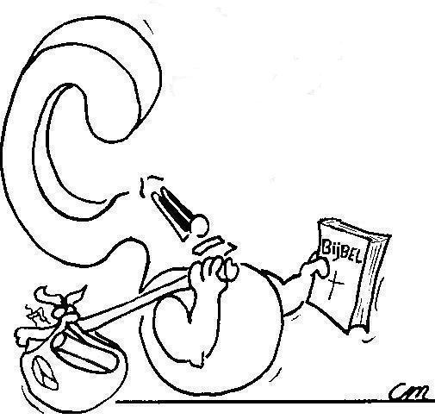
Apologetics is the discipline of defending yourself and your convictions with words
Apolo-what?

Slide 14
Defending one’s faith
But in your hearts honor Christ the Lord as holy, always being prepared to make a defense to anyone who asks you for a reason for the hope that is in you; yet do it with gentleness and respect,
1 Peter 3:15
Apologetics is from a Greek word meaning “to defend with words”.
Think of the English verb: to apologize
In Christian circles, apologetics deals with the defense of the Christian faith against other religions (e.g. Islam) and systems of thought (e.g. evolutionism).

Slide 15

Original title page – Belgic Confession

Slide 16

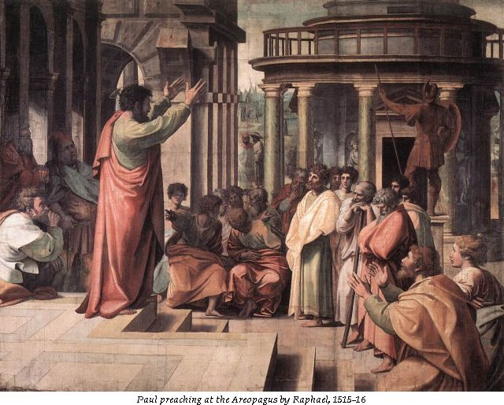
Bible Study: Acts 17 & 1Cor 1&2

Slide 17
Bible Study: Acts 17 & 1Cor 1&2
1. The city was full of idols
2. He reasoned with Jews, devout people (Greeks who believe in Yahweh) and whoever happened to be in the marketplace.
3. Talking about and listening to the latest ideas
(this was before the Internet…)
4. To present his teaching
5. He was prepared to do so.
6. He began with their situation, and tried to expand their horizon. He chose a non-confrontational approach to have them change their mind.

Slide 18
Bible Study: Acts 17 & 1Cor 1&2
7. When he mentioned the resurrection of the dead
8. Because Greeks believe that the body is a
prison of the spirit, true life is spiritual. So a resurrection of the dead is ridiculous…
9. Because it doesn’t make human sense (victory through dying) and seems very weak (death).
10. Wisdom. Something that makes sense and is appealing.
11. In the Lord.
12. Lofty speech or superior wisdom
13. In weakness, in fear and much trembling.

Slide 19
Bible Study: Acts 17 & 1Cor 1&2
14. We are to be non-confrontational, stand our ground, go by God’s standards, and boast in God.

