Slide 1
Catechism
Apologetics; Existence of God
Lesson 2
Notes:
By U5K0 - Own work, CC BY-SA 4.0, https://commons.wikimedia.org/w/index.php?curid=36129151

Slide 2
Psalm 14:1,2
1.The fool says in his heart, “There is no God.”
They are corrupt, their horrid deeds they cherish;
not one of them does good, while just men perish.
None calls upon the Lord, none sings his laud
or fears his rod.
2. The Lord looks down from heaven’s holy throne
to see if anyone has understanding.
Not one seeks God, but wickedness intending,
the sons of men, to sin and evil prone,
his law disown.

Slide 3

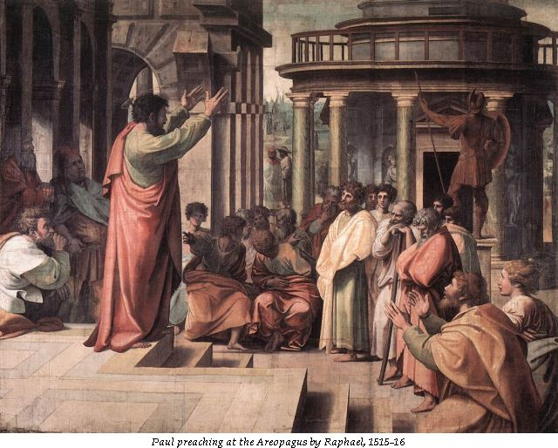
Bible Study: Acts 17 & 1Cor 1&2

Slide 4
Bible Study: Acts 17 & 1Cor 1&2
1. The city was full of idols
2. He reasoned with Jews, devout people (Greeks who believe in Yahweh) and whoever happened to be in the marketplace.
3. Talking about and listening to the latest ideas
(this was before the Internet…)
4. To present his teaching
5. He was prepared to do so.
6. He began with their situation, and tried to expand their horizon. He chose a non-confrontational approach to have them change their mind.

Slide 5
Bible Study: Acts 17 & 1Cor 1&2
7. When he mentioned the resurrection of the dead
8. Because Greeks believe that the body is a
prison of the spirit, true life is spiritual. So a resurrection of the dead is ridiculous…
9. Because it doesn’t make human sense (victory through dying) and seems very weak (death).
10. Wisdom. Something that makes sense and is appealing.
11. In the Lord.
12. Lofty speech or superior wisdom
13. In weakness, in fear and much trembling.

Slide 6
Bible Study: Acts 17 & 1Cor 1&2
14. We are to be non-confrontational, stand our ground, go by God’s standards, and boast in God.

Slide 7



Three Approaches
Evidentialism
Philosophical & Presuppositionalism
Fideism
Notes:
Begin by asking how one might do apologetics.

Slide 8
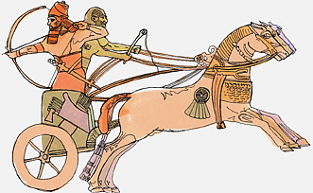
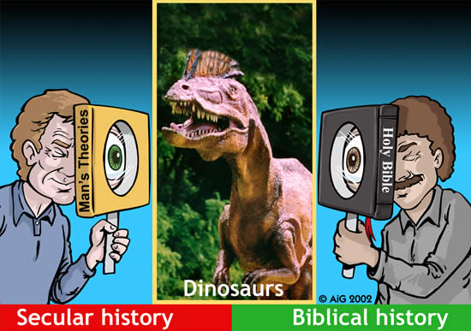
Evidentialism
Evidentialism seeks to prove
that your faith is correct.
Method: use means acceptable to the opponent.
Common forms:
- archaeological evidence for Bible history
- scientific proof for Bible doctrine

Slide 9
Evidentialism
Drawbacks:
- not everything has been proven
- not everything can be proven (miracles)
- overstating one’s case (fundamentalism)

Slide 10
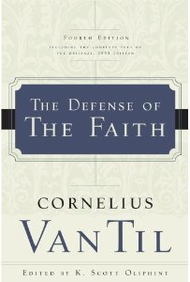

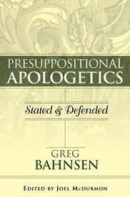
Philosophical & Presuppositionalism
The philosophical approach seeks to
prove your faith true/most probable.
Presuppositionalism seeks to
convince another that his faith
makes no sense and yours does.
Method: use reasoning.

Slide 11

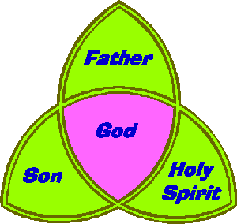
Presuppositionalism
Drawbacks:
- reasoning is circular
- some Biblical truths are beyond reason
?

Slide 12


Fideism
Fideism is accepting you can’t prove
your faith; all you can do is describe
it.
Method: describe your faith and invite others in.

Slide 13
Fideism
Drawbacks:
- implies relativism: you can believe
whatever you want (faith in faith)
- won’t convince anyone

Slide 14
Useful or not?
It is unwise to make just one approach your only approach.
The approach that works best will depend on the issue, the situation, and the opponent.
In coming lessons we’ll see the various apologetic approaches at work.

Slide 15
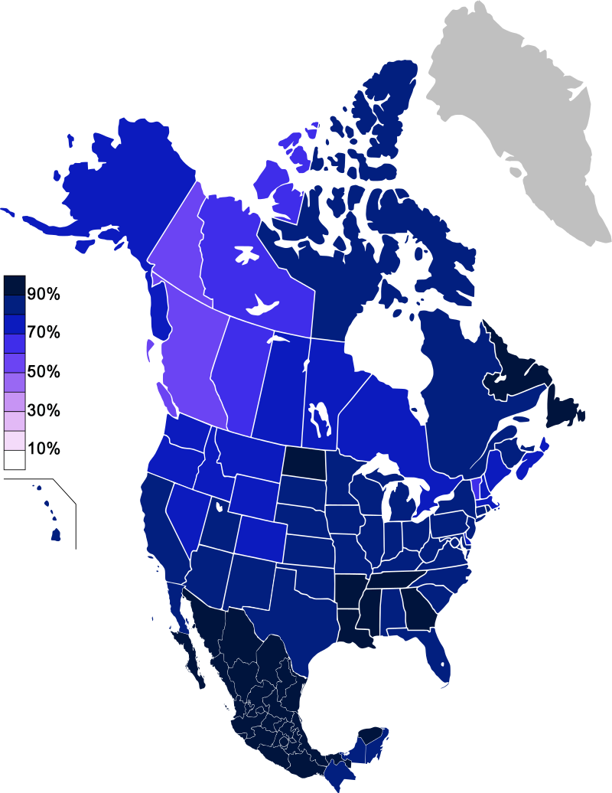
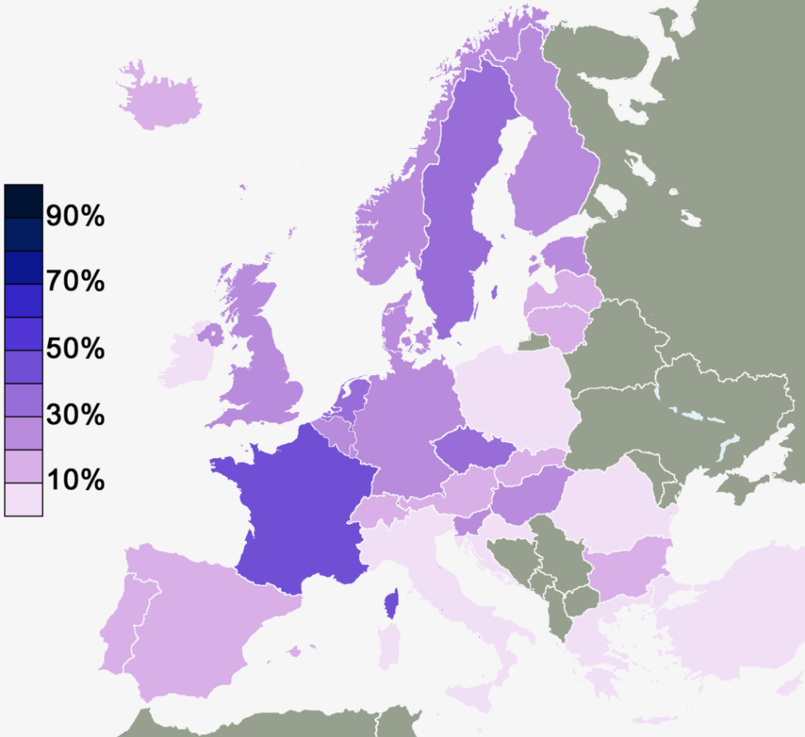
Belief in the existence of a divine being
North America – 2010-2012
Light = atheist / not religious
Europe – 2010
Dark = atheist / not religious
Notes:
Source: Wikipedia

Slide 16
Views on the existence of God
Theism: Yes, there’s something out there
Atheism: No, God does not exist
Agnosticism: Maybe, we cannot know whether God exists
Apatheism: It’s not important.

