Slide 1
Catechism
Existence of God (ctd)
Lesson 4

Slide 2
Psalm 115:2
Our God, enthroned on heaven’s cherubim,
will bring to pass whatever pleases him.
The idols of the nations,
though skilful works of silver and of gold,
are merely things that hands of men did mould
into abominations.

Slide 3
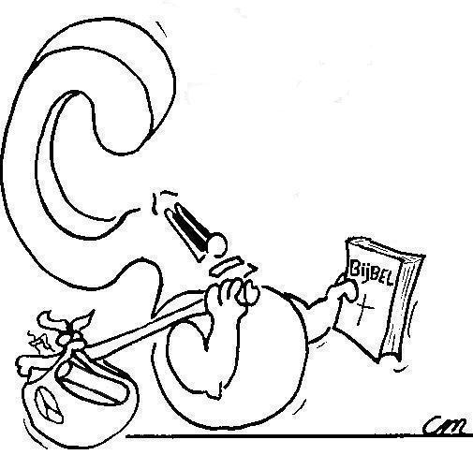

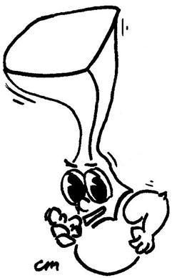
Proving the existence of God
Not definitively. We can only prove the likelihood of God existing.
How can I prove that God exists?

Slide 4
Good question! The tricky part is: what do you mean by “know”?
Hmmm, can I then know God exists?

Slide 5
Knowledge and Faith
Knowledge is commonly defined as a rational, justified belief.
Rational: Does it makes sense?
Justified: Can it be verified, proven?
Belief: Is it convincing?
I.e. Knowledge = Logic + Proof + Faith

Slide 6
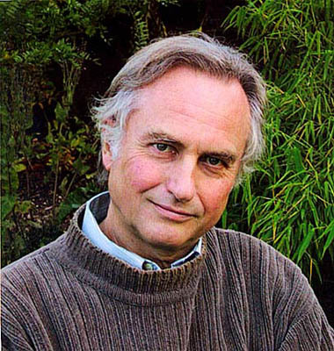
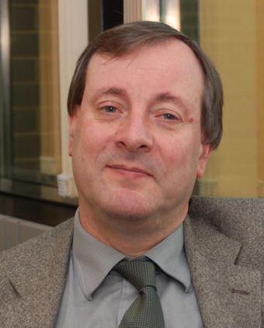
Knowledge and Faith
Knowledge:
  Rational: does it makes sense?
  Justified: Can it be verified?
  Belief: Is it convincing?
An atheist (Dawkins) interviews an atheist-become-Christian (McGrath), drawing on books they both have written.
Tough stuff, but here’s a taste of how the arguing goes.

Slide 7
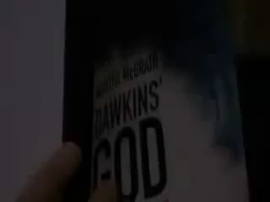
Knowledge and Faith
Watch 3 – 7.5 minutes of this

Slide 8
Knowledge and Faith
Knowledge:
  Rational: does it makes sense?
  Justified: Can it be verified?
  Belief: Is it convincing?
Philosophy: focuses on ‘rational’, yes/no
Science: focuses on ‘justified’, yes/no
Presuppositional: focuses on
‘rational’ & ‘belief’, likely or unlikely
Faith: focuses on
‘justified’ & ‘belief’, yes/no

Slide 9
Prove? No.
But you do know it.
For God has spoken and you’ve heard Him.
So, can I prove that God exists?

Slide 10
Belgic Confession 1 & 2
1. No, for we have heard God speak.
2. (Your call)
3. No. After the Plunge into Sin it is impossible for people to truly know God without God talking to them. And ever since the Bible was completed, that is the way God speaks to us.
4. We need the Spirit of God to give us knowledge of God.

Slide 11
In summary
Article 1
We confess the existence of God.
Article 2
And we know He exists because He has revealed Himself:
  - in Creation (but fallen man is deaf and blind)
  - in His Word (which, today, goes out to everyone)

Slide 12
You got it!
Witnessing, and the Holy Spirit opening the heart.
So I’ll never convince someone that God exists by arguing it or proving it with evidence? Only witnessing will?

Slide 13
An e-mail – summer 2012
Hi I'm a former church going Christian. But I have many questions that I haven't been able to find answers to so far, so I thought I should ask some of the churches I have attended some of my questions. I want both sides of the argument before I make my decision. Just a little background on me, I used to attend a Can RC church for around the first 20 years of my life. Since then I have gone off to explore the world, I am in the military and have seen some messed up stuff that doesn't make sense if there was a God. Also God doesn't seem to be logical or stand up to any rational logic. I don't have any fancy degrees, but I am very open minded and a logical thinker, and think I am pretty smart. 1. The biggest question I have: Is there a God? If so prove it.

Slide 14
Rev. Janssen’s response
1). Prove to a 3 year-old that his mom is his mother. He’ll look at you and say “She is, I know.” I can’t prove God exists in the way the scientific world wants verifiable evidence. But I can say that the probability of God existing is greater than Him not existing. For God has spoken. I have heard Him. I trust Him. And I’m not nuts. (If Christianity was an invented religion, would man be responsible for the entry of evil into this world and God be responsible for solving the problem? Almost all other religions have it the other way around: the gods cause problems and man is either a victim or Mr. Fix-It.)

Slide 15
The place of proofs
There is a legitimacy to all four approaches.
Their usefulness depends on the context.
It is one-sidedness that can make them inappropriate.
And remember,
Faith might be rational to an extent.
But faith does not come by reasoning (philosophically or scientifically).
Faith comes by the Holy Spirit who works it in our hearts by the preaching of the Gospel.

