Slide 1
Catechism The Need for Faith
Lesson 5
God keeps His Word

Slide 2
Psalm 98:1
Sing to the Lord, a new song voicing,
for mighty wonders he has done.
His right hand and his arm most holy
the victory for him have won.
The Lord has blessed us with salvation;
his righteousness has he made known.
He has revealed to all the nations
that justice issues from his throne.

Slide 3
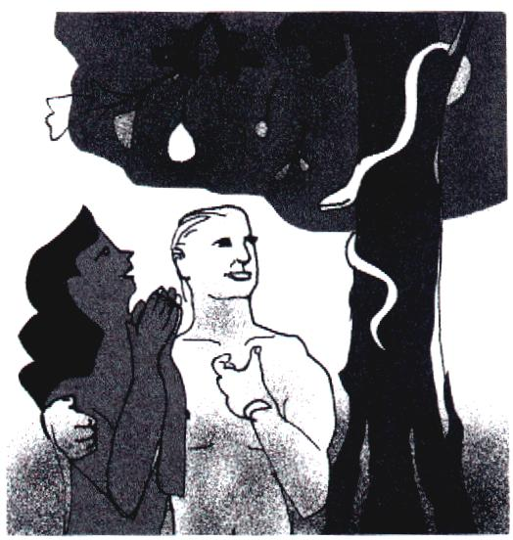
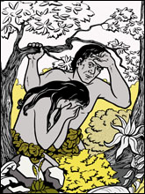
The Plunge into Sin
At the instigation of the serpent (the serpent lied to the woman)
in deliberate disobedience (the man and the woman knew what they were doing)
humanity plunged itself into sin.
The man and woman ‘hide’ from each other and hide from God.
God, however, comes to find them.

Slide 4
With the Fall into Sin
God
Satan
+
mankind
How will God react?

Slide 5

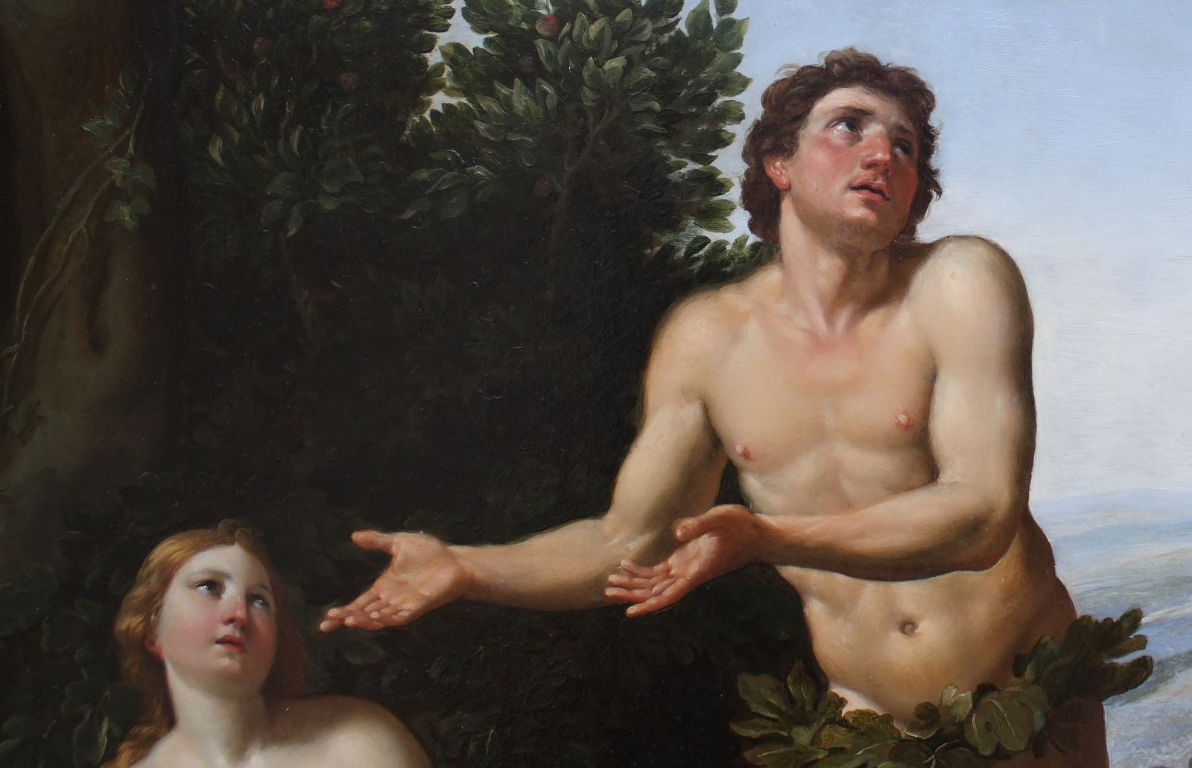
Bible Study: Genesis 3:14-19

Slide 6
Bible Study: Genesis 3:14-19
1. The serpent became the lowest of all creatures.
2. One of enmity (being enemies)
3. The enmity between followers of God and rebels against God.
4. Pregnancy and child-rearing will be filled with labour.
5. The relationship between man and woman is filled with tension.
6. Leading the family and providing for them will be filled with labour.
7. Death would be a certainty.

Slide 7
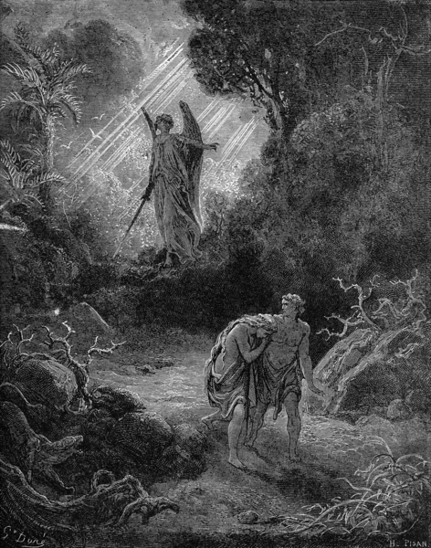
GO!

Man no longer had the right to eat from the tree of life.
Life is only for those who serve God perfectly.
Hence man was banished from Paradise.
God did allow man durable clothes made of animal skins.

Slide 8
Catechism
9. Q. But does not God do man an injustice by requiring in His law what man cannot do?
A. No,
for God so created man that he was able to do it.
But man,
at the instigation of the devil,
in deliberate disobedience
robbed himself and all his descendants of these gifts.

Slide 9
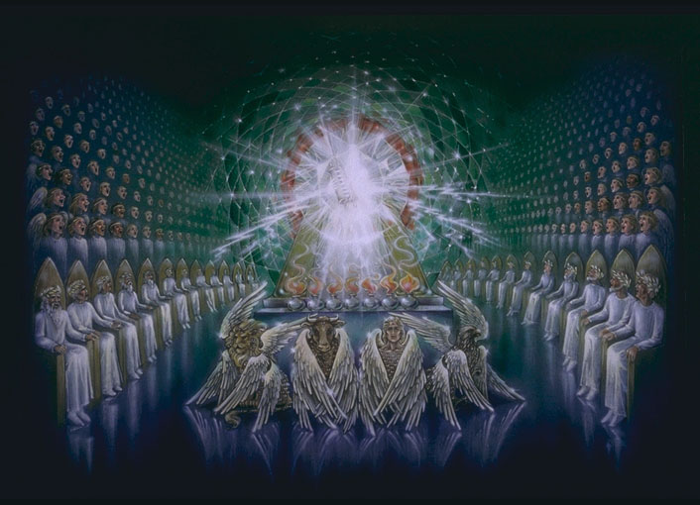
The righteousness of God
God had clearly forbidden man to eat from the Tree of Knowledge of Good and Evil.
God had indicated the penalty on eating would be death.
The man and the woman sinned deliberately, they could be held accountable.
Thus God was perfectly fair in what He did.
The LORD God is a righteous God, He does what is right, proper, just.

Slide 10
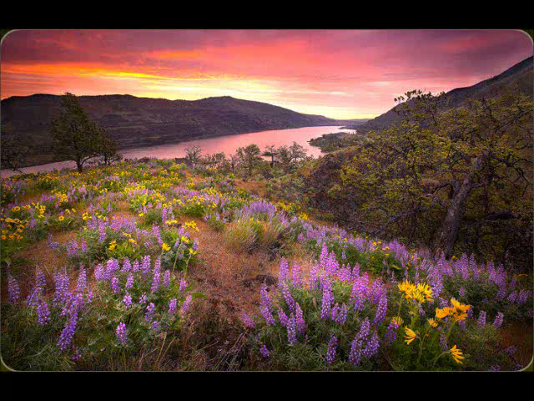
Adam, where are you?
Notes:
Over 5:00 minutes long.

Slide 11
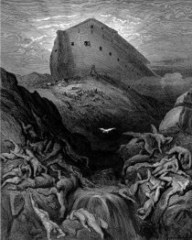
God punishes sin
We’ll read Genesis 6:1-13
Write down some thoughts on these questions:
- Was God’s punishment deserved?
Was God’s punishment fair?
We will discuss them

Slide 12
Just punishments
Think of other accounts in the Bible that describe a sin and the punishment of God for that sin.
Sin Punishment
Violence and corruption World wide flood
Tower of Babel Confusion of languages
Sodom and Gomorrah Destruction
Golden Calf Israelites killed
David counts the people 3 days of pestilence
Apostasy Philistines, Babylon
Rejection of Messiah Destruction of temple

Slide 13
Catechism
10. Q. Will God allow such disobedience and apostasy
to go unpunished?
A. Certainly not. He is terribly displeased
with our original sin
as well as our actual sins.
Therefore He will punish them by a just judgment
both now and eternally, as He has declared:
Cursed is everyone who does not continue to do everything written in the Book of the Law (Galatians 3:10).

Slide 14

Our sinfulness
a. The origin of sin, our sinful nature.
b. This is the same for everyone.
a. The sins of commission and omission, the wrongs we do and the good we do not do.
b. This is different per person.
3. Actual sins arise from original sin.
4. As everybody sins against the law, by nature all are cursed by God.

Slide 15
A counter argument
11. Q. But is God not also merciful?
A. God is indeed merciful, but He is also just.
His justice requires that sin committed
against the most high majesty of God
also be punished with the most severe,
that is,
with everlasting, punishment of body and soul.

Slide 16
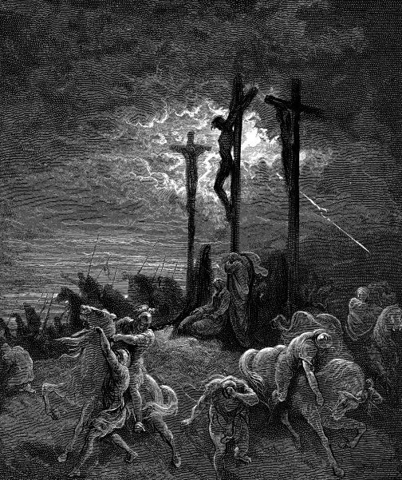
Mercy and Justice

God is just in His mercy and merciful in His justice.
His justice is: the punishment will be meted out.
His mercy is: the Son of God undergoes it for God’s chosen.

