Slide 1
Catechism
The Need for Faith
Lesson 7 – LD 5b-6a
God Sends The True Mediator

Slide 2
Hymn 23:1,2,3
Let us of Christ our Lord and Saviour sing,
for, though God’s equal, though eternal King,
he did not to his rightful glory cling.
Hallelujah, hallelujah!
Himself he emptied that he us might save;
himself for us, God’s chosen ones, he gave,
and, born as man, our Lord became a slave.
Hallelujah, hallelujah!

Slide 3
Hymn 23:1,2,3
He bore the weakness of our human frame
and he obedient unto death became,
for on a cross he died, in bitter shame.
Hallelujah, hallelujah!

Slide 4
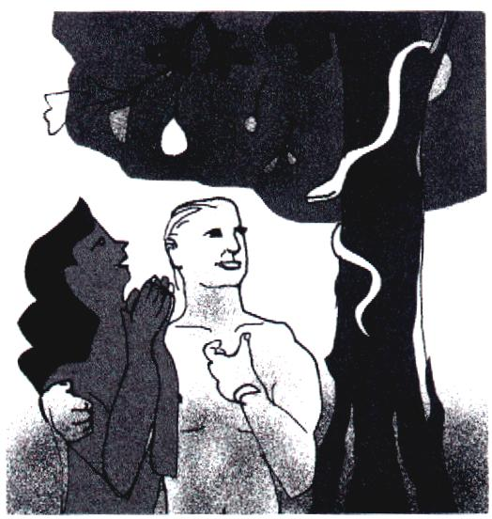
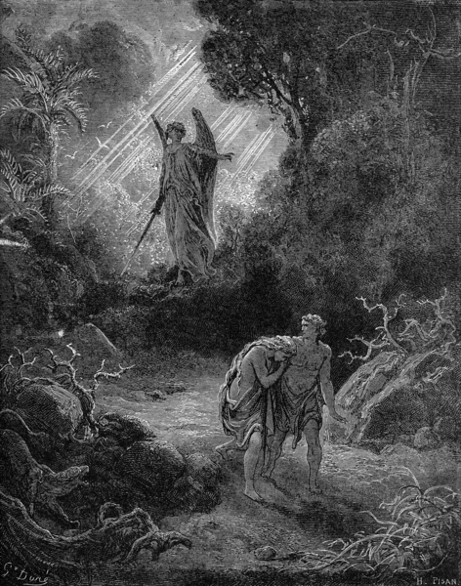
What we have seen so far

Through the Plunge into Sin, Sin and Death entered the world.
God is just: sin will be punished.
Atonement is only possible by complete payment.
Neither we humans nor another creature can pay that price.

Slide 5
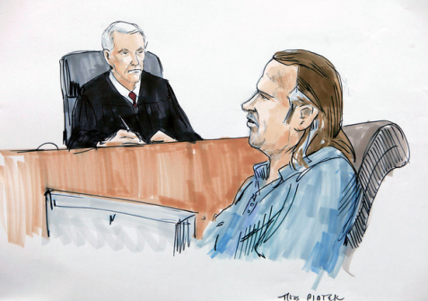
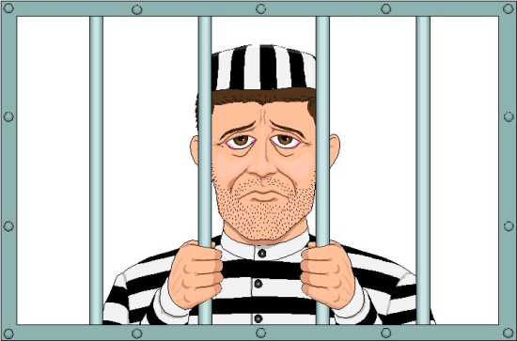

What is needed for a real Mediator
Man sinned so man must pay the penalty
Therefore, the mediator must be a true man.

Slide 6

What is needed for a real Mediator
Man owes God perfect love
Therefore, the mediator must be a righteous man.
X
?

Slide 7
What is needed for a real Mediator
The penalty to be undergone is eternal death
Therefore, the mediator must have power beyond that of creatures, He must be true God.

Slide 8
What makes a good mediator?

Man sinned so man must pay the penalty
Therefore, the mediator must be a true man.
Man owes God perfect love
Therefore, the mediator must be a righteous man.
The penalty to be undergone is eternal death
Therefore, the mediator must have power beyond that of creatures, he must be true God.

Slide 9
Catechism
15. Q. What kind of mediator and deliverer must we seek?
A. One who is a true and righteous man,
and yet more powerful than all creatures;
that is, one who is at the same time true God.

Slide 10
Given by God

God sent His Son to save us.
This is proof of God’s love for us.
For God so loved the world that He gave His only-begotten Son, that whoever believes in Him should not perish but have eternal life.
John 3:16
Greater love has no one than this, that someone lay down his life for his friends.
John 15:13

Slide 11

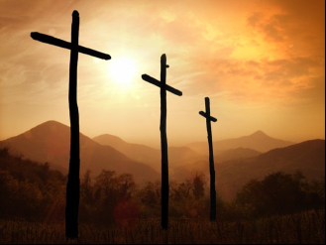
What Jesus did

Though God, He became a human being
  Would you be prepared to become a worm
  to save all worms?
He was born into the poorest of families
  If you had everything, would you be willing to give it up?
He lived a life of popularity and rejection
  Would you tell the truth, or try to keep your friends?
He died the most ignoble of deaths
  Would you be prepared to die for a good cause?

Slide 12


Bible Study: Romans 5:6-11

Slide 13
Bible Study: Romans 5:6-11
1. Weak (can’t save ourselves) and ungodly (unloving)
2. His love for us
3. We, at that time were sinners, God’s enemies!
4. By the death of Christ
5. By the life of Christ
(Christ is now alive and pleads our case before God. So when we sin and seek forgiveness, Christ will ensure that God indeed forgives our sins.)
6. Joy: we rejoice because of reconciliation.

Slide 14
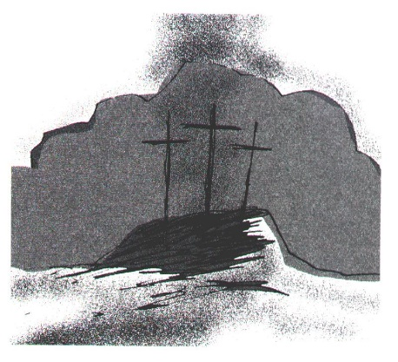
Delivered

It is through Christ’s death on the cross that true atonement for sin was made.
His blood flowed, that ours might never have to flow.
God put forward Christ Jesus as a propitiation (sacrifice of atonement) by his blood, to be received by faith. This was to show God’s righteousness because in His divine forbearance He had passed over former sins.
Romans 3:25a

Slide 15
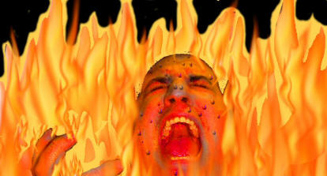
The canyon bridged
Jesus Christ
God
Us
sin

Slide 16
Catechism
18. Q. But who is that Mediator who at the same time is true God and a true and righteous man?
A. Our Lord Jesus Christ,
who has become for us wisdom from God – that is,
our righteousness, holiness and redemption (1 Corinthians 1:30).

Slide 17
Mediator

The position of Jesus Christ is that He stands between God and God’s people.
That’s why He is called the Mediator.

Slide 18
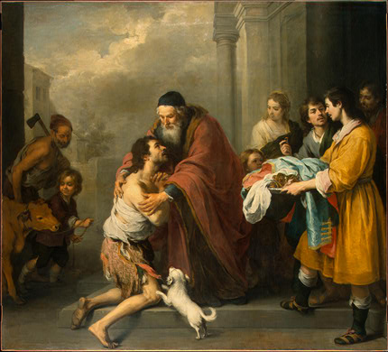
True Atonement is

- that everything is good again between God and people; God and man are reconciled
- that Jesus the Christ has borne the penalty for our sins and now has us changed to become perfectly loving and loyal people.

Slide 19
What saves us?

Praying lots?
Going to church often?
Paying much money to church and charity?
Living a good and holy life?
NO! They’re important, but they don’t save us.
What saves us is
God’s love proven in Jesus Christ

