Slide 1
Catechism
The Need for Faith
Lesson 8 – LD 6b
A Wonderful Message

Slide 2
Hymn 48:1,2
Come, praise the Holy Spirit!
The prophets he inspired;
they after our salvation
unceasingly inquired.
They spoke of Christ our Saviour,
of grace that was to be,
proclaimed to us the wonders
which angels long to see.

Slide 3
Hymn 48:1,2
The gospel of salvation
God has to us revealed,
and we, the Word believing,
were with the Spirit sealed.
What none had seen or heard of
has been to us declared;
what no man had imagined
God has for us prepared.

Slide 4
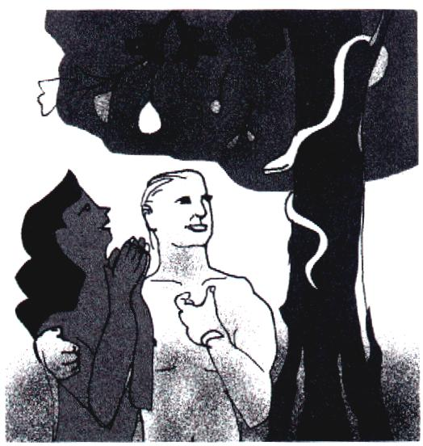
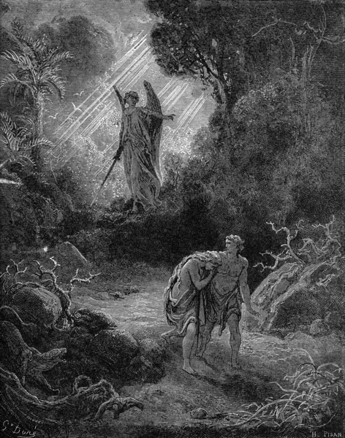
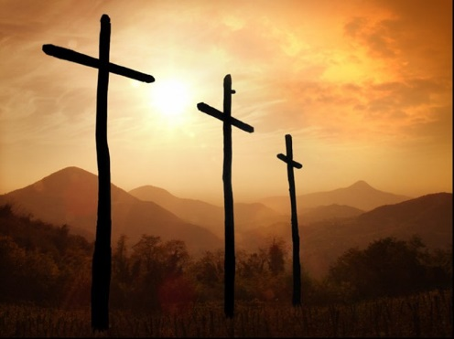
What we have seen so far
We are all sinful
God is just: sin will be punished.
Atonement is only possible by complete payment.
Neither we humans nor another creature can pay that price.
But Jesus the Christ did!

Slide 5
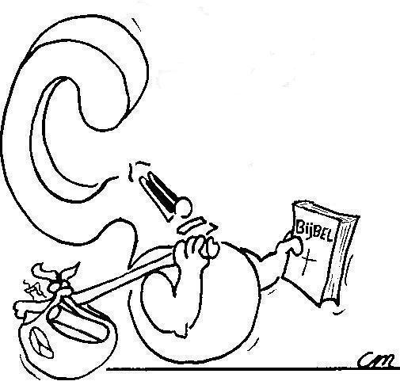


But how do you know all that for sure?
I learnt it at school
I learned it in church.
My parents told me.

Slide 6
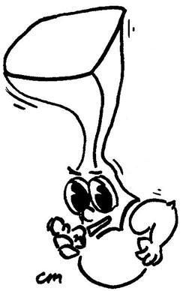
But how do they know that for sure?
God Himself told them, through the Bible

Slide 7
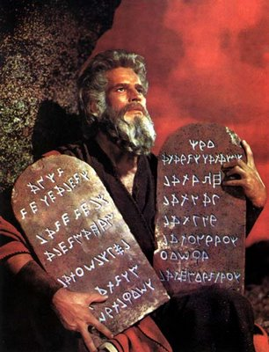
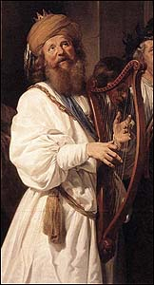
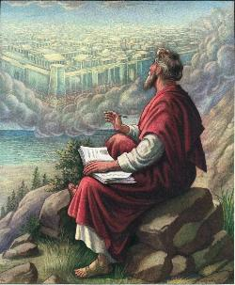
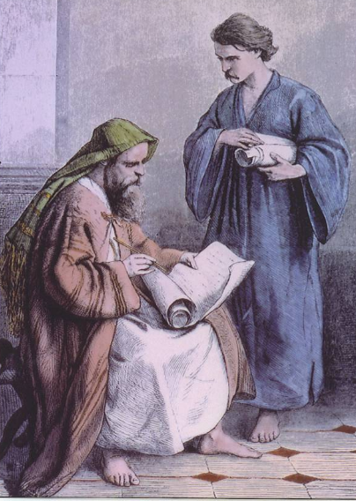
From where do you know this?

God has revealed this throughout the ages.
He had the account of this revelation recorded for us by people in writing.
These writings have been collected and today form the Bible.
Moses David Jeremiah Paul

Slide 8
The message of the Bible

The message of the Bible is referred to as
The Gospel
The word gospel is from “good spell”, which is old English for “good message”.
The Greek word is eu-angelia, from which we have “evangelism”. It, too, means “good message”.
The New Testament was originally written in Greek.

Slide 9
The accounts of Jesus’ life

We have four written accounts of Jesus’ life.
They are collectively known as gospels.
They are:
Matthew, Mark, Luke and John
But the account about Jesus goes all the way back to
Genesis 1!
[Jesus said:] You search the Scriptures because you think that in them you have eternal life; and it is they that bear witness about Me,
John 5:39

Slide 10

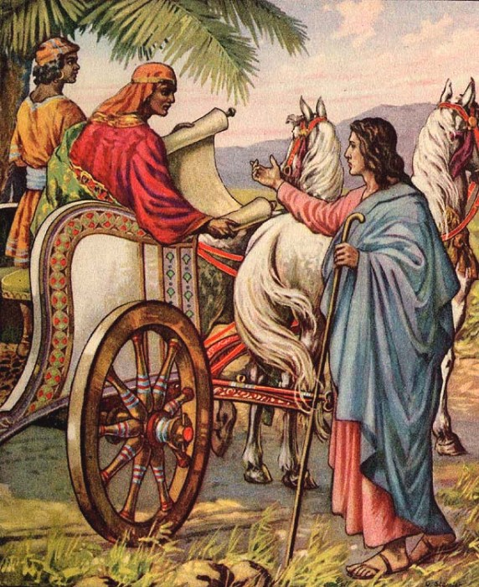
Bible Study: Acts 8:26-35

Slide 11
Bible Study: Acts 8:26-35
1. The prophet Isaiah
2. Do you understand what you are reading?
3. How can I, unless someone guides me?
4. Isaiah 53:7,8
5. Who is the prophet talking about?
6. The good news about Jesus

Slide 12

What is the Bible about?

Slide 13
What is the Bible about?
The Bible is not basically about me and what I must do.
The Bible is basically about Jesus and what He has done, is doing, and will yet do.

Slide 14
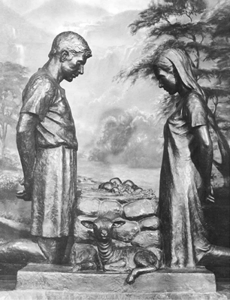
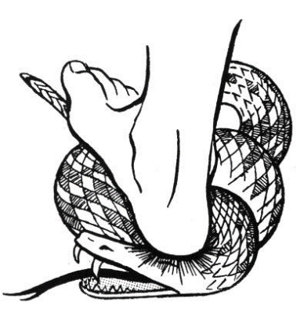
The first time God tells us

When we humans plunged ourselves into sin, God came to find us.
He punished us.
But even before He punished us, He promised deliverance.
Genesis means “origin, birth”
I will put enmity between you and the woman, and between your offspring and her offspring; he shall bruise your head, and you shall bruise his heel.
The Mother Promise: Genesis 3:15

Slide 15
The mother promise
I will
put enmity
There will be war

Slide 16
The mother promise
between you
and the woman
The
serpent
The
woman

Slide 17
The mother promise
between your offspring and hers
His
offspring
(e.g.
Pharaoh, Haman, Herod, unbelievers)
Her
offspring
(e.g. Moses, Esther, Jesus, believers)

Slide 18


The mother promise
He will crush your head;
and you will strike his heel.
Satan will
be
destroyed
to the
point of
death
Satan will
cause
much harm
and misery
in this
world

Slide 19

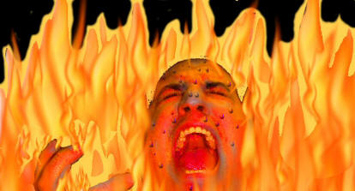
A huge promise
Already in Paradise God promised much:
  God limits the influence the devil can have, he can’t do anything he wants
  God provides liberation (salvation) for people
  One day the devil will be conquered and not be able to do anything anymore

Slide 20
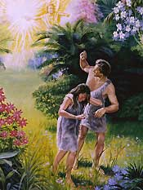
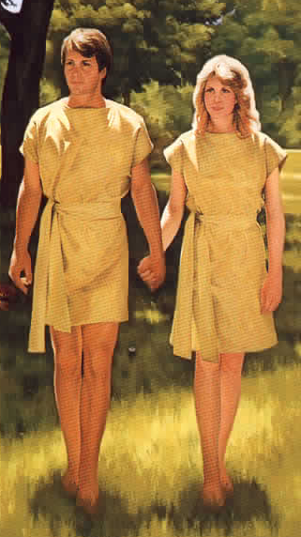
Our first parents respond…
The first name Adam gave to his wife was “woman”, she was taken from man.
After the promise and penalty, he calls his wife “Eve”, which means “mother of all living”.
While God had cursed with death,
Adam expressed his faith in
God’s blessing of eternal life!

Slide 21
God tells more

Throughout the history recounted in the Old Testaments, more and more is told by God.
The parentage of Jesus becomes more and more focused.

Slide 22

Jesus
The royal house of
David
The generation of
Jesse
The tribe of
Judah
The people of
Abraham

Slide 23
Did the Jews know who Jesus was?
Yes, many did, right from the start. Their lack of faith was not from ignorance but from rebellion!

Slide 24
Thus God’s people knew…

When Jesus was born and the magi (wise men) came looking for “the new-born king of the Jews”, King Herod asked the priest and Pharisees about “the Christ”.
And they knew, from the prophecies of Micah, He would be born in Bethlehem to the house of David.
But you, O Bethlehem Ephrathah,
who are too little to be among the clans of Judah,
from you shall come forth for me one who is to be ruler in Israel,
whose coming forth is from of old, from ancient days.
Micah 5:2

