Slide 1
Catechism
The Need for Faith
Lesson 6 – LD 5a
Atonement … Not Simple!

Slide 2
Psalm 130:1,4
Out of the depths of sadness
to you, O Lord, I cry.
Bless me again with gladness
and help me from on high.
Lord, hear my supplication
and listen to my plea.
O Fount of consolation,
with mercy comfort me.

Slide 3
Psalm 130:1,4
Hope in the Lord, O nation!
With him is steadfast love,
and he with full salvation
will bless you from above.
The Lord will in compassion
for Israel atone;
yes, from all their transgression
he will redeem his own.

Slide 4
Sinful
After the Plunge into Sin, all men were in Satan’s camp. But you are a believer (right?). So how did you get into God’s camp again?
It’s because atonement has been made.

Slide 5
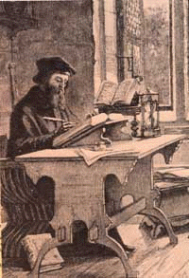
Atonement

The word atonement has been made up by one of the first English Bible translators, John Wycliff.
It is made up of the two words: at and one.
Wycliff invented it to express the coming together of God and man again: God and man become at one with each other.
@ + 1 = ATONE

Slide 6
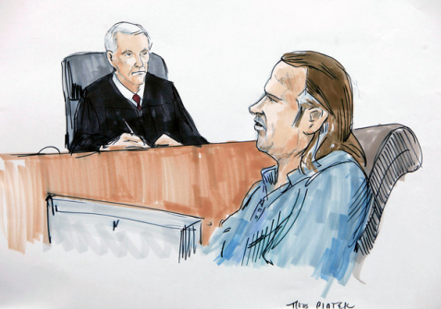

Two things are needed

For atonement to take place, for a person to live eternally with God, two things are needed.
1. All wrongs have to be set right.
The penalty must be paid.
2. All that is done must be right.
A person must be perfectly
loving and loyal.
I.e. get rid of the bad and ensure there is good

Slide 7
Catechism
Q. Since, according to God’s righteous judgment we deserve temporal and eternal punishment, how can we escape this punishment and be again received into favour?
A. God demands that His justice be satisfied.
Therefore we must make full payment,
either by ourselves or through another.

Slide 8
Can we save ourselves?

There’s a bit of logic here, in the Catechism.
  1. To be saved, the penalty for sin must be paid.
  2. No human can pay that penalty (eternal death), and live.
  THEREFORE, no man can save himself or others.
And
  1. To be saved, God must consider a person perfectly loving.
  2. No one is perfectly loving.
  THEREFORE, no man is saved of himself.

Slide 9

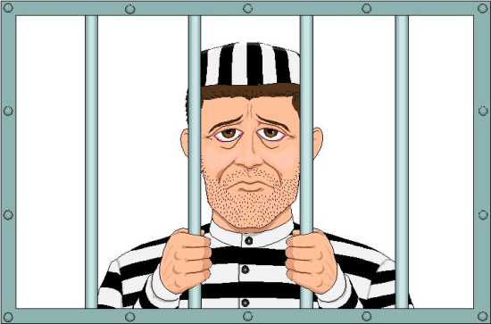
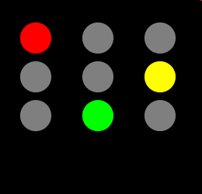
Can we save ourselves?

There’s a bit of logic here.
  1. To be saved, God must consider a person perfect.
  2. No one is perfect.
  THEREFORE, no man is saved of himself.
And
  1. To be saved, the penalty for sin must be paid.
  2. No human can pay that penalty (eternal death), and live.
  THEREFORE, no man can save himself or others.
Conclusion
  a. Our failure to pay the penalty condemns us before God.
  b. Our lack of love condemns us before God.
X
?

Slide 10

Catechism
Q. Can we by ourselves make this payment?
A. Certainly not.
On the contrary, we daily increase our debt.

Slide 11
Atonement by another

In the Old Testament:
When someone had sinned, a sin offering had to be brought.
And once a year, the Day of Atonement would be celebrated, to atone for all the sins of Israel.
In the Old Testament blood was to flow for the sins of the people. For the wages of sin is death, and life is in the blood.

Slide 12

The Exchange

Slide 13

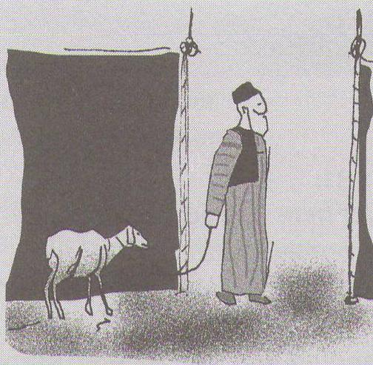
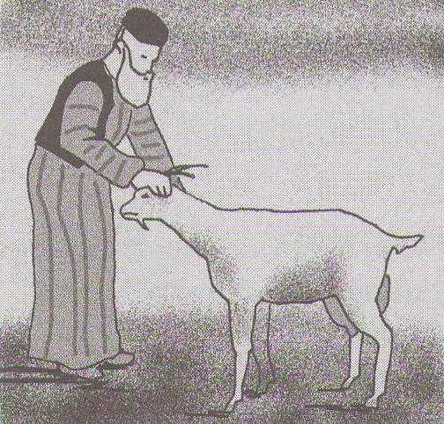
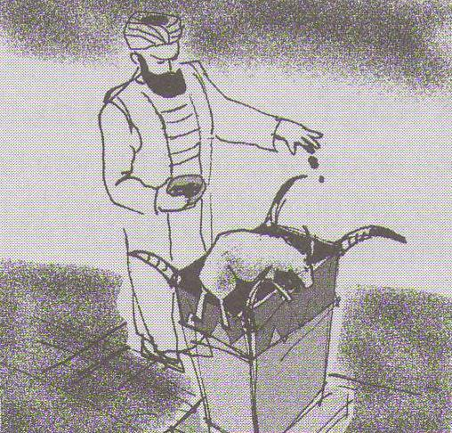
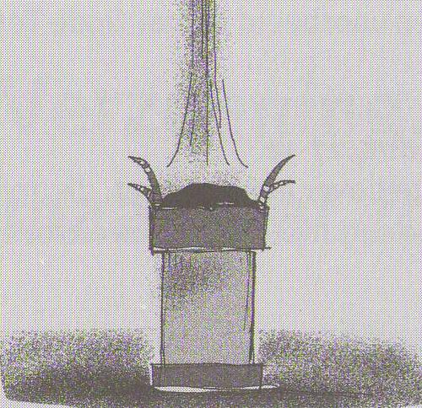
Bible Study: Leviticus 16:1-25

Slide 14
Bible Study: Leviticus 16:1-25
1. One young bull, two rams, and two male goats.
2. The sins of the high priest and the sins of the Israelites.
3. The removal of the sins, Israel was to be a holy people, without sin.
4. The atonement cover.
Three hours of darkness.
5. For his own sins.
For the sins of Israel.
6. It was sent into the desert.
7. White symbolizes purity, holiness.
8. The high priest is sinful, Jesus is without blemish

Slide 15
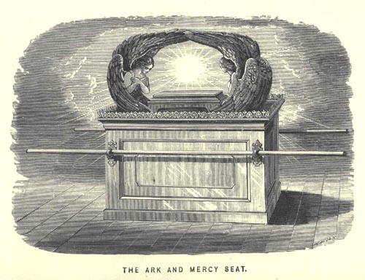
Ark of the Covenant
Throne of God
Atonement Cover
Covenant of God and His people

Slide 16
Good enough?

The sacrifice of an animal is symbolic for paying the penalty but does not pay the penalty.
For note:
  1. Man sinned, thus man should pay.
  2. No mere creature can die eternally.
But in these sacrifices there is a reminder of sins every year. For it is impossible for the blood of bulls and goats to take away sins.
Hebrews 10:3-4

Slide 17
Catechism
Q. Can any mere creature pay for us?
A. No.
In the first place,
God will not punish another creature
for the sin which man has committed.
Furthermore,
no mere creature can sustain
the burden of God’s eternal wrath against sin
and deliver others from it.

Slide 18
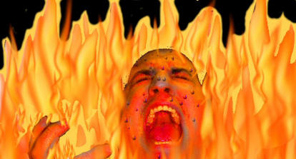
The Ravine
Sacrifice, yourself
God
Us
sin

Slide 19
In summary
To be saved we need
1. to have our debt paid
2. to be perfect in love and loyalty
We as mere humans cannot pay
1. We are physically not able to pay our debt
2. We are not perfect
No other creature can pay for us
1. Man sinned, so man pays
2. No mere creature is physically able to pay our debt.

Slide 20

A Saviour is Needed

The Old Testament tells the story of God teaching humanity they cannot save themselves.
Humanity must expect salvation
from God.
Scripture tells the
story of the snake crusher.

