Slide 1
Catechism
The Need for Faith
Lesson 8 – LD 6b
A Wonderful Message

Slide 2
Hymn 48:1,2
Come, praise the Holy Spirit!
The prophets he inspired;
they after our salvation
unceasingly inquired.
They spoke of Christ our Saviour,
of grace that was to be,
proclaimed to us the wonders
which angels long to see.

Slide 3
Hymn 48:1,2
The gospel of salvation
God has to us revealed,
and we, the Word believing,
were with the Spirit sealed.
What none had seen or heard of
has been to us declared;
what no man had imagined
God has for us prepared.

Slide 4
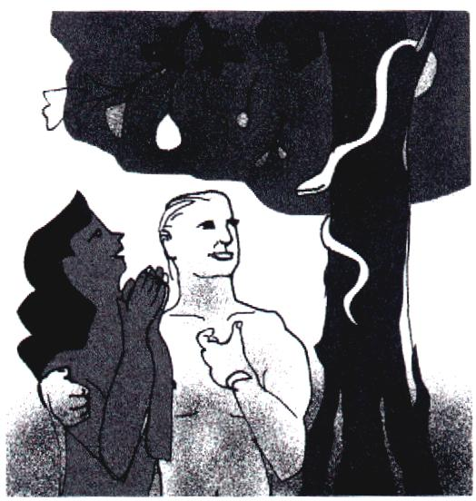
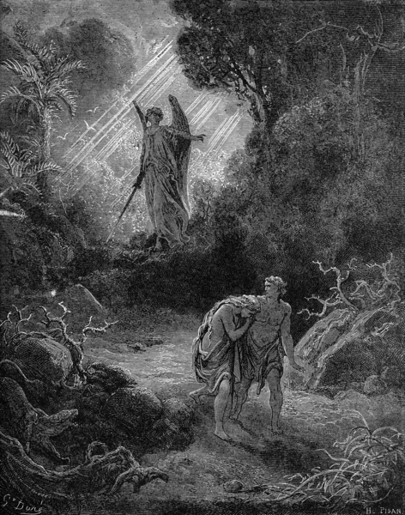
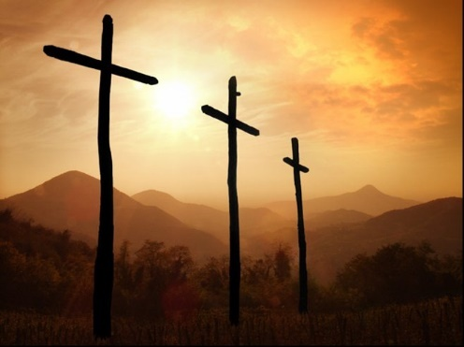
What we have seen so far
We are all sinful
God is just: sin will be punished.
Atonement is only possible by complete payment.
Neither we humans nor another creature can pay that price.
But Jesus the Christ did!

Slide 5
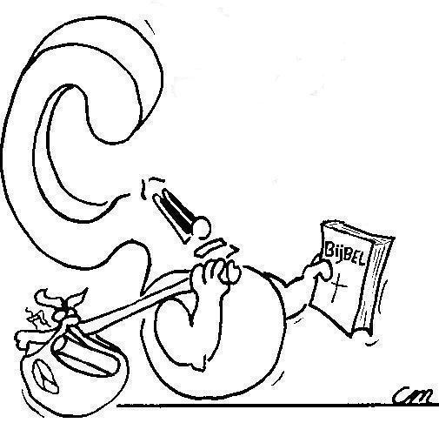


But how do you know all that for sure?
I learnt it at school
I learned it in church.
My parents told me.

Slide 6
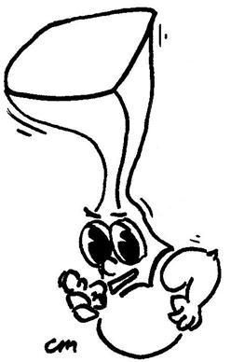
But how do they know that for sure?
God Himself told them, through the Bible

Slide 7
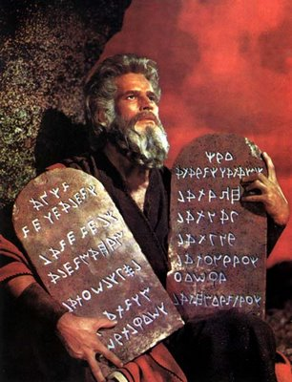
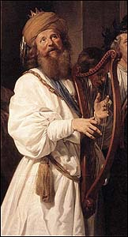
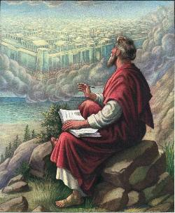
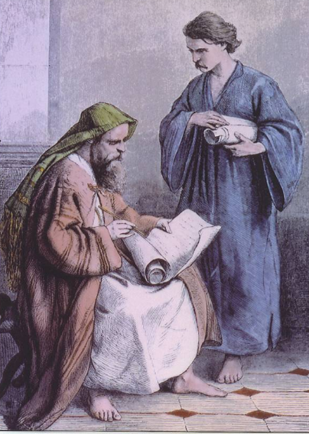
From where do you know this?

God has revealed this throughout the ages.
He had the account of this revelation recorded for us by people in writing.
These writings have been collected and today form the Bible.
Moses David Jeremiah Paul

Slide 8
The message of the Bible

The message of the Bible is referred to as
The Gospel
The word gospel is from “good spell”, which is old English for “good message”.
The Greek word is eu-angelia, from which we have “evangelism”. It, too, means “good message”.
The New Testament was originally written in Greek.

Slide 9
The accounts of Jesus’ life
We have four written accounts of Jesus’ life.
They are called collectively known as gospels.
They are:
Matthew, Mark, Luke and John
But the account about Jesus goes all the way back to
Genesis 1!
[Jesus said:] You search the Scriptures because you think that in them you have eternal life; and it is they that bear witness about Me,
John 5:39

Slide 10

What is the Bible about?

Slide 11
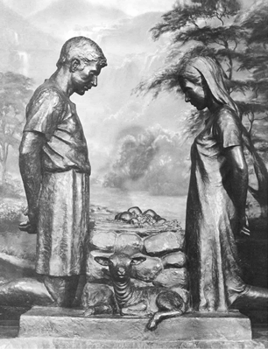
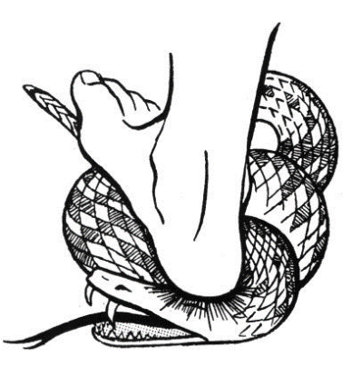
The first time God tells us

When we humans plunged ourselves into sin, God came to find us.
He punished us.
But even before He punished us, He promised deliverance.
Genesis means “origin, birth”
I will put enmity between you and the woman, and between your offspring and her offspring; he shall bruise your head, and you shall bruise his heel.
The Mother Promise: Genesis 3:15

Slide 12


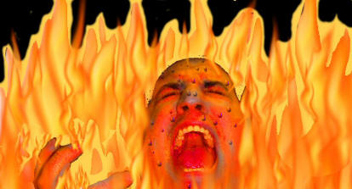
A huge promise
Already in Paradise God promised much:
  God limits the influence the devil can have, he can’t do anything he wants
  God provides liberation (salvation) for people
  One day the devil will be conquered and not be able to do anything anymore

Slide 13
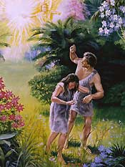
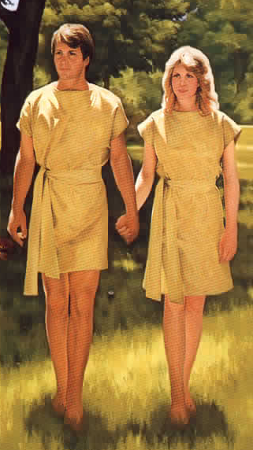

The response…
The first name Adam gave to his wife was “woman”, she was taken from man.
After the promise and penalty, he calls his wife “Eve”, which means “mother of all living”.
While God had cursed with death,
Adam expressed his faith in
God’s blessing of eternal life!

Slide 14
God tells more

Throughout the history recounted in the Old Testament, more and more is told by God.
The parentage of Jesus becomes more and more focused.

Slide 15

Jesus
The royal house of
David
The generation of
Jesse
The tribe of
Judah
The people of
Abraham
Notes:
See if students can fill this in on their worksheet before running through this slide.

Slide 16

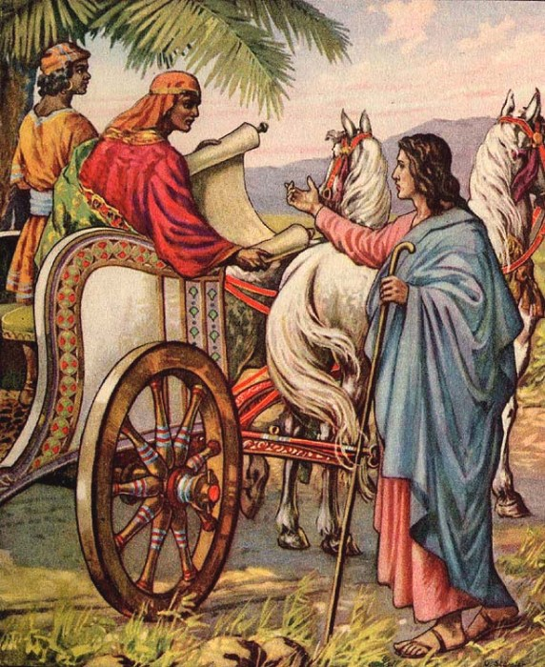
Bible Study: Various

Slide 17
Bible Study: Various
1a. Bethlehem
1b. Micah had said so (Mic 5:2)
2a. Blood
2b. He would have to shed His blood
3a. The curtain before the most Holy Place
3b. Through the death of Christ there is free access to God.
4a. The Passover lamb
4b. Christ is our Passover lamb

Slide 18
Did the Jews know who Jesus was?
Yes, many did, right from the start. Their lack of faith was not from ignorance but from rebellion!

Slide 19
Pointers

The laws given through Moses pointed to many aspects of the work of the Mediator sent by God.
The prophets spoke in various ways of things that would happen during the life of the Messiah on earth as proofs for which person would be the true Messiah.
And they told of the work which the Messiah would do.
These things were unclear to them, but became clear when Christ was on earth.
Concerning this salvation, the prophets who prophesied about the grace that was to be yours searched and inquired carefully, inquiring what person or time the Spirit of Christ in them was indicating when he predicted the sufferings of Christ and the subsequent glories. 1Peter 1:10-11

