Slide 1
Catechism
Essentials of Faith
Lesson 5
The Trinity (1)

Slide 2
Hymn 5:1
Holy, holy, holy, Lord God Almighty!
Early in the morning our song shall rise to thee:
Holy, holy, holy, merciful and mighty,
God in three persons, blessed Trinity!

Slide 3
A new understanding
Jesus of Nazareth taught: the Messiah is the Son of God in an essential way (e.g. John 5:17-18, 8:58).
The Jews thus had to rethink their understanding of God.
Some were convinced: they became the new Israel, Christians.
In relation to essence (being)
Christ is “essentially” God

Slide 4
Growing in understanding
As the implications of divine revelation became clear, the conviction became more crystalized that when it comes to God, He actually exists in three distinct persons.
This came to be known as the doctrine of the Trinity.
Trinity is from the Latin trius & unus

Slide 5
Bone of contention
The doctrine of the Trinity has been the focus of many battles in the history of the church.
- Councils of Nicea (325) & Constantinople (381)
  - Nicene creed (325 & 381)
  - Athanasian creed
The Trinity is denied by:
- Islam (Mohammed)
- Unitarians during Reformation (Socinus) and today (e.g. in the United Church of Canada)
- Sects today: Mormons, Jehovah’s Witnesses

Slide 6

Trinity
We distinguish three persons: Father, Son, and Spirit
We’ll read the first half of the Athanasian Creed (1-28) as well as BC articles 8-9.
We’ll then discuss the questions.

Slide 7

A mystery
Mysteries of the faith are those matters which can be described but not understood. The Trinity is such a mystery.
We cannot understand how Three can be One. In fact, we don’t even have the words to describe it.
Person or individual?
  Advantage: it makes clear that the individual is not a thing
  Disadvantage: suggests also distinction as to essence
(If Father, Son and Spirit are Persons, is God a Person or three persons?)

Slide 8
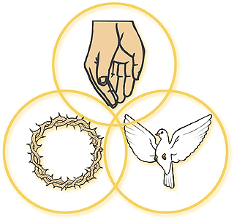
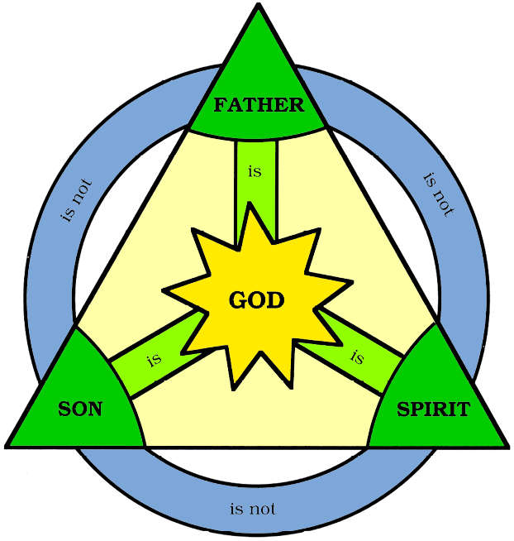
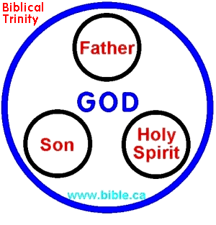

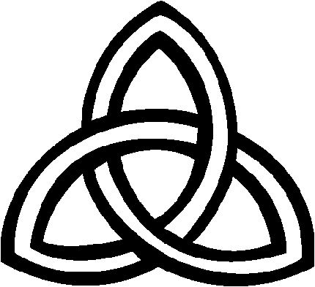
Representation
We cannot understand the essence of the Trinity.
Thus we cannot represent it either in a picture.

