Slide 1
Catechism
The Need for Faith
Lesson 9 – LD 7
Absolutely Certain!

Slide 2
Trust and Obey 1,2
When we walk with the Lord in the light of His Word,
What a glory He sheds on our way!
While we do His good will, He abides with us still,
And with all who will trust and obey.
Refrain
Trust and obey, for there’s no other way
To be happy in Jesus, but to trust and obey.

Slide 3
Trust and Obey 1,2
Not a shadow can rise, not a cloud in the skies,
But His smile quickly drives it away;
Not a doubt or a fear, not a sigh or a tear,
Can abide while we trust and obey.
Refrain
Trust and obey, for there’s no other way
To be happy in Jesus, but to trust and obey.

Slide 4
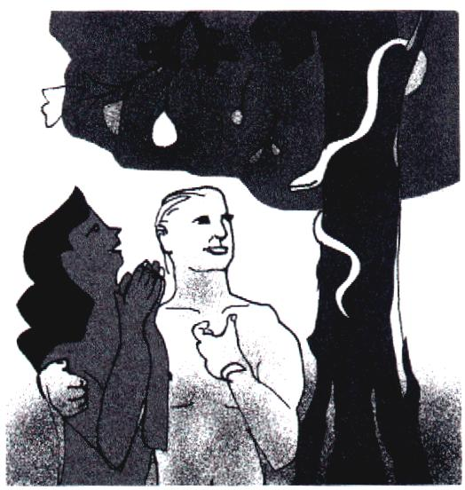
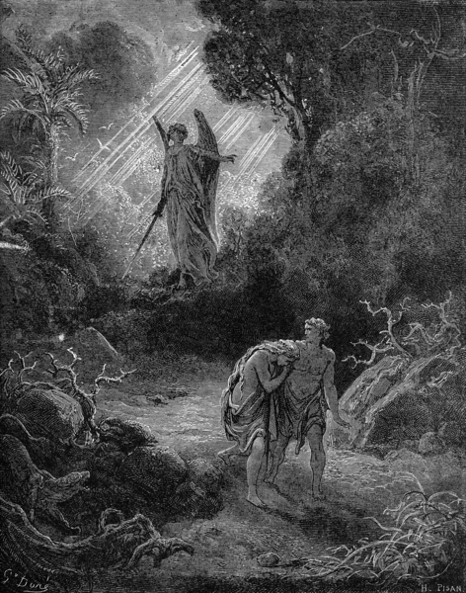
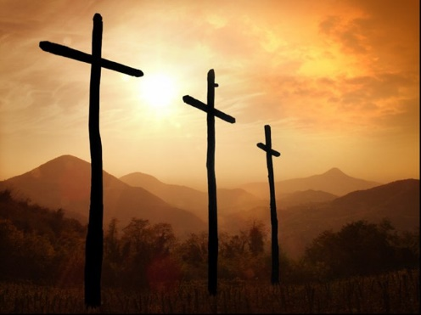
What we have seen so far
We are all sinful
God is just: sin will be punished.
Atonement is only possible by complete payment.
Neither we humans nor another creature can pay that price.
But Jesus the Christ did!
The Gospel tells us so

Slide 5
Is everybody saved?
No. Only true believers are saved.
Only those who trust God for care, salvation and renewal, and thus live in obedience to Him.
Those who don’t trust God and don’t obey Him, want nothing to do with God, and God lets it be that way. (So they shouldn’t complain either.)
God
+
Jesus Christ &
believers
Satan
+
unbelievers

Slide 6
Catechism
20. Q. Are all men, then, saved by Christ just as they perished through Adam?
A. No.
Only those are saved who
by a true faith
are grafted into Christ and
accept all His benefits.

Slide 7

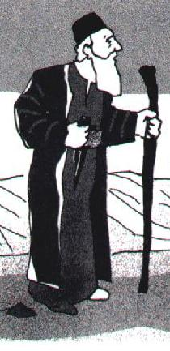
Bible Study: Abram 1
1. to leave his country and family for the land God would show him.
2. A great nation (many descendants)
A great name (fame)
Protection against enemies
Blessings would be through Abram
3. Yes
4. 75 years old
5. Sarai was also old, and they had no children.

Slide 8
An illustration of true faith

Abram went.
He doesn’t know where he is going
He is old and childless
Yet he goes. He trusts God. He believes God will fulfil His promise.
Abram trusts and obeys
By faith Abraham obeyed when he was called to go out to a place that he was to receive as an inheritance. And he went out, not knowing where he was going. Hebrews 11:8

Slide 9
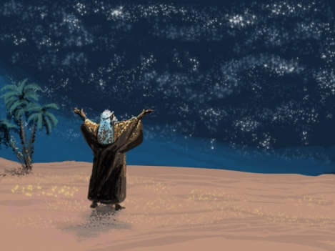
Bible Study: Abram 2

Slide 10
Bible Study: Abram 2
1. That he was childless
2. Showed him the stars and reassured him
3. He believed God (had faith)
4. No
5. Yes - the family was to happen
Yes - God was not giving children
Yes - he did as Sarai suggested

Slide 11
Bible Study: Abram 2
6. 86 years old
11 years ago
7. Faith waxes and wanes, i.e. sometimes it is stronger, sometimes it is weaker.

Slide 12
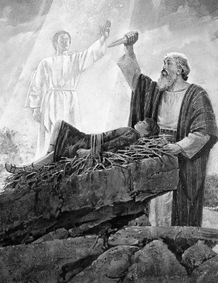
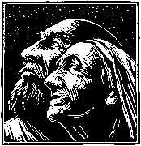
Bible Study: Abram 3

Slide 13
Bible Study: Abram 3
1. 99 years old
24 years ago
Confirm the covenant by changing the names of Abram and Sarai
2. Give the sign and seal of circumcision as a constant reminder
3. Next year, this time, you will have a child
4. She laughed - disbelief

Slide 14
Bible Study: Abram 3
5. He was gracious and did as promised
6. Sacrifice Isaac.
7. Yes
8. That Abraham trusted and obeyed God.

Slide 15
Abraham believed
The apostle Paul uses the faith of Abraham as an illustration.
We read together Romans 4:18-21.
113? – Abram is unbelievably certain (sacrifice of Isaac)
100 – Abram did not waver in his faith
86 - Abram was still somewhat unsure.
75 – Abram trusted and obeyed, but had to learn lots yet!

Slide 16
Catechism
21. Q. What is true faith?
A. True faith is a sure knowledge whereby I accept as true all that God has revealed to us in His Word.
At the same time it is a firm confidence that
not only to others, but also to me,
God has granted forgiveness of sins, everlasting righteousness, and salvation, out of mere grace, only for the sake of Christ’s merits.
This faith the Holy Spirit works in my heart by the gospel.

Slide 17
God’s promise to you

Abraham received a special promise. So did all of us here.
As God promised to be Abraham’s God, so God has promised to be our God.
We had it illustrated and sealed through baptism.
Like Abraham, we are to trust and obey.
That’s not easy, it takes many struggles and we’ll never be perfect in this life!
But God will help us improve,
through Christ and His Spirit!

