Slide 1
Catechism
The Benefit of Faith
Lesson 11 – LD 23b-24
By Faith, Not By Works

Slide 2
Hymn 28:6
Faith clings to Jesus’ work alone
and rests in him unceasing;
and by its fruits true faith is known,
with love and hope increasing.
By faith alone we’re justified;
works serve the neighbour and supply
the proof that faith is living.

Slide 3
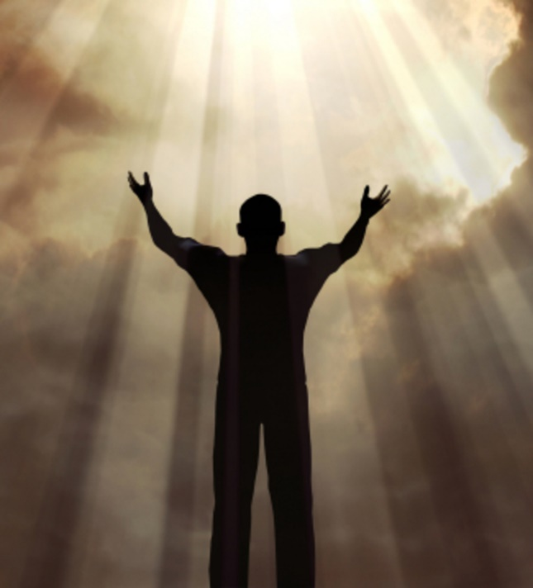
Sola Fide - By Faith Alone

Faith are the arms by which we embrace Christ and all His benefits.
Faith is
NOT the grounds of our salvation
BUT a means in making salvation
our own
Our salvation depends entirely on what Christ has done and God is doing.

Slide 4
Catechism
61. Q. Why do you say that you are righteous only by faith?
A. Not that I am acceptable to God on account of the worthiness of my faith,
    for only the satisfaction, righteousness, and holiness of Christ is my righteousness before God.
I can receive this righteousness and make it my own by faith only.

Slide 5

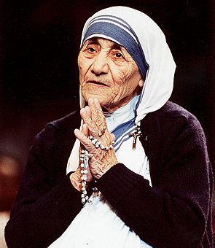
But what about good works?

In most religions, good works play an important role.
Good works are actions, behaviour which is in keeping with the religion.
Such good works might be
- fulfilling the rites of the religion
- doing good things to other people
- having faith in God

Slide 6
Works don’t earn salvation

For by works of the law no human being will be justified in God’s sight. Romans 3:20
No one is perfect, is able to do what God would have us do (Romans 3:20)
You won’t receive eternal life by living by the law.
Salvation comes through the instrument of faith. (Galatians 3:11)
Now it is evident that no one is justified before God by the law, for “The righteous shall live by faith.”
Galatians 3:11

Slide 7


Bible Study: Rom 3:9-20, 27-30

Slide 8
Bible Study: Rom 3:9-20, 27-30
1. No because all are under sin.
2. The Bible, the Old Testament. Most are from the Psalms.
3. The whole world.
4. No human being. (No one)
5. It gives us knowledge of sin.
6. By faith apart from works of
the law
7. No.

Slide 9

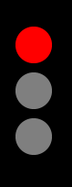
So what about good works?

Good works cannot save us.
For our works to pass God’s inspection and be approved, they must be absolutely perfect.
But even our best works will be tainted with the sin of self-centred desires.
X
?

Slide 10


Catechism
62. Q. But why can our good works not be our righteousness before God, or at least a part of it?
A. Because the righteousness which can stand before God’s judgment
must be absolutely perfect
and in complete agreement
with the law of God,
whereas even our best works in this life are
all imperfect and defiled with sin.

Slide 11
Hang on a minute...
[Jesus said:] Rejoice and be glad, for your reward is great in heaven Matthew 5:12a
And without faith it is impossible to please him, for whoever would draw near to God must believe that he exists and that he rewards those who seek him.
Hebrews 11:6
The Bible clearly teaches that there will be a reward for those who believe. Doesn’t that mean they are earning something?

Slide 12
What about the reward?

It is true that God rewards those who believe.
But it is not true that He rewards their good works.
This reward is an undeserved, unmerited, not earned gift.
63. Q. But do our good works earn nothing, even though God promises to reward them in this life and the next?
A. This reward is not earned; it is a gift of grace.

Slide 13
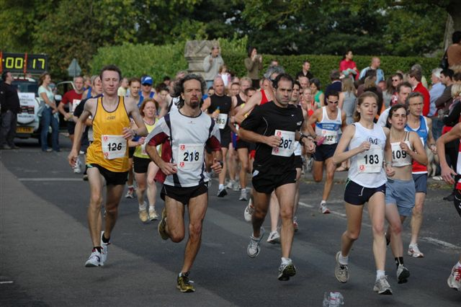
So forget about good works?
A reward is always a good motivator for work.
If in a race, everybody wins a price, would you still do your best to win the race?
The idea may arise: if good works are not rewarded why bother?
And this would make church people careless and wicked.

Slide 14
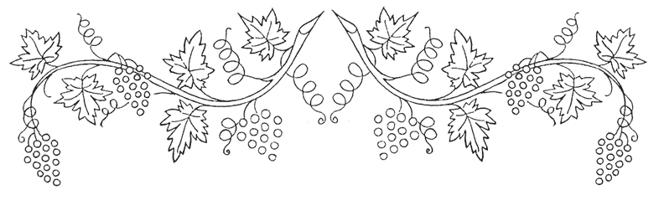
Catechism
64. Q. Does this teaching not make people careless and wicked?
A. No.
It is impossible that those grafted into Christ by true faith should not bring forth fruits of thankfulness.

Slide 15
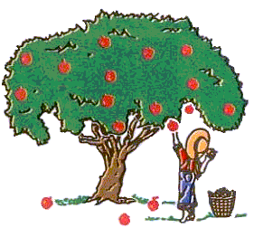
Good works still in the picture

While good works do not save, they will be present in the life of all believers.
For the fruit of faith is ALWAYS good works.
No good works means there is NO faith.
So also faith by itself, if it does not have works, is dead. James 2:17
Can a fig tree, my brothers, bear olives, or a grapevine produce figs? … Who is wise and understanding among you? By his good conduct let him show his works in the meekness of wisdom. James 3:12-13

