Slide 1
Catechism The Benefit of Faith
Lesson 10 – LD 23a
Faith Embraces All We’ll Need

Slide 2
Psalm 27:6
How I would have despaired in my affliction
if I had not believed that in this life
the Lord would show his goodness, his protection;
I would have perished in my tears and strife.
Wait for the Lord; be strong and undismayed.
The Lord is faithful. Why then be afraid?
Take courage, for his steadfast love is sure.
Wait for the Lord. His mercy shall endure.

Slide 3
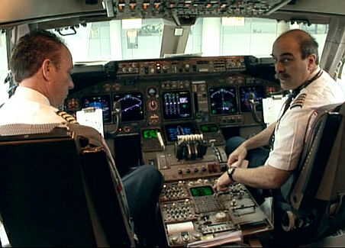
Faith

To have faith in someone is to entrust yourself to them.
In an airplane, the passengers have faith in the pilots.
There are two sides to such faith:
- knowledge: faith has content
- the pilot is well trained to fly a plane
- God’s Word is true
- confidence: faith is conviction, certainty
- I’m safe with the pilot
- God will indeed keep me safe and make things come well

Slide 4
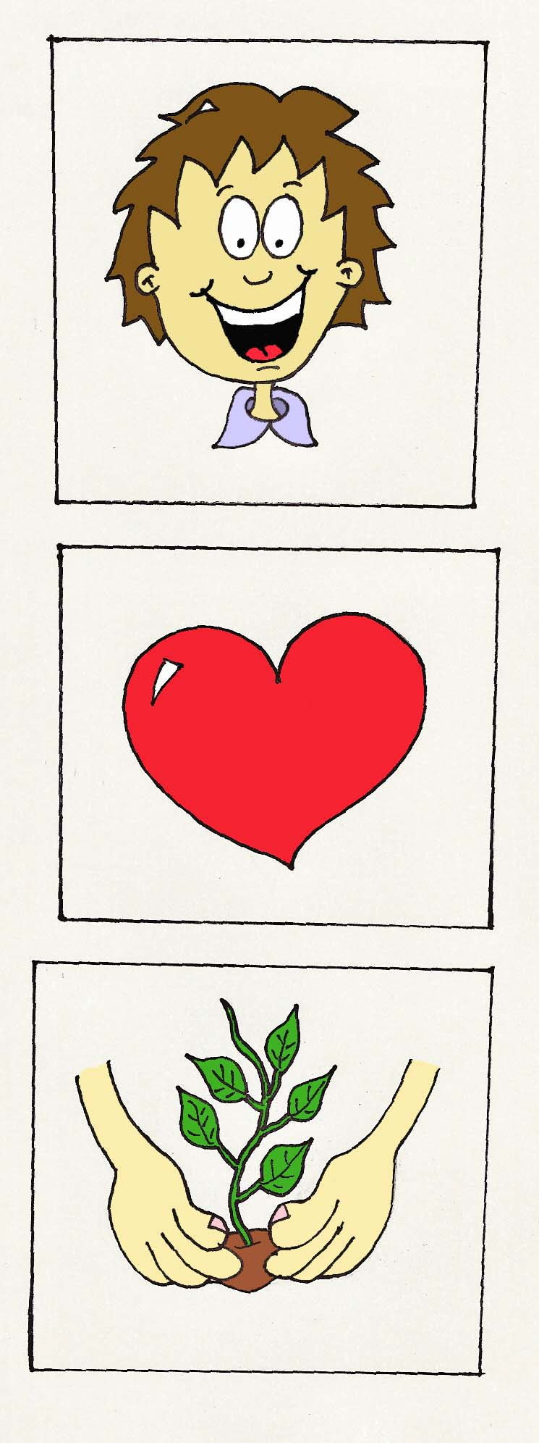
Faith

The two sides to faith will lead to proper behaviour.
Knowledge
Confidence
Behaviour
Faith / Trust
Good works / Obey

Slide 5
Sides or Components?

In some Reformed traditions, the two ‘sides’ to faith become two ‘components’ to faith.
It is then thought one can have one component without the other. Usually it is argued that knowledge comes before confidence.
Such people will say:
Those who only have knowledge have historic faith.
Those who also have confidence have saving faith.
The passage from knowledge to confidence is by many referred to as “seeing the light”.

Slide 6
Sides or Components?

But knowledge and confidence are simply two sides to faith. They cannot be separated.
Mind you, it is true that the experience of knowledge may differ from confidence:
Weak in faith: weak knowledge and not very confident
Strong in faith: strong knowledge and confident
Mix: strong knowledge but not very confident
Typical for Netherlands Reformed people
Mix: weak knowledge but confident
Typical for Evangelicals

Slide 7
The Benefit of Faith
We are jumping from Lord’s Day 7 to Lord’s Day 23.
Lord’s Day 1: The Profession of Faith
Lord’s Day 2-7: The Need for Faith
Lord’s Day 8-22: The Substance of Faith
Lord’s Day 23-24: The Benefit of Faith
Lord’s Day 25-31: The Growth of Faith
Lord’s Day 32-44: The Works of Faith
Lord’s Day 45-52: The Communication of Faith

Slide 8
The Benefit of Faith
We are jumping from Lord’s Day 7 to Lord’s Day 23.
Lord’s Day 1: The Profession of Faith
Lord’s Day 2-7: The Need for Faith
Lord’s Day 8-22: The Substance of Faith
Lord’s Day 23-24: The Benefit of Faith
Lord’s Day 25-31: The Growth of Faith
Lord’s Day 32-44: The Works of Faith
Lord’s Day 45-52: The Communication of Faith
Completed

Slide 9
The Benefit of Faith
Important question: what’s the use, the benefit?
Why do you go to church?
Why do you believe?
What is the sense of being a Christian?
What are you getting out of the Christian faith?
Lord’s Day 23 is an important Lord’s Day in the Catechism!

Slide 10
Catechism
59. Q. But what does it help you now that you believe all this?
A. In Christ
I am righteous before God
and heir to life everlasting.
Everything that is outlined in the Apostles’Creed
Forgiven, justified
Renewed, sanctified

Slide 11

Bible Study: Hebrews 10:35-11:2
1. It has a great reward
2. What He has promised (eternal life)
3. Habakkuk 2:3-4
4. Romans 1:17 (and also Galatians 3:11)
5. Martin Luther
6. Those who do not shrink back but believe
7. The assurance of things hoped for, the conviction of things not seen.
8. Abel, Enoch, Noah, Abraham, Isaac, Jacob, Joseph, Moses’ parents, Moses, Rahab,...

Slide 12
The Benefit of Faith

The benefit of faith is two things:
1) Things are fine between God and the believer; God is no longer angry at the believer.
2) things are fine as to the future of the believer; the believer will live the life God intended for him or her: loving and loyal forever.

Slide 13
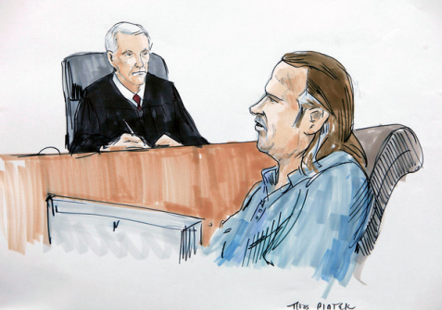
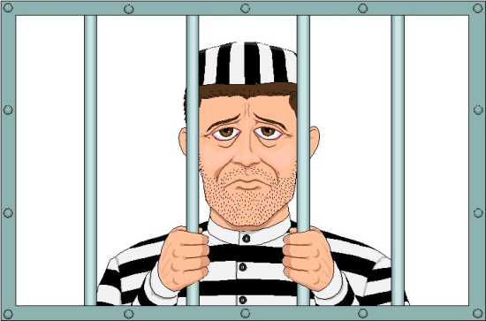
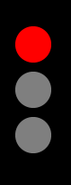

The Benefit of Faith
After the Plunge into Sin it was:
X
?

Slide 14
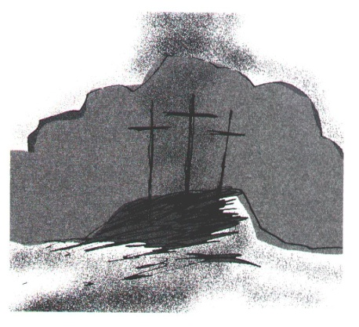

The Benefit of Faith
After the cross it has become:
?

Slide 15

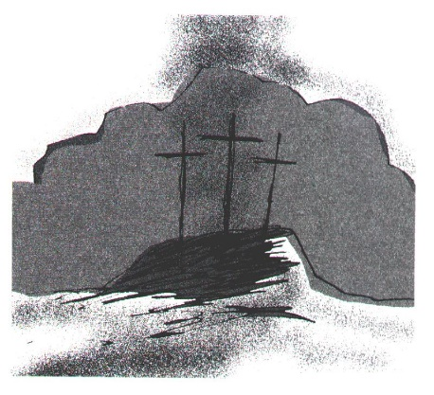
The Benefit of Faith
After the cross it has become:
1 - Justification (forgiven)
?
2 - Sanctification (renewal)

Slide 16
Meaningful?

To live a purpose-filled life we are to be what our Creator intended us to be: His image.
However, we fail miserably
- we transgress all God’s commandments
- we don’t do the good we should
- we have evil desires in our hearts
But God graciously grants us in Christ
- forgiveness of all transgressions
- righteousness (good works)
- holiness (removes evil desires)
This is true for those who believe: saved by faith!

Slide 17
Catechism
60. Q. How are you righteous before God?
A. Only by true faith in Jesus Christ.
Although my conscience accuses me that I have grievously sinned against all God’s commandments, have never kept any of them, and am still inclined to all evil,
yet God, without any merit of my own, out of mere grace, imputes to me the perfect satisfaction, righteousness, and holiness of Christ.
He grants these to me as if I had never had nor committed any sin, and as if I myself had accomplished all the obedience which Christ has rendered for me, if only I accept this gift with a believing heart.

Slide 18
The Reformation
Martin Luther came to understand one is saved by grace through faith and not by works (indulgences). This rediscovery of God’s truth restored faith as God’s gracious gift to it’s rightful place.
At the Diet of Worms Luther was summoned by the German emperor to recant all his works.
But he refused, unless it be proven from Scripture that his writings were wrong.
(Clip length 4:45)

Slide 19

Luther at the Diet of Worms
Notes:
4:44

Slide 20
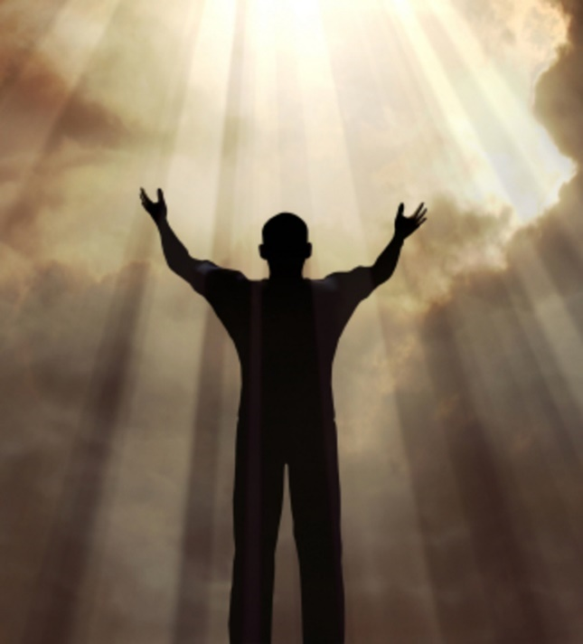
Belgic Confession

Among Protestant Christians the biggest point of debate is the role which faith plays in the salvation of a Christian.
Remember the following phrase from the Belgic Confession:
A true faith
embraces Jesus Christ
with all His merits.

