Slide 1
Catechism The Benefit of Faith
Lesson 11 – LD 23b-24
By Faith, Not By Works

Slide 2
Hymn 28:6
Faith clings to Jesus’ work alone
and rests in him unceasing;
and by its fruits true faith is known,
with love and hope increasing.
By faith alone we’re justified;
works serve the neighbour and supply
the proof that faith is living.

Slide 3
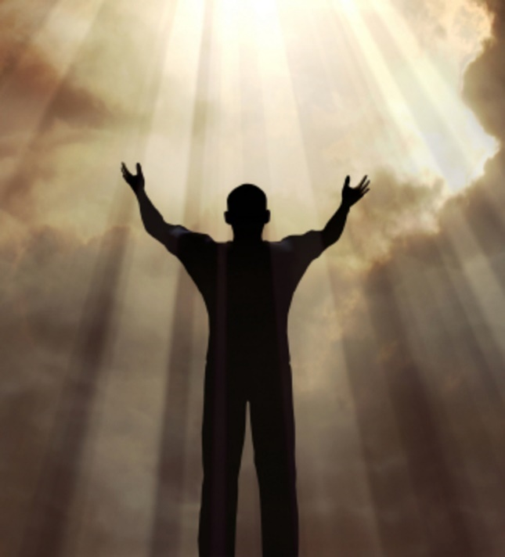
Sola Fide - By Faith Alone

Faith are the arms by which we embrace Christ and all His benefits.
Faith is
not the grounds of our salvation
but God’s chosen means for making salvation ours
Our salvation depends entirely on what Christ has done and God is doing.

Slide 4
Catechism
61. Q. Why do you say that you are righteous only by faith?
A. Not that I am acceptable to God on account of the worthiness of my faith,
for only the satisfaction, righteousness, and holiness of Christ is my righteousness before God.
I can receive this righteousness and make it my own by faith only.

Slide 5
But what about good works?
In most religions, good works play an important role.
Good works are actions, behaviour which is in keeping with the religion.
Such good works might consist of
- fulfilling the rites of the religion
- doing good things to other people
- having faith in God

Slide 6
Roman Catholicism

The Roman Catholic Church teaches salvation by works.
Such works are of two sorts:
- deeds in accordance with God’s law
- fulfilling the proper rites (prayer and sacraments)
You can help save others by doing good works for them:
- pray for dead people still in purgatory
- do something good for the church (indulgences)
BTW, indulgences still exist today. Young people who attend the international youth conferences of the Roman Catholic Church receive an indulgence.

Slide 7
However

For by works of the law no human being will be justified in God’s sight. Romans 3:20
No one is perfect, is able to do what God would have us do (Romans 3:20)
You won’t receive eternal life by living by the law.
Salvation comes through the instrument of faith. (Galatians 3:11)
Now it is evident that no one is justified before God by the law, for “The righteous shall live by faith.”
Galatians 3:11

Slide 8
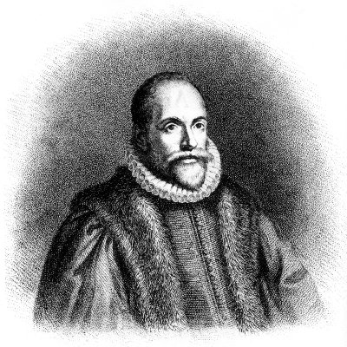
Arminianism

Many evangelicals are, to a great or lesser extent, Arminian.
Arminians will teach that faith is the “good work” which God requires of Christians to be saved.
They point out that God promises salvation to everyone who has faith.
Arminians teach:
1 God promises salvation.
2 A person believes in God.
3 God grants salvation to the believer.

Slide 9
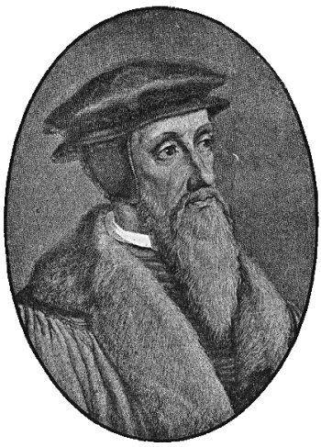
However

Faith is not first of all a work of man.
Faith is first of all a gift of God’s grace.
Calvinists (like us) teach:
1 God promises salvation.
2 God gives faith to a person.
3 A person believes in God.
4 God grants salvation to the believer.

Slide 10


Bible Study: Galatians 3:1-14

Slide 11
Bible Study: Galatians 3:1-14
1. As crucified
2. By hearing with faith
3. By the flesh (=human effort)
4. By faith
5. Cursed
6. No one.
7. By becoming a curse for us
8. By faith

Slide 12


So what about good works?

Good works cannot save us.
For our works to pass God’s inspection and be approved, they must be absolutely perfect.
But even our best works will be tainted with the sin of self-centred desires.
X
?

Slide 13


Catechism
62. Q. But why can our good works not be our righteousness before God, or at least a part of it?
A. Because the righteousness which can stand before God’s judgment
must be absolutely perfect
and in complete agreement with the law of God,
whereas even our best works in this life are all imperfect and defiled with sin.

Slide 14
Hang on a minute...
[Jesus said:] Rejoice and be glad, for your reward is great in heaven Matthew 5:12a
And without faith it is impossible to please him, for whoever would draw near to God must believe that he exists and that he rewards those who seek him.
Hebrews 11:6
The Bible clearly teaches that there will be a reward for those who believe. Doesn’t that mean they are earning something?

Slide 15
What about the reward?

It is true that God rewards those who believe.
But it is not true that He rewards their good works.
This reward is an undeserved, unmerited, not earned gift.
63. Q. But do our good works earn nothing, even though God promises to reward them in this life and the next?
A. This reward is not earned; it is a gift of grace.

Slide 16
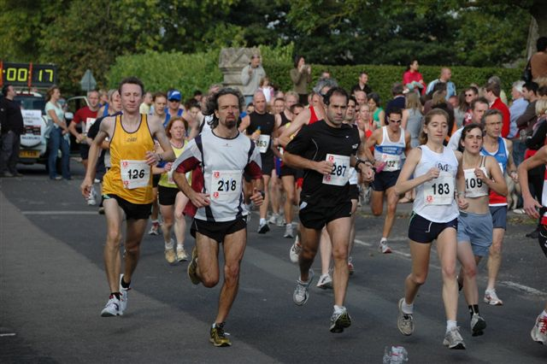
Good works are not an issue
A reward is always a good motivator for work.
If in a race, everybody wins a price, would you still do your best to win the race?
The idea may arise: if good works are not rewarded why bother?
And this would make church people careless and wicked.
It is true that loyal Roman Catholics and Arminians tend to be more zealous in their faith.
Shame on us?

Slide 17
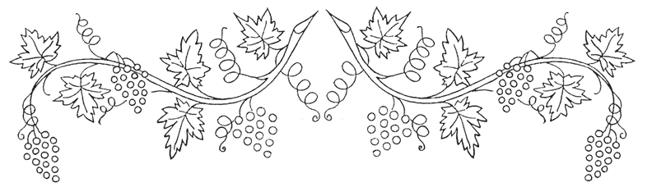
Catechism
64. Q. Does this teaching not make people careless and wicked?
A. No.
It is impossible that those grafted into Christ by true faith should not bring forth fruits of thankfulness.

Slide 18
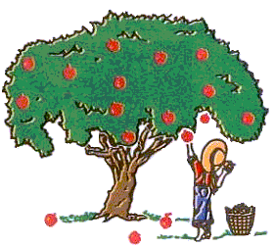
Good works still in the picture

While good works do not save, they will be present in the life of all believers.
For the fruit of faith is ALWAYS good works.
No good works means there is NO faith.
So also faith by itself, if it does not have works, is dead. James 2:17
Can a fig tree, my brothers, bear olives, or a grapevine produce figs? … Who is wise and understanding among you? By his good conduct let him show his works in the meekness of wisdom.
James 3:12-13

