Slide 1
Catechism
Essentials of Faith
Lesson 8
The Natures of the Christ (ctd)
The Work of the Christ

Slide 2
Hymn 79:1,3
We come, O Christ, to you, true Son of God and man,
by whom all things consist, in whom all life began.
In you alone we live and move
and have our being in your love.
You are the living truth; all wisdom dwells in you,
the source of every skill, the one eternal True!
O great I AM! in you we rest,
sure answer to our every quest.
Willoughby Heights CCLI: 11344914

Slide 3
Lutheranism

One difference between Lutheranism and Calvinism relates to the two natures of Christ.
Lutherans officially teach that at this present point in time, Christ is both human and divine, and that the properties of the distinct natures apply fully to the person.
This implies, Christ is both divinely and humanly omnipresent.
The Calvinist objection is that the divine and human natures of Christ do not communicate their attributes to each other through the person.
This implies, Christ is humanly local, divinely omnipresent.

Slide 4
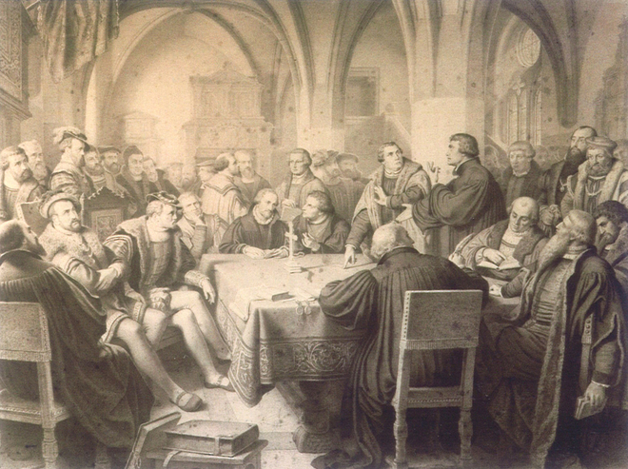
Marburg - 1529
Notes:
Luther pointing out the words “this is my body” to Zwingli.

Slide 5
Heidelberg Catechism
48. Q. But are the two natures in Christ not separated from each other if His human nature is not present wherever His divinity is?
A. Not at all,
for His divinity has no limits and is present everywhere.
So it must follow that His divinity is indeed beyond the human nature which He has taken on and nevertheless is within this human nature and remains personally united with it.

Slide 6
The Work of the Christ
For all have sinned and fall short of the glory of God, and all are justified freely by his grace through the redemption that came by Christ Jesus. God presented Christ as a sacrifice of atonement, through the shedding of his blood—to be received by faith.
Romans 3:23-25
We all know: Christ came to save sinners.
The question is: how did He do that?

Slide 7



Humiliation - Exaltation
Divine
glory
Eternity
Return
Incarnation
Ascension
Suffering
Died
Resurrection
Notes:
The students should know these steps

Slide 8
For whom did Christ die?
Christians tend to hold to one of two positions:
Universalism
All people are saved
Christ died for all people
People have the choice whether to be saved
Arminianism
Christ died for God’s chosen only
Only the chosen are saved
Calvinism

Slide 9



Bible Study: 1 Tim 2:1-7; 4:10

Slide 10
Bible Study: 1 Tim 2:1-7; 4:10
1. All people (in the original it just says “all”)
2. (b), as the next verse mentions some types of people, not individuals
3. All people
4. (b) – it says “desires all people to be saved”
5. For all
6. (b) or (c) – It cannot be (a) as we know that some people will not be saved
7. Of all people, especially of those who believe

Slide 11
Bible Study: 1 Tim 2:1-7; 4:10
8. This is not easy. Various explanations exist:
(a) “Saviour” = “Benefactor”: God takes care of all people in this world.
(b) “especially” = “that is”: “all people” are then “those who believe”
(c) read it as “God is the Saviour of all types of people, as is clear in those who believe”
The believers consist of all types of people, making clear that God is the Saviour of all types of people.

Slide 12
Canons of Dort II.8
God chose (elected) those who are to live eternally with Him.
God further willed
  That Christ should save all the elect
  That Christ should give the elect faith
  That Christ should cleanse the elect from sin
  That Christ should preserve the elect through life
  That Christ should present the elect to Himself as perfect

Slide 13

For whom did Christ die?
Many Scripture texts say God saves “all” or wants to save “all”. In many of these passages “all” doesn’t mean “every single person” but “all types of people”. No one is excluded on the basis of gender, sexual orientation, ethnicity, social standing, or whatever.

