Slide 1
Catechism
The Source of Faith
Lesson 12
How God Makes Himself Known

Slide 2
Psalm 19:1
The spacious heav’ns declare
God’s glory everywhere;
the skies proclaim his might.
The knowledge they display
day echoes forth to day
and night makes known to night.
They use no speech or word,
yet everywhere is heard
the voice of all creation.
The truth that it expounds
throughout the world resounds
and reaches every nation.

Slide 3
The Source of Faith
2 Year Course overview
√ Lord’s Day 1: The Profession of Faith
√ Lord’s Day 2-7: The Need for Faith
Lord’s Day 8-22: The Substance of Faith
√ Lord’s Day 23-24: The Benefit of Faith
Lord’s Day 25a: The Source of Faith
Lord’s Day 25b-31: The Growth of Faith
Lord’s Day 32-44: The Works of Faith
Lord’s Day 45-52: The Communication of Faith

Slide 4

Where does faith come from?
We know that faith is needed - Lord’s Days 2-7
We know that faith benefits us - Lord’s Days 23-24
This being so, a logical question is, how do we get that faith? What makes us believe?

Slide 5
Catechism
65. Q. Since then faith alone makes us share in Christ and all His benefits, where does this faith come from?
A. From the Holy Spirit,
who works it in our hearts by the preaching of the gospel,
and strengthens it by the use of the sacraments.

Slide 6
Catechism
The immediate source of faith is NOT the Bible but the Holy Spirit!
A. From the Holy Spirit,
who works it in our hearts by the preaching of the gospel,
and strengthens it by the use of the sacraments.
The mediate source of faith is the preaching of the Bible!
Sacraments are not a source of faith but cause faith to grow

Slide 7





The Source of Faith

Faith is worked in our hearts by the Holy Spirit.
The Holy Spirit uses the Bible to create faith in our hearts.
The Holy Spirit uses the sacraments to cause our faith to grow and be strong.
Of course, the Holy Spirit also uses the Bible for this.

Slide 8
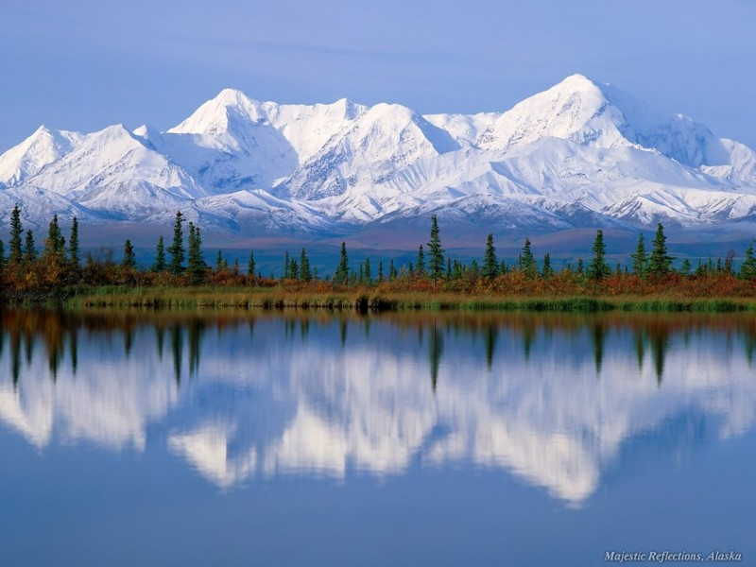
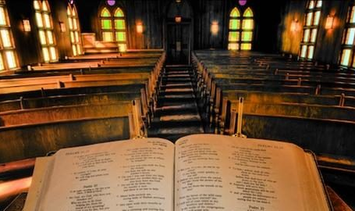
Revelation

Revelation is from the word “to reveal”, “to show something”
In the Christian faith, “revelation” refers to how God makes Himself and other things known to us.
There are basically two ways in which God reveals Himself:
1. Through creation 2. Through speaking

Slide 9
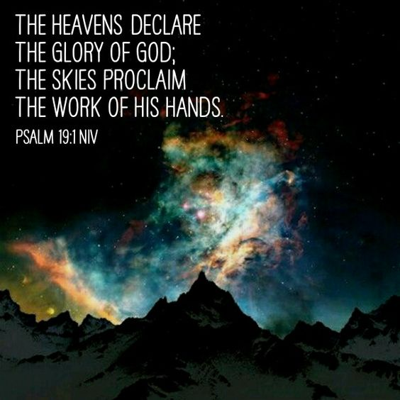
Bible Study: Psalm 19:1-11

Slide 10
Bible Study: Psalm 19:1-11
The heavens and the sky
No
Yes
The Bible
Important because the Bible helps us
to understand creation correctly. Without the Bible we’d misunderstand what creation tells us

Slide 11
Distinction

Creation Speaking
God’s WORKS / DEEDS God’s WORDS
General Revelation Special Revelation
everybody can see only those with Holy
Spirit will understand

Slide 12
General Revelation

In everything God has done and does, people could learn things about God.
But they don’t, as the Plunge into Sin has blinded and warped their vision.
For his invisible attributes, namely, his eternal power and divine nature, have been clearly perceived, ever since the creation of the world, in the things that have been made. So they are without excuse.
Romans 1:20

Slide 13


Warped vision (1)

By our fallen nature we see something - that’s where religions come from - but we don’t see it properly.

Slide 14
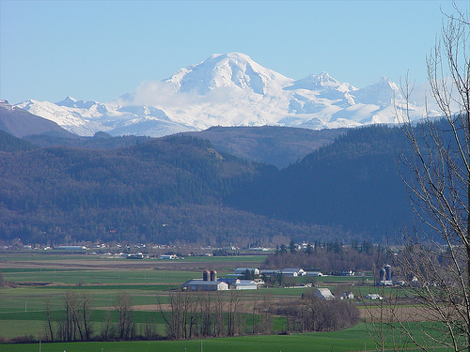
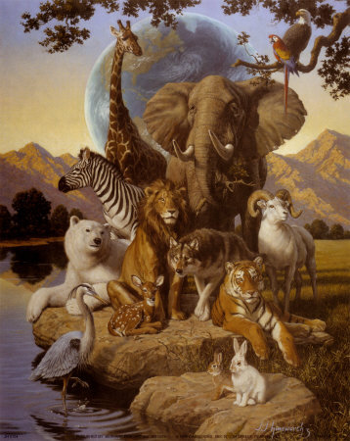

Warped Vision (2)

But that we don’t see it is not God’s fault.
God is doing a proper job of revealing Himself.
We are not doing a proper job of understanding it.

Slide 15
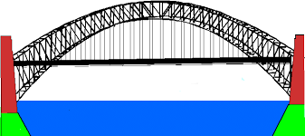


Special Revelation

Two things are needed for us to appreciate God.
1. God needs to tell us personally who He is and how to understand Creation.
This is the Bible
2. God needs to make us receptive to His speaking.
This is the Holy Spirit at work in our hearts.

Slide 16
Bridge Building

The Holy Spirit as it were builds a bridge.
From the Bible He works towards our person. This is the “outward call”
From the person He works towards the Bible. This is the “inward call”

Slide 17
Bridge building

The Holy Spirit as it were builds a bridge.
As the Author of the Bible He works from the Bible towards our person
This is called the external call as it is the Holy Spirit calling us from the outside
As the Giver of Faith He works in our hearts to make us receptive.
This is called the internal
call as it is the Holy Spirit
calling us from within us.

