Slide 1
Catechism The Source of Faith
Lesson 13 – LD 25a & BC 3,4 & 6
The Bible (1)

Slide 2
Psalm 119:40
Your word, it is a lamp to guide my feet,
a lantern shining on the path before me.
I’ve sworn an oath and here my vow repeat
to keep the laws that of your love assure me.
I suffer in affliction and defeat;
true to your promise, comfort and restore me.

Slide 3
Special Revelation

General Revelation: for everyone
Special Revelation: to particular people
Throughout time, special revelation has taken on various forms.
Long ago, at many times and in many ways, God spoke to our fathers by the prophets, but in these last days He has spoken to us by His Son,
Hebrews 1:1,2a

Slide 4
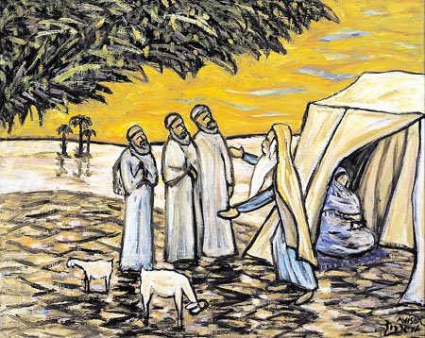
1. In personal appearances


Slide 5
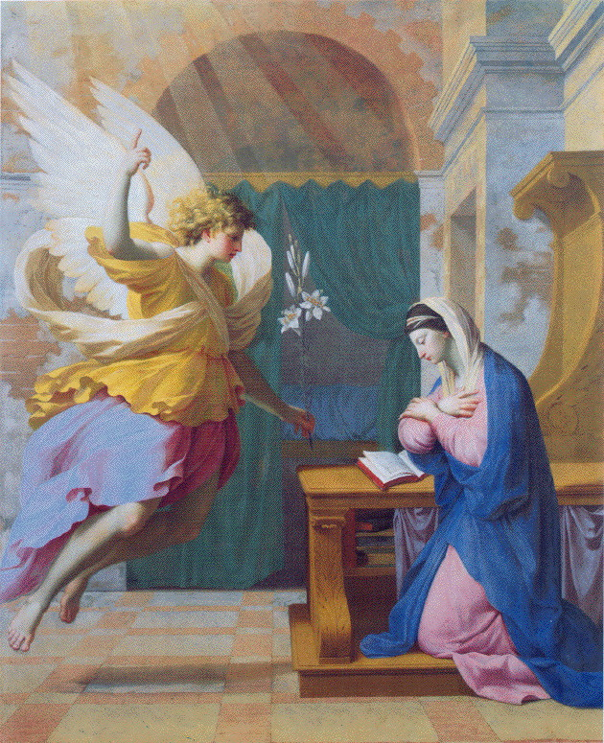
2. Through angels


Slide 6
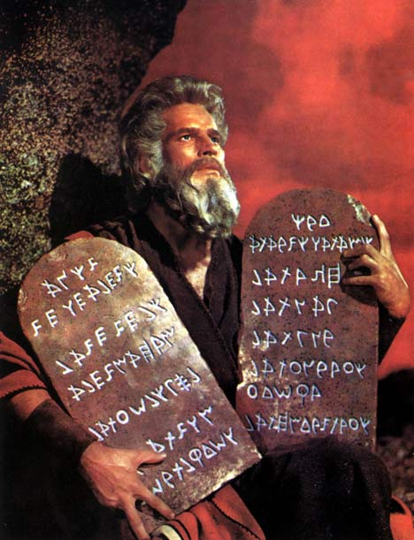
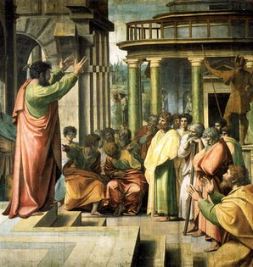
3. Via people (prophets, apostles)


Slide 7
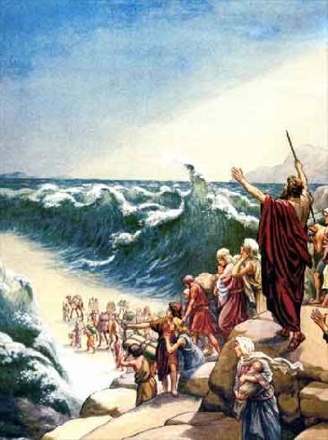
4. By miracles


Slide 8
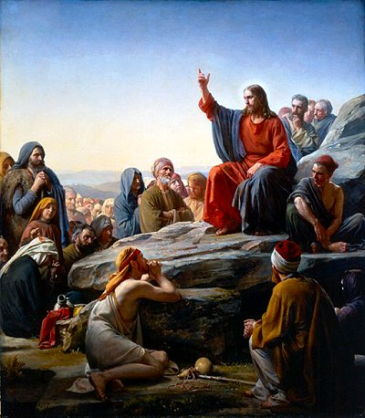
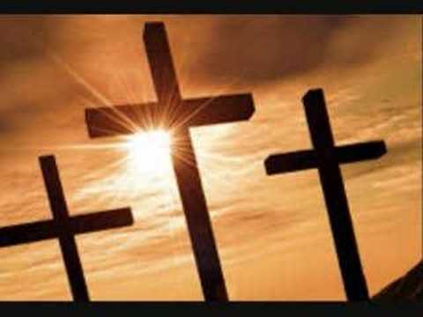
5. In Jesus Christ


Slide 9
Bible - Origin
Creation
Abraham
David
Christ
Us
2000
1000
0
2000
Moses writes Genesis-Deuteronomy
John writes Revelation
Malachi writes Malachi

Slide 10
From spoken to written

As special revelation took place, God had some of it committed to writing.
Over 1500 years the Bible grew to be what it is now.
As we live after Christ and the apostles, in the last days, there is no more need for extra special revelation.
Never have human beings determined what belongs to the Bible. At most they have said what does not belong to the Bible.

Slide 11

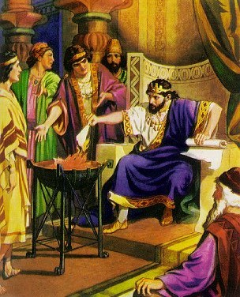
Bible Study: Jeremiah 36

Slide 12
Bible Study: Jeremiah 36
1. The LORD
2. Baruch became his secretary and wrote it down
3. Baruch took it to the temple to read it to the people.
4. All the officials
5. To go and hide themselves.

Slide 13
Bible Study: Jeremiah 36
6. To the King (Jehoiakim).
7. He burned it bit by bit.
8. To write another scroll.
9. The LORD.
10. To warn God’s people with God’s Word.

Slide 14
Inspiration

The Bible has been inspired, God-breathed.
The Bible does not contain man’s thoughts on God.
The Bible contains God’s words to man.
All Scripture is breathed out by God and profitable for teaching, for reproof, for correction, and for training in righteousness
2 Timothy 3:16

Slide 15

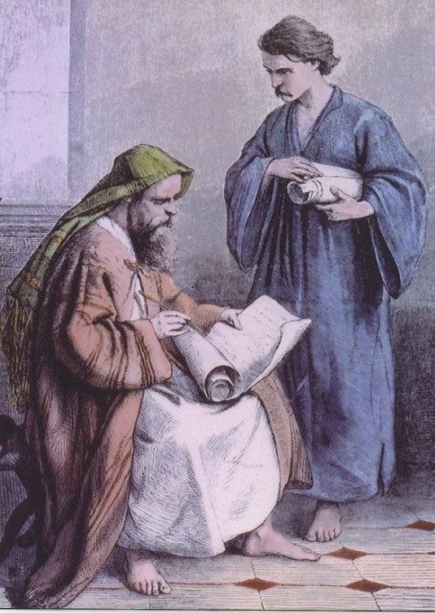
Organic Inspiration

God did not use people the way people use computers for word processing.
God used people with their God-given skills in their God-controlled circumstances to commit His Word to writing.

Slide 16
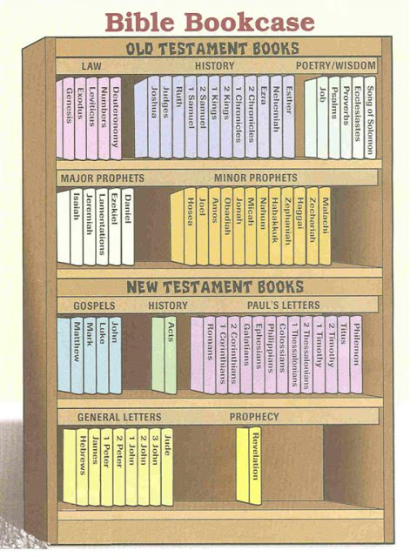
The Books of the Bible

“Bible” is from the Greek BIBLIA = books.
The Bible is actually a library of books.
The canon (standard) of the Bible consists of a total of 66 books.
Books belonging to the Bible are said to be canonical.

Slide 17
Divisions

The Bible divides into two parts.
The Old Testament: 39 books (3 9 books)
The New Testament: 27 books (3 x 9 books)
The OT has different groups (genres) of books: law, history, wisdom & poetry, prophecy
The NT has different groups (genres) of books:
history, letters, prophecy

Slide 18
Which book is what?
Leviticus: OT law
Mark: NT history
Hebrews: NT letter
Joel: OT prophecy
Psalms: OT wisdom & poetry
Isaiah: OT prophecy
2 Samuel: OT history
Revelation: NT prophecy
Job: OT wisdom & poetry
Ruth: OT history
Romans: NT letter
Hezekiah: not a Bible book!

Slide 19

Books of the Bible (2:42)

