Slide 1
Catechism The Substance of Faith
Lesson 15 – LD 8
Confessing Our Triune God

Slide 2
Hymn 4:1,2,3
We praise you, God the Father, the Creator;
we praise you, God the Son, our Lord and Saviour;
we praise you, God the Spirit, coeternal;
one God almighty.
Trinity holy, Unity unbroken,
let all creation praise you without ceasing,
for you are one in truth and love and splendour,
Rock of salvation.

Slide 3
Hymn 4:1,2,3
We praise you, Father, Son, and Holy Spirit;
Lord God eternal, we bow down before you.
Yours be all honour, yours the pow’r and glory,
now and forever.

Slide 4
The Benefit of Faith
We are going back to Lord’s Day 8.
Lord’s Day 1: The Profession of Faith
Lord’s Day 2-7: The Need for Faith
Lord’s Day 8-22: The Substance of Faith
Lord’s Day 23-24: The Benefit of Faith
Lord’s Day 25-31: The Growth of Faith
Lord’s Day 32-44: The Works of Faith
Lord’s Day 45-52: The Communication of Faith

Slide 5
A confession of faith

To say what you believe is to confess your faith.
And if you believe everything in the Bible, your confession of faith will be a brief summary of everything in the Bible, its main points.
To confess your faith is
to say in summary what the Bible says.

Slide 6
Confessions of faith
Peter (Matthew 16:16): You are the Christ, the Son of the Living God.
Thomas (John 20:28): My Lord and my God.
The Eunuch (Acts 8:37): I believe that Jesus Christ is the Son of God.
If you confess with your mouth “Jesus is Lord”and believe in your heart that God raised Him from the dead, you will be saved.
Romans 10:9
I believe ...

Slide 7
Formalized confessions
Baptism is into the Name of the Father, the Son, and the Holy Spirit.
To be baptized, an adult would be asked, what do you believe?
Their response was then to be:
I believe in God the Father.
I believe in God the Son.
I believe in God the Holy Spirit.

Slide 8
The confession of Rome, 150 AD
Do you believe in God the Father, Almighty?
Do you believe in Christ Jesus, God’s Son,
Born by the Holy Spirit from the virgin Mary
Crucified under Pontius Pilate and die
On the third day arisen from the dead
Ascended into heaven
Seated at the right hand of the Father
and who shall come to judge the living and the dead?
Do you believe in the Holy Spirit,
In the holy church
And the resurrection of the body?

Slide 9
Rome and the Apostles’ Creed
I believe in God, the Father, the Almighty, Creator of heaven and earth.
And in Jesus Christ, God’s only-begotten Son, our Lord
who was conceived by the Holy Spirit, born of the Virgin Mary
suffered under Pontius Pilate, was crucified, dead, and buried, He descended into hell.
On the third day He arose from the dead,
He ascended into heaven, and sits at the right hand of God, the Father, Almighty,
From there He will come to judge the living and the dead.
I believe in the Holy Spirit;
I believe a holy, catholic, Christian church, the communion of saints
The forgiveness of sins
The resurrection of the body
And the life everlasting.

Slide 10
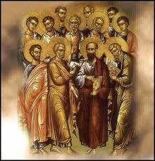
The confession grows

Initially the confession was the Trinity as in the baptism formula.
Over time it expanded to include extra elements.
Eventually it became known as the Apostles’ Creed.
For this Creed taught what the apostles had taught as commanded by Christ.
Note: the Apostles’ Creed was NOT written by the 12 apostles.

Slide 11
The Apostles’ Creed
The Apostles’ Creed consists of 3 sections, with a total of 12 articles.
The Heidelberg Catechism deals with the individual articles of the Apostles’ Creed in LD 9-22.
1 God the Father Our Creation LD 9-10
2 God the Son Our Redemption LD 11-19
3 God the Spirit Our Sanctification LD 20-22

Slide 12
Judaism and Christianity on God
Hear, O Israel: The LORD is our God, the LORD is one.
Deuteronomy 6:4
This is one of the confessions of Israel.
There is one God: monotheism.
Yet we speak of Father, Son, and Spirit.
Do Christians have more gods than Israelites?
Do Christians have three gods: tri-theism?

Slide 13
Three gods or one?

Together with the Israelites of old we believe in one God.
However, God Himself has made clear that in God there are not one but three persons.
God is Tri-Une, Three-in-One.
We cannot understand this. But we accept on God’s authority that this is so. And thus believe it.

Slide 14

Three gods or one?
There are things that are the way they are, and yet they puzzle us.
Like a Mobius Strip
The Trinity is a mystery: we can describe it but not explain it.
God is so awesome He is beyond our understanding!

Slide 15
Two heresies
The Athanasian Creed is very detailed on the doctrine of the Trinity.
This was after battles with two heresies:
Subordinationism: the Persons of the Trinity are not co-equal in being but subordinated.
Modalism: the Persons of the Trinity are not distinct beings but modes of existence for just one being.

Slide 16
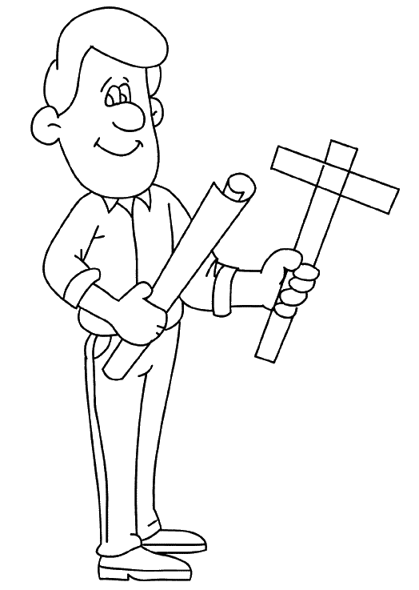


Subordinationism

This heresy teaches:
The Father is lord of the Son and the Spirit.
The Father and the Son are lord of the Spirit.
While subordinationism is not true where it concerns the being of the Persons, it is true when it comes to their work.
Father - architect Son - contractor Spirit - trades

Slide 17
Subordinationism

This heresy teaches:
The Father is lord of the Son and the Spirit.
The Father and the Son are lord of the Spirit.
While subordinationism is not true where it concerns the being of the Persons, it is true when it comes to their work.
Compare men and women. Biblically speaking they are equally human, but with different tasks. In being they are co-equal, in their roles or activities women are subordinate to men.

Slide 18
Subordinationism

This heresy teaches:
The Father is lord of the Son and the Spirit.
The Father and the Son are lord of the Spirit.
While subordinationism is not true where it concerns the being of the Persons, it is true when it comes to their work.
Subordinationism is wrong, because Scripture clearly teaches that all three Persons are wholly and perfectly God, and there is but one God.

Slide 19
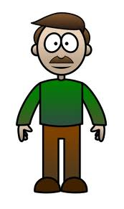
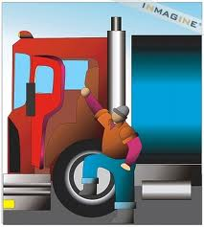

Modalism

This heresy teaches:
God is one Person with three functions.
It’s like a man being father truck driver & elder.
Modalism is wrong because Scripture clearly speaks of the three Persons as individuals who communicate with each other.
x
x
x

