Slide 1
Catechism Essentials of Faith
Lesson 11B
The World of Spirits

Slide 2
Hymn 3:1
1. O God, we praise you, we acknowledge you as Lord.
Eternal Father, you are everywhere adored.
Led by the seraphim, the angels praise you rightly :
“O holy, holy, holy is the Lord Almighty!
Both heaven and earth are filled with your majestic
splendour.”
To you all angels never-ceasing praises render.

Slide 3
Spirits - history
On occasions refered to in Old Testament
Very active when Jesus was on earth
Spirits interacted with our world, often without us knowing and realizing it
Satan had challenged God over Job’s faith (Job 1-2)
Satan and Michael fought over the body of Moses (Jude)
Some devil managed to delay Gabriel in coming to Daniel; Michael had to free Gabriel (Daniel 10)

Slide 4
Spirits today
the world of spirits is as real in the present as it was in the past
the activity of evil spirits is curtailed, but not absent
modern witchcraft (Wicca) is in fact a form of spirit-worship
by created order, people are higher in rank than angels
on account of the fall, we have lost our authority
in Christ as perfect man we regain our authority

Slide 5
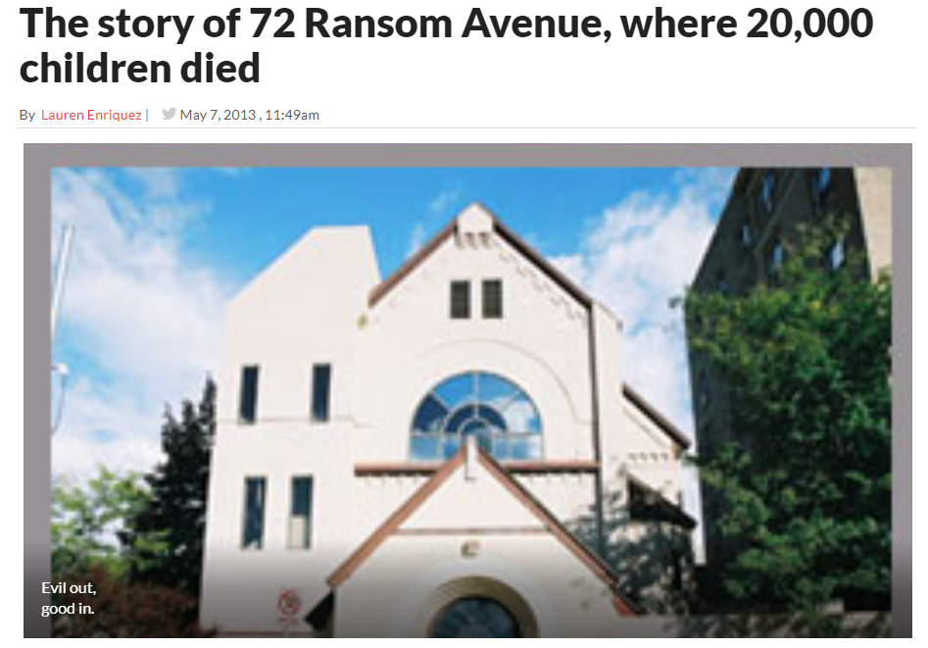
Spirits today

Slide 6
Demon oppression
Demons can only control a person if they are let in
Think of demons as terrorists: very limited in activity, active where they get room
The symptoms for psychological disorders and demon oppression are often similar
psyche = spirit of man
our understanding of our own spiritual nature is very limited
it is simplistic to argue all psychological disorders are proof of demon oppression
it is simplistic to argue all demon oppression is psychological disorder

Slide 7
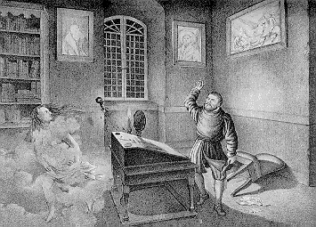
Demon oppression
Excorcism is the act of driving out a demon from a person
In Roman Catholic church: a ministry of the church couched in rituals
In Reformed Churches
demon oppression is rarely encountered (the mission field is the exception)
liberation is sought through prayer

Slide 8

Miracles – Christian Broadcasting Network
Notes:
5:35

