Slide 1
Catechism Defending the Faith
Lesson 12
Creation (1)

Slide 2
Psalm 33:2
By his command God made the heavens,
their starry host by his decree.
He gathered in his storehouse chambers
the waters of the deepest sea.
Let the earth revere him,
and its peoples fear him.
God spoke, and ’twas done.
He set all creation
firm on its foundation.
Praise him, everyone!

Slide 3
Pre-confession class
5 – 6 week course open to grade 12+ students
Where/when: depends on who signs up
Best: right after school at Credo
For Willoughby Heights: if we begin first week after Christmas break profession of faith would be on March 3.
It’s tight but doable
For a more relaxed approach we can aim for profession of faith on May 5.
Think it over and let me know next week

Slide 4

Creation
Belgic Confession Article 12a,13
Lord’s Day 9.
Jot down some personal notes for the questions and then we’ll discuss.

Slide 5
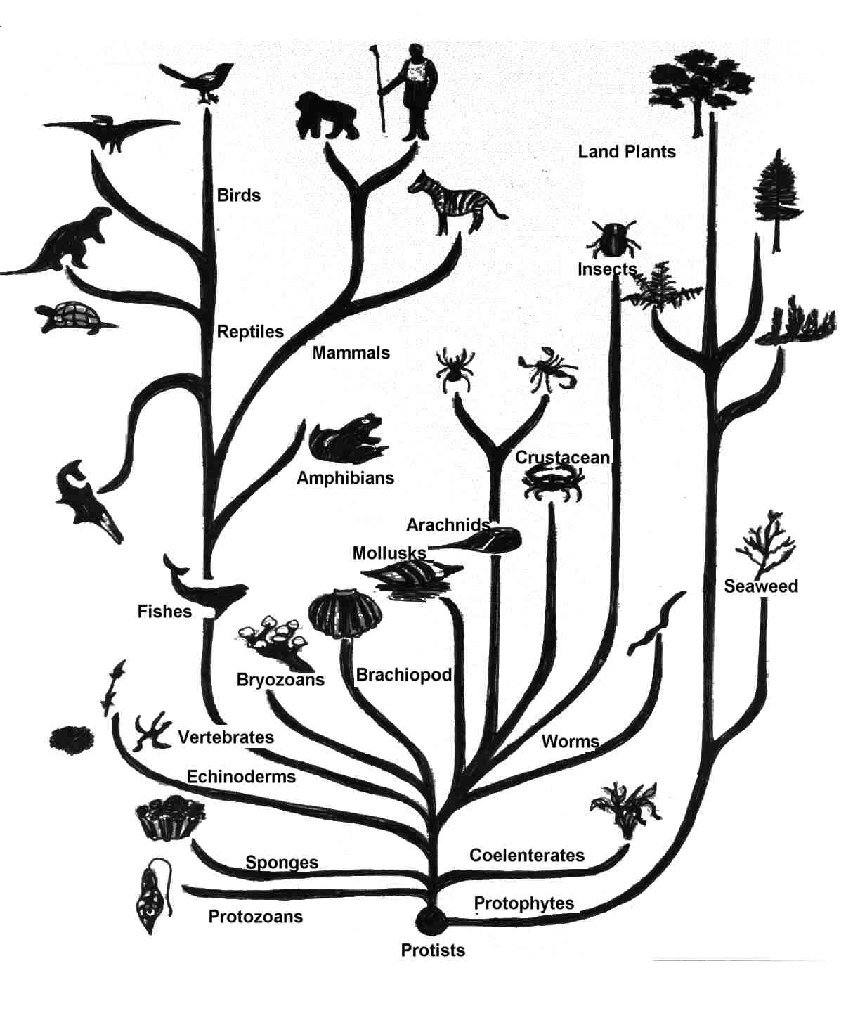
Evolution
Evolution is the scientific theory that one life form develops from another.
Since it was first proposed, it has been extended to suggest that one form of existence has developed from another.
Cosmic evolution (planet earth)
→ chemical evolution (life)
→ biological evolution (man)

Slide 6
The Origins debate
The “logic” positions are:
Intelligent Design:
Observation: all that exists is detailed and fine-tuned
Thought: this cannot be the product of chance
Theory: everything has a designer
Evolutionism:
Observation: all that exists shows similarities
Thought: with enough time chance can produce this
Theory: everything evolved from a common origin

Slide 7
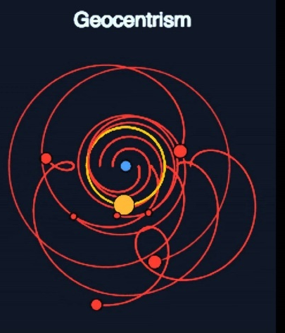

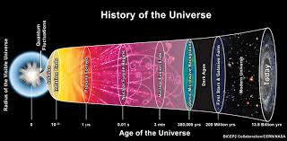

The spectrum for Christians
Geocentrism
Young Earth Creationism
Old Earth Creationism
Evolutionary Creationism
- aka theistic evolution

Slide 8
The spectrum for Christians
Geocentrism
Young Earth Creationism
Old Earth Creationism
Evolutionary Creationism
- aka theistic evolution
Concordist
(Bible & science must agree)
Non-concordist
(Bible & science need not agree)

Slide 9
Geocentrism
The earth is the centre of the universe
Usually: the earth is flat, som the earth is a ball
Creation in 6 days of 24 hours
All today’s species come from Noah’s ark
Global flood
Always a position held in the church
Flat Earth Society

Slide 10
Young Earth Creationism (YEC)
Science and Bible have to agree
The earth revolves around the sun
The earth is a ball
Creation in 6 days of 24 hours
All today’s species come from Noah’s ark
Global flood
Always a position in the church
Answers in Genesis; Institute for Christian Research

Slide 11
Old Earth Creationism (OEC)
Science and Bible have to agree
The earth revolves around the sun
The earth is a ball
Creation over billions of years (gap theory)
All today’s species were created distinct
Global or Local Flood
Began around 1750
Reasons to Believe

Slide 12
Evolutionary Creationism
Science and Bible don’t have to agree
The earth revolves around the sun
The earth is a ball
Creation over billions of years
All today’s species have a common ancestor
Local Flood
Began around 1900’s
Bio-Logos

Slide 13

Salvation Issue ? (2:48)

Slide 14
Salvation Issue?
The term “salvation issue” is misleading
Believing something that is not true is sin, and all sin condemns.
A better approach is:
Will God forgive my sin of believing the wrong thing?
God can, as He is a God of grace
God will if, as a true child of God,
I am always willing to learn from God
I always strive to live a life of love and loyalty in God’s service
Thus we can agree to disagree, but we will continue to debate so as to grow in understanding

Slide 15
Using Scripture
Beware of:
Literalism for: God does use figurative language
Culturalism for: God does tell facts
Fundamentalism for: we don’t know everything
Liberalism for: we do know some things
Respect
Mysteries of the faith
Human limitations
Scripture interprets itself
Next week: Creation and Science

