Slide 1
Catechism Defending the Faith
Lesson 13
Creation (2)

Slide 2
Psalm 8:1,5
O Lord, our Lord, yours be all adoration.
How glorious is your name in all creation!
You have displayed your majesty on high;
your glory reaches far above the sky.
You have appointed man as lord and master
of bird and beast in forest, field, and pasture;
of all the fish and creatures of the sea.
O Lord, how great is your name’s majesty!

Slide 3
Creation: when and how long?
The appearance of all things around us as understood by the theory of evolution suggests that things are much older than the Bible suggests, and also took much longer to come into existence.
Some people figure it is possible to be an evolutionist and a Bible-believing Christian at the same time.
Until recently this was called “theistic evolution”. Today it is called “evolutionary creationism”.

Slide 4
Creation: when and how long?
The Bible is clear on how long it took God to create.
Six days you shall labour, and do all your work, but the seventh day is a Sabbath … For in six days the LORD made the heavens and the earth, the sea, and all that is in them, but he rested on the seventh day.
Exodus 20:9-11

Slide 5
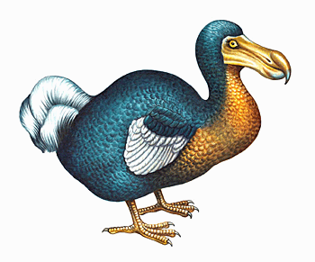
Creation: when and how long?
The Bible is not completely clear on how long ago this was. The genealogy in Genesis 5 is shorter than the one in Luke 3. (Compare Gen 5:24; 1 Chron 1:18, Luke 3:35). Also “to become the father of” could mean “to become the great-great grandfather of”. (Matt. 1:8 & 1Chr. 3:10-12).
This suggests that it might be wrong to simply do the math and say: creation was about 6000 years BC.
However, the suggestion that the earth has existed for millions or billions of years without humans on it, is wrong. All the kinds that exist today, existed already on the 7th day.
Mind you, not everything that existed then still exists today!

Slide 6
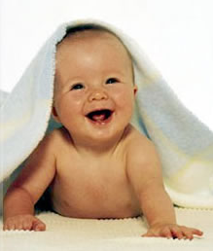
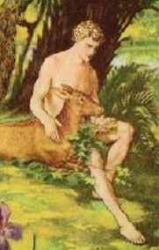
How old?
Who would Adam have looked like more on day 8?
How old was the orange tree from which Eve picked an orange on day 9? How many growth rings would the orange tree have had?
How about a 300 foot redwood or a 200 foot cedar?

Slide 7
How old?
Would there have been coal deposits for Adam to find?
Would there have been fossils in the coal deposits?
How old would the mountains have appeared?
What about the stars, those that are millions of light years away?
God created all things with age. So could God have created a history that never happened?
Richard Dawkins figures if He did, God is a deceiver.
But God is not a deceiver if He told us He did.

Slide 8
A history that never happened
If God did indeed create a history that never happened, then the observations of science could be okay.
Note:
Not “the universe is 14 billion years old” but “the universe appears 14 billion years old”
New creation moments ?
Distinguish between “observations” and “hypotheses” and “theories”

Slide 9
Moments of divine creation
God created in the beginning (Genesis 1)
God will create when Christ returns (Revelation 21)
One might consider some miracles acts of creation
The bush that did not burn (Exodus 3)
Changing water into wine (John 3)
Did God create
When He cursed creation because of sin (Genesis 3)?
When He sent the Flood upon the earth (Genesis 6-8)?
When He confused the languages (Genesis 11)?

Slide 10
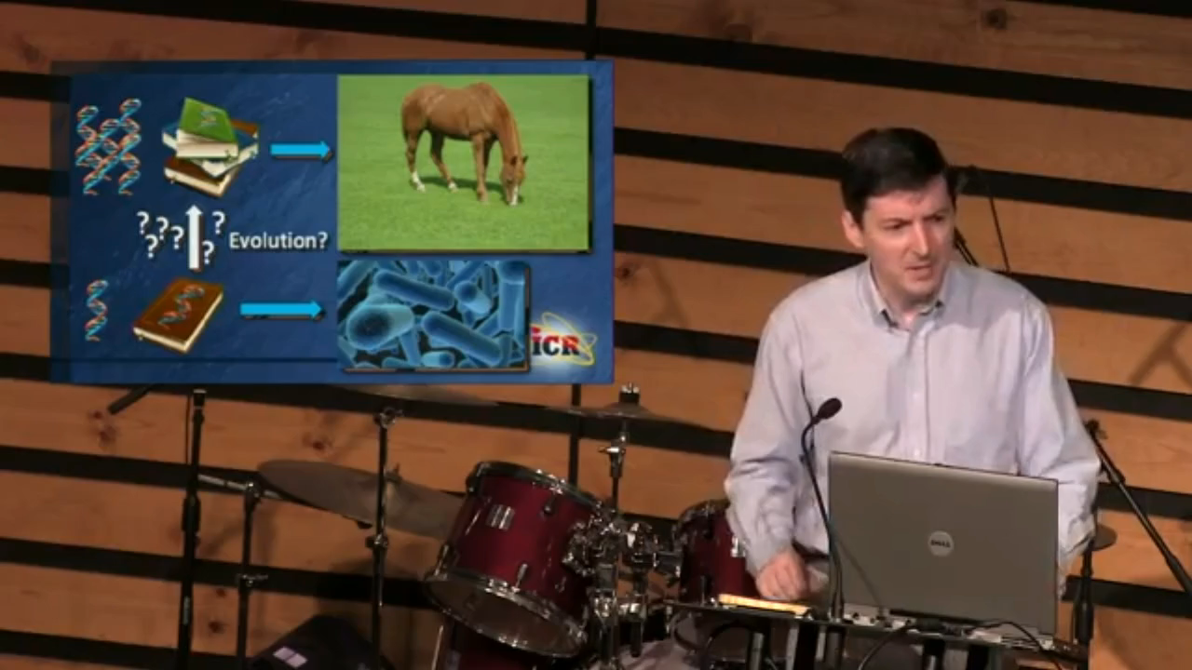
Gaining or Losing Information (6:20)
Notes:
6:20

Slide 11
Faith in science?
Science observes present realities
Science uses logic to theorize about the future and the past
The movement is from ‘hypothesis’ to ‘theory’
A ‘hypothesis’ is a possible explanation
A ‘theory’ is an explanation that has been tested thoroughly and withstood tests
Science thus assumes continuity
But can science reach beyond a divine creative moment?
e.g. Can science tell us what the world looked like before the flood?
.e.g Can science tell us what our bodies will look like in the new creation (cf. 1Cor 15:35-53)

Slide 12
Science and Revelation
Science is a human activity
We are creatures, limited in our abilities
We are sinful, skewed in our intentions and thoughts
Revelation is a divine activity
God is creator, all-knowing
God is perfect, all-good
Believing is a human activity
We need the Spirit to understand God’s revelation
We do well to be humble

