Slide 1
Catechism
The Substance of Faith
Lesson 18 – LD 12
Messiah. Christ. Anointed.

Slide 2
Hymn 57:1
We praise you, Lord, for Jesus Christ,
who died and rose again;
he lives, he broke the power of sin
and over death now reigns.

Slide 3
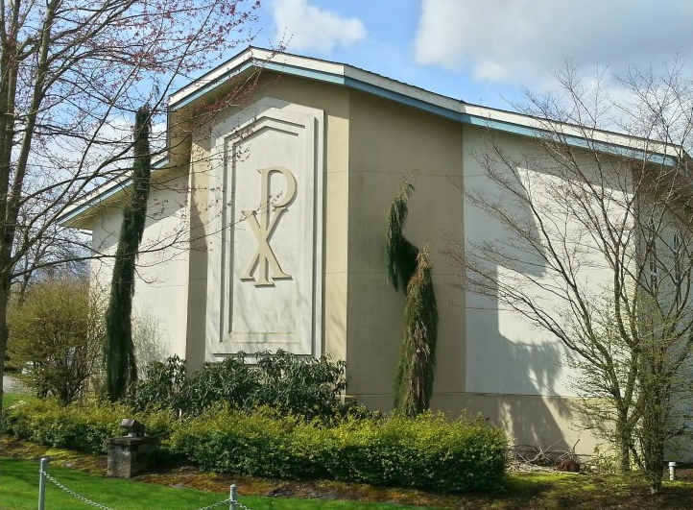
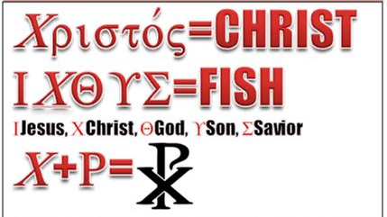
A symbol and three words

This is the Chi-Rho symbol.
It combines the first two
letters of the Greek word
Christos.
Hebrew: Messiah
Greek: Christ
English: Anointed

Slide 4
Anointed

In the Old Testament, people were anointed to three types of position.
Text Anointer Anointee(s) Position
1 Kings 19:16b
Exodus 30:30
1 Samuel 10:1
Elijah Elisha Prophet
Moses Aaron & sons Priest
Samuel Saul King

Slide 5
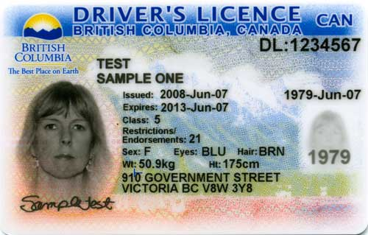
Anointing - why?
Being anointed was a sign of two things:
authorization
qualification
A modern equivalent would be a driver’s license.
- it authorizes you to drive on public roads
- it is proof that you have passed a test to prove you are qualified (able) to drive.

Slide 6
The anointing of David
In this text we see a reference to:
authorization being made capable
And the Lord said, “Arise, anoint him, for this is he.” Then Samuel took the horn of oil and anointed him in the midst of his brothers. And the Spirit of the Lord rushed upon David from that day forward.
1 Samuel 16:12b-13a

Slide 7
The reasons for anointing

A person was anointed for two reasons.
1. Authorization.
The anointing made clear that this person was chosen to the task of prophet, priest, or king, by God Himself.
2. Qualification.
The anointing made clear that this person received the Spirit of God to be capable of fulfilling the task.

Slide 8

What were their tasks?
Prophet Priest King
Nathan
Isaiah
Daniel
Zadok
Abiathar
Joshua
Solomon
Jehu
Hezekiah
Their tasks were:
To proclaim God’s word to the people.
To bring God and His people closer to each other through sacrifice and prayer.
To protect and rule over God’s people.

Slide 9

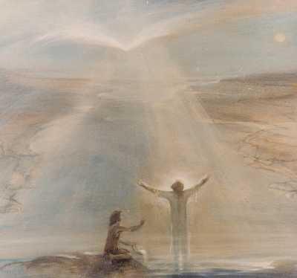
Bible Study: Matthew 3:16-17

Slide 10
Bible Study: Matthew 3:16,17
1. Right after His baptism
2. A baptism for repentance (avoiding sin)
3. The Spirit of God
4. God the Father
5. The words from heaven
6. Receiving the Spirit.

Slide 11
Anointed
31. Q. Why is He called Christ, that is, Anointed?
A. Because He has been ordained by God the Father,
and anointed with the Holy Spirit, to be
our chief Prophet and Teacher,
who has fully revealed to us the secret counsel and will of God concerning our redemption;
our only High Priest,
who by the one sacrifice of His body has redeemed us, and who continually intercedes for us before the Father;
and our eternal King,
who governs us by His Word and Spirit, and who defends and preserves us in the redemption obtained for us.

Slide 12
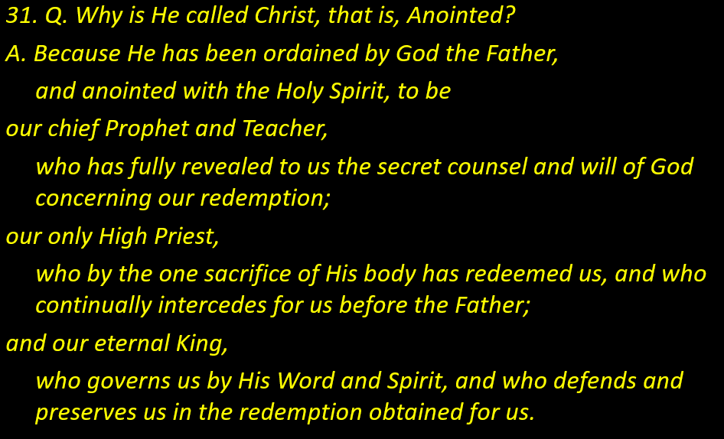
Anointed
Authorization
Qualification
Task 1
Task 2
Task 3

Slide 13
Anointed
31. Q. Why is He called Christ, that is, Anointed?
A. Because He has been ordained by God the Father,
and anointed with the Holy Spirit, to be
our chief Prophet and Teacher,
who has fully revealed to us the secret counsel and will of God concerning our redemption;
our only High Priest,
who by the one sacrifice of His body has redeemed us, and who continually intercedes for us before the Father;
and our eternal King,
who governs us by His Word and Spirit, and who defends and preserves us in the redemption obtained for us.

Slide 14
Jesus’ three-fold office

Jesus is the Messiah, the Christ of God.
He is to God’s people a prophet, priest, and king.
And not just one among many.
He is the CHIEF prophet, the ONLY high priest, and the ETERNAL king.
Eternal king = He will never be succeeded by another.

Slide 15
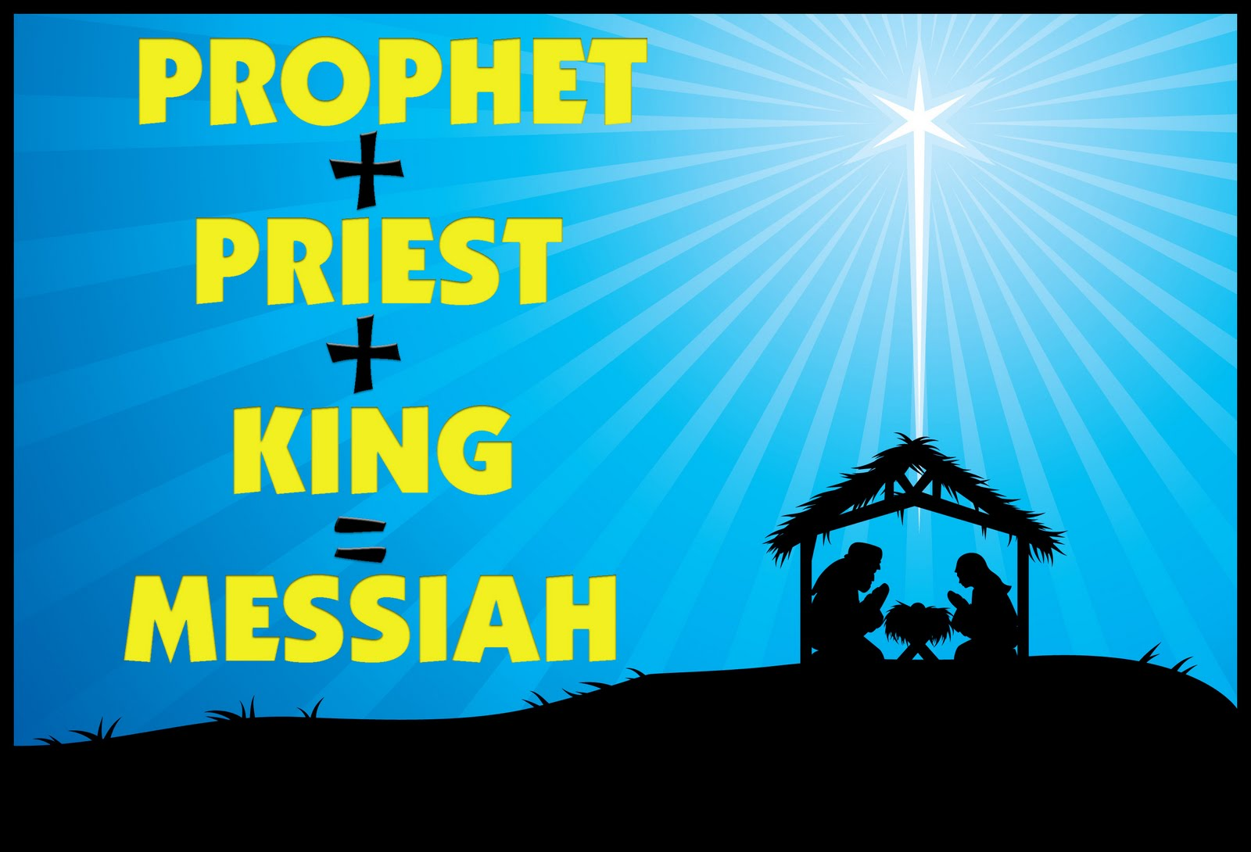

Slide 16
What Jesus does as

Prophet Priest King
Proclaim God’s word to the people.
Bring God and His people closer to each other through sacrifice and prayer.
To protect and rule over God’s people.
Some examples
Sermon on the Mount
- Matthew 5-7
Prayer for His followers
- John 17
Calming the storm.
- Mark 4

Slide 17
As what did Jesus do/say it?
Prophet Priest King
1. Die on the cross.
2. Jesus said to Peter: “I have
prayed for you.”
3. Jesus said: “What I teach I
have received from Him who
sent Me.”
4. Jesus is with us until the end
of the world
5. Jesus is the Good Shepherd
who lays down His life for the
sheep.
✓
✓
✓
✓
✓

Slide 18
As what did Jesus do/say it?
Prophet Priest King
6. The Lord Jesus instructs the
people travelling to Emmaus.
7. Jesus said “I tell you, if you
call your brother a fool, you
deserve to go to hell.”
8. Jesus praying for the unity
of the church.
9. All authority in heaven and
on earth belongs to Jesus.
✓
✓
✓
✓

Slide 19
What Jesus does for you

As prophet
He gives you the Word of God in the form of the Scriptures, and sends the Holy Spirit into your heart to make you understand the Bible
As priest
He has paid the penalty for your sins and prays for you to the Father to accept you into God’s Kingdom
As king
He governs your life, placing you in a church community where you will be protected and taken care of.

