Slide 1
Catechism The Substance of Faith
Lesson 16 – LD 9&10
God Almighty: our Creator & our Father

Slide 2
Psalm 104:1
O bless the LORD, my soul, and praise his name.
O LORD, how great you are, how bright your fame!
You who are clothed in majesty and splendour,
enrobed in light, to you my praise I render.
The heavens you have stretched out like a tent,
your palace founded on the firmament.
Clouds are your chariots, storms lend you their pinions;
winds are your heralds, fire and flame your minions.

Slide 3
Where does it all come from?
Today, most people hold to one of two theories.
There was nothing, it exploded, and this universe began to evolve.
There was nothing, God spoke, and this universe came to be
The Big Bang Theory
The Creation Theory

Slide 4
Creation
The very first verse of the Bible tells us:
The heavens and the earth: that’s quite a lot.
And God did it in just six days!
In the beginning, God created the heavens and the earth.
Genesis 1:1
For in six days the Lord made heaven and earth, the sea, and all that is in them,
Exodus 20:11

Slide 5



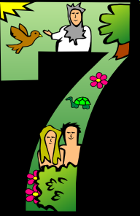



Creator

Everything that exists outside of God has been created by Him. (Everything, also the devil!)
He did it in 6 days.

Slide 6







Creator
God is Creator: He made all things.

Slide 7
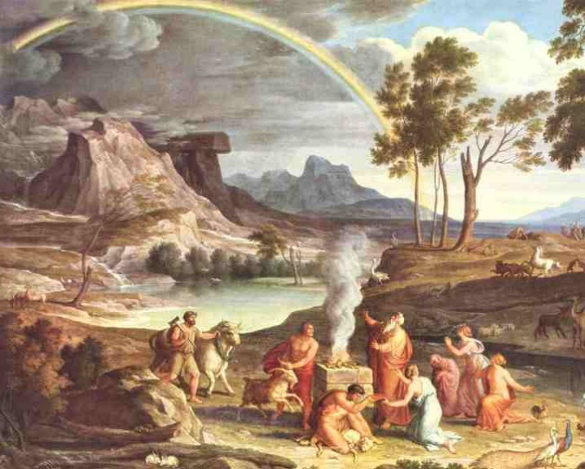
The Flood

God could have destroyed this world
He chose not to.
Instead, He washed creation clean and made a new start.
And God made a covenant with Creation:
He promised to sustain Creation forever.

Slide 8
The means God uses

God could have chosen to sustain all things in a miraculous way. However, that would make life unpredictable and unbearable for man.
Instead, God chose to rule creation by means of (what we call) laws and systems of nature.
Gravity, motion, seasons, the water cycle, biological reproduction, death, the jet stream, tides, movements of the earth’s crust, all these things are means God uses to keep Creation going.
Of course, God can always go beyond these means: God can do miracles!

Slide 9
Providence

For living beings, God’s sustaining includes that He provides for their food.
We speak of God’s providence.
Providence has the word “provide” in it.
God looks into the future to see our needs, and then ensures that those needs are provided for.
Pro vide
Forwards
Seeing

Slide 10
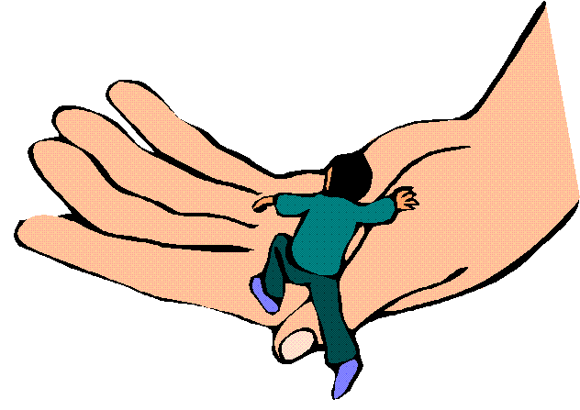
Sustainer & Provider
God is Creator: He made all things.
God is Sustainer & Provider:
He provides for all things to continue.

Slide 11

Bible Study: Psalm 104

Slide 12
Bible Study: Psalm 104
1. God is very great
2. Above
3. Water
4. The fourth (sun, moon, and stars)
5. Without God, no living being would survive. God provides for all.
6. He is Almighty.
7. Believer (godly) versus unbeliever (wicked)
8. Creation is to be filled with those who serve God, as God serves creation. The wicked don’t belong there.

Slide 13
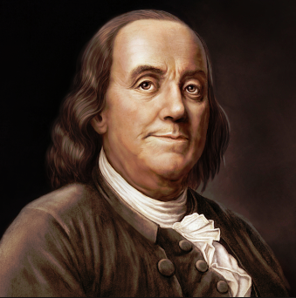
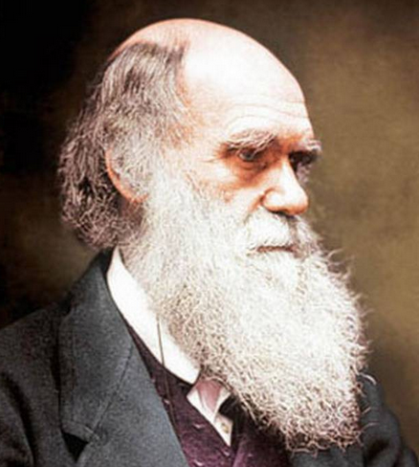
Deism
During the 1700’s man became increasingly more knowledgeable about his environment. The scientific method advanced understanding. This time period is usually referred to as “the Enlightenment”.
During the course of the enlightenment prominent people no longer saw God as the Provider. They argued, God is like a watch maker. He made the world, wound it up, and now it runs itself. This is known as Deism.

Slide 14
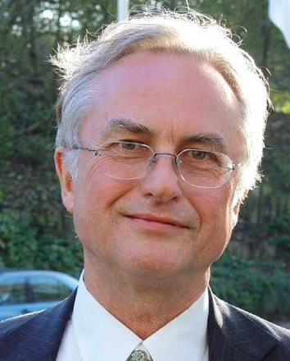
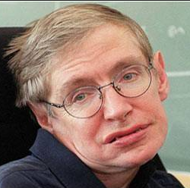
Atheism & Agnosticism
Over time, prominent people began to question the sense of creation by God. Discoveries suggested that our universe is not at all like that described in the Bible. Moreover, people did not like the idea of being accountable to Someone (i.e. God).
And so, in the course of time, deism led to atheism. Atheism is the belief that there is no god at all. Agnosticism is similar to atheism, it says that we cannot know whether there is a god.

Slide 15
Government

God is in complete control of all things that happen.
Nothing happens by chance.
God’s rule is detailed: He knows the number of hairs on your head!
God’s rule is comprehensive: it covers everything.
Are not two sparrows sold for a penny? Yet not one of them will fall to the ground apart from the will of your Father. And even the very hairs of your head are all numbered. Matthew 10:29-30
I am the LORD and there is no other. I bring prosperity and create disaster; I, the LORD, do all these things.
Isaiah 45:6b-7

Slide 16
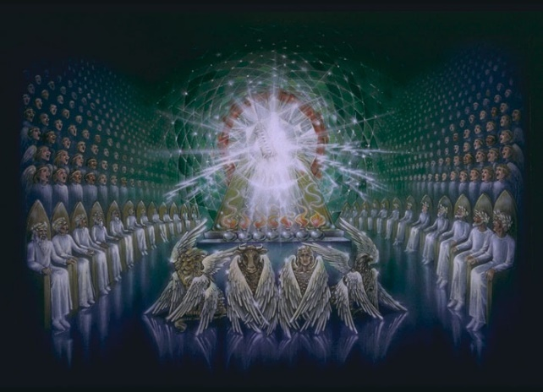
Our God

God is Creator: He made all things.
God is Sustainer & Provider:
He provides for all things to continue.
God is Governor:
He controls all things that happen.

Slide 17
This Almighty God is our Father!!!
God is Creator: He made all things.
God is Sustainer & Provider:
He provides for all things to continue.
God is Governor:
He controls all things that happen.

Slide 18

Footprints (3:25)

Slide 19
For the sake of Christ

God is a Father to all.
But God’s Fatherhood will only be for the good of those who respond to it with love and loyalty.
Those who don’t, experience His Fatherly anger.
No one is loving and loyal of themselves. Only because of Christ does this become possible.
It is through Christ alone that God can and will be our Father, caring for us forever.
The Almighty Creator, Sustainer, Provider, and Governor of all things is, for Christ’s sake, my God and my Father.

