Slide 1
Catechism Defending the Faith
Lesson 14b
Providence

Slide 2
Psalm 65:5
O God, you show the earth your favour,
the bounty of your hand,
for filled with water is your river,
enriching all the land.
You soften furrows with your showers
and bless the sprouting grain.
How great, O God, your love and power
throughout all your domain!

Slide 3
God and Adversity (evil)
And we know that for those who love God all things work together for good, for those who are called according to his purpose.
Romans 8:28
The LORD gave and the LORD has taken away
Job 1:21
I form light and create darkness,
I make well-being and create calamity
I am the LORD, who does all these things. Isaiah 45:7
Does disaster come to a city unless the LORD has done it?
Amos 3:6

Slide 4
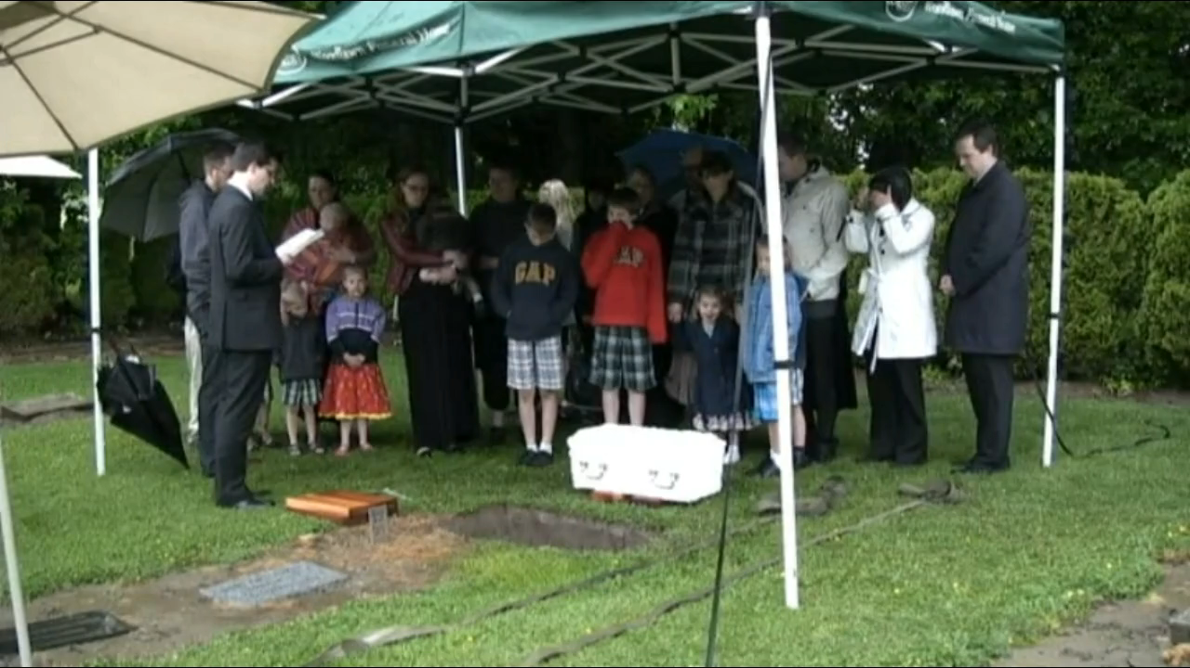
A grave – Reyanna Francina Janssen
Died and born, May 10, 2014.
Notes:
1:16

Slide 5
God and Adversity (evil)
All things (Rom 8:28) come from God’s fatherly hand
From God’s hand:
- God knows and plans everything, He is never caught by surprise
- God is Almighty, He can deal with everything
From Father’s hand:
- God loves me as His creature and His saved child
- all things ultimately work for my good (Rom 8:28)
Hence, I don’t have to be afraid – not ever!
When I am afraid, I will trust in You.
Psalm 56:3

Slide 6
Appreciating God’s Providence
Patient in adversity
- it’s very easy to distrust God when things are not ok.
- do not neglect to ask God for help
Thankful in prosperity
- it’s very easy to not need God when things are ok
- do not neglect to give God thanks
Why would the Catechism first mention adversity and then prosperity?

Slide 7
Asking “why?”
People who struggle with issues in their lives will have the urge to ask the ‘why’ question.
Job had that.
Job 3: Why was I born to see this misery?
Job 10: Why is God doing all this to me?
It is often thought that people are not allowed to ask the why question. After all, God is sovereign, He decides, His will be done (even if I don’t like it).

Slide 8
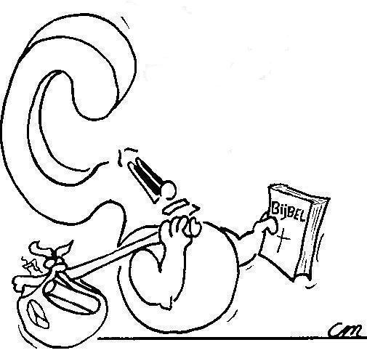
Asking “why?”
What do you think: are people allowed to ask the why question in prayer?
If yes, how should God respond?
If not, why not?

Slide 9

We won’t understand until…
Notes:
2:12

Slide 10
The why question
People feel the urge to ask the why question.
Even Jesus did: “Why have You forsaken Me?”
Some will say: we can ask the why question in the sense of “whereto”, not in the sense of “wherefore”.
Others will note: asking the why question is articulating your feelings, a way of processing emotions. Asking the question does not obligate God to responding.

Slide 11
The why question
Both responses have merit to them.
God does at times have bad things happen to us in order to tell us something. There’s the “whereto”.
God has no issues with Job asking what he did.
Job 42:7 Job had spoken rightly of God
But God did have issues with Job expecting a response.
Job 40:2: Job is not to contend with God
Job 42:6: Job repents of accusing God

Slide 12
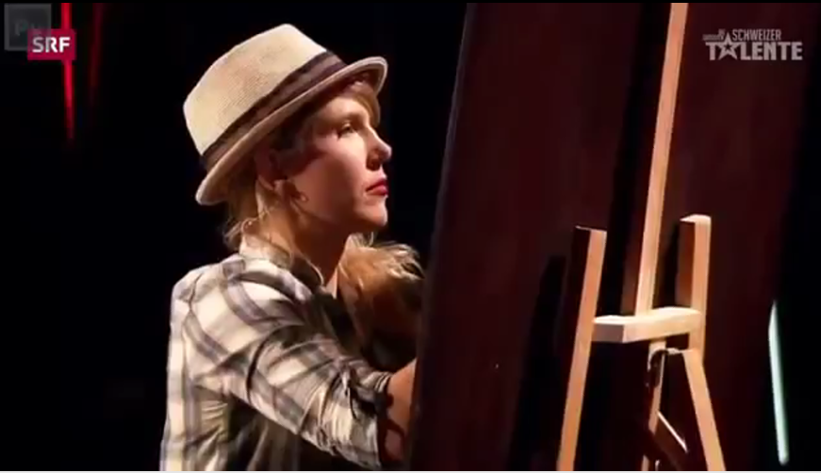
One day we’ll see why

