Slide 1
Catechism Defending the Faith
Lesson 15
Caring for Creation (the Environment)

Slide 2
Psalm 8:3,4,5
3.Lord, when my gaze upon the heavens lingers,
on moon and stars, the work of your own fingers,
O what is man that you should think of him,
the son of man that you should care for him?
4.You little lower than divine have made him
and so with glorious honour have arrayed him.
All things you gave to him as his domain,
that over your creation he might reign.
5.You have appointed him as lord and master
of bird and beast in forest, field, and pasture;
of all the fish and creatures of the sea.
O Lord, how great is your name’s majesty!

Slide 3
A hot issue
How we as humans interact with the environment is a hot issue.
- personal well-being
- climate change: true? who is responsible?
- depletion of resources
- non-renewable resources (oil, coal)
- habitat destruction (salmon)
- conservation or utilization?

Slide 4


Slide 5

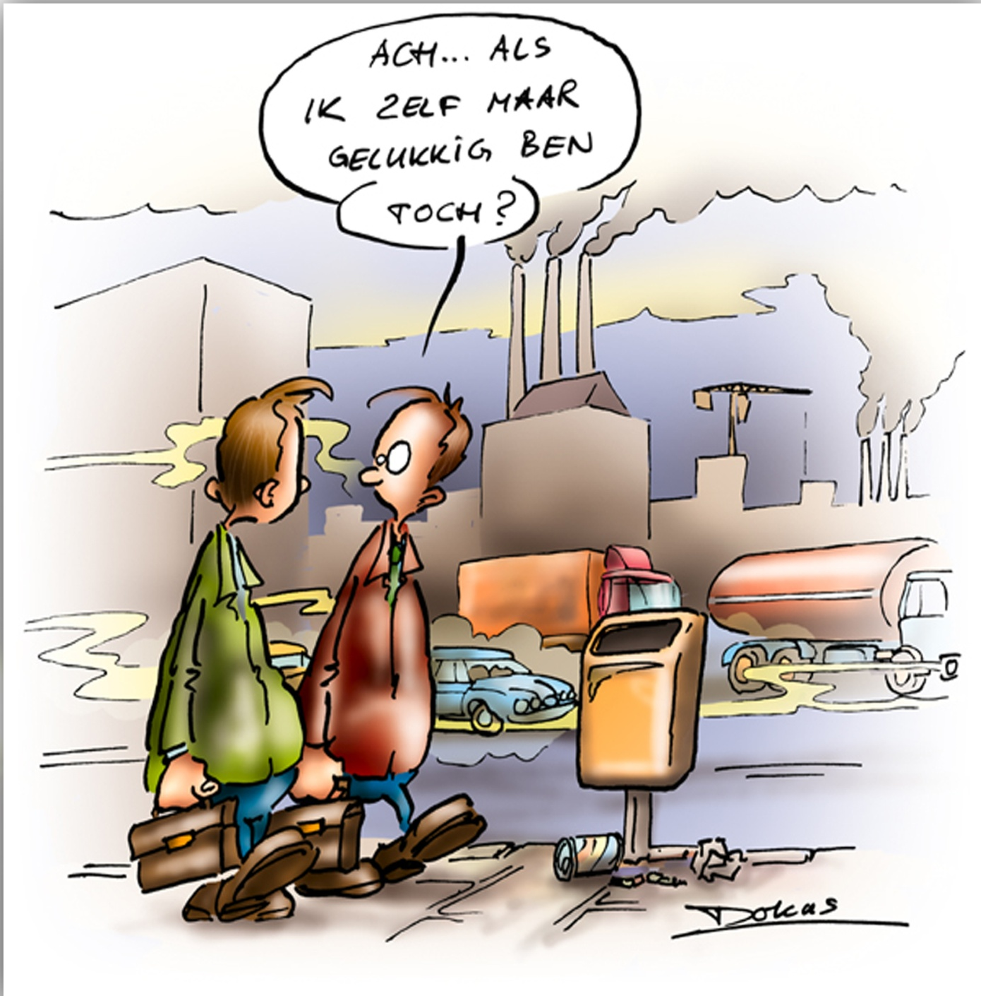
Agree?
As long as I’m happy.

Slide 6
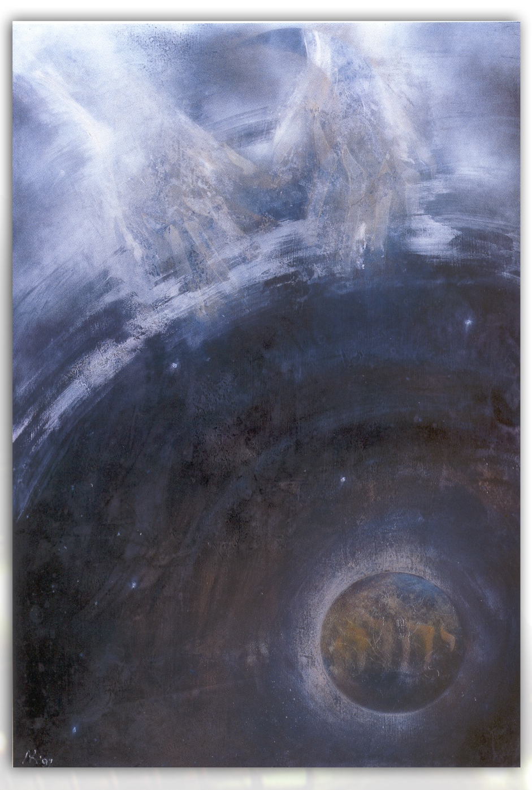
Environment
We read together Psalm 8 and Leviticus 25:1-7
And then we’ll discuss the questions.

Slide 7
Christians and the Environment
Humans were made in the image of God
Among others it means that man is to manage God’s creation in God’s Name.
Humanity is the steward of God’s Creation.
We need to treat Creation the way God treats Creation.
These all look to you
to give them their food at the proper time.
When you give it to them,
they gather it up;
when you open your hand,
they are satisfied with good things.
When you hide your face,
they are terrified;
when you take away their breath,
they die and return to the dust.
When you send your Spirit,
they are created, and
you renew the face of the earth.
From Psalm 104

Slide 8
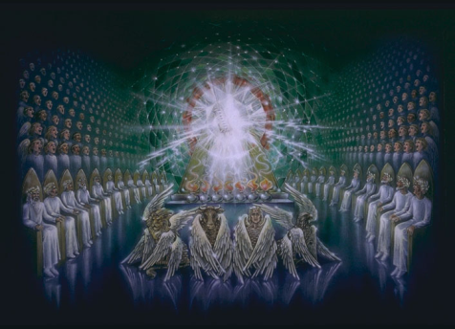
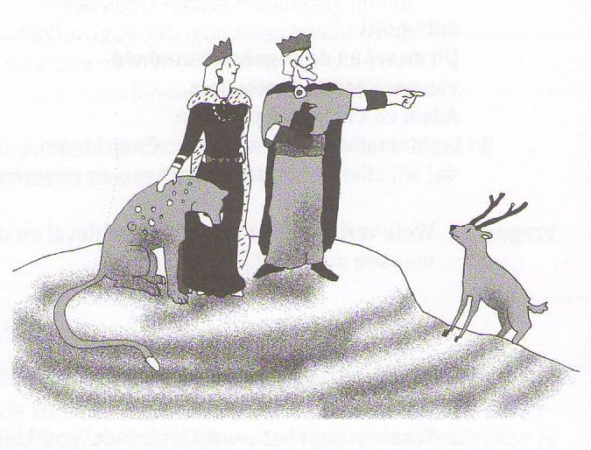
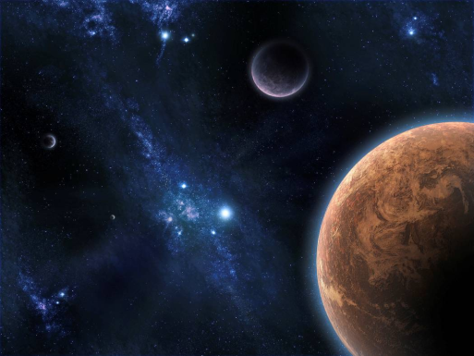
God’s image: Man’s position
God is king
(Ruler Supreme)
⇓
Man is vice-regent
(Ruler on behalf of God)
⇓
Creation is subject
(That which is ruled)

Slide 9
Stewards
As stewards humans are to
- preserve and regulate what God has made
- e.g. Provincial and National Parks
- use what God has made
- e.g. mining, lumber industry, agriculture
- develop what God has made
- e.g. industry, technology, research

Slide 10
Still valid
Genesis 1:28 is known as the cultural mandate.
Matthew 28:19-20 is known as the mission mandate.
Some Christians say: the mission mandate has replaced the cultural mandate.
However, the new creation is a renewed old creation.
The mission mandate has been added to the cultural mandate.
Regarding the New Jerusalem: The glory and honour of the nations will be brought into it.
Revelation 21:26

Slide 11

The environmental movement
Did you known that Greenpeace began in British Columbia?
The environmental movement tends to be composed of naturalists (pantheists) and conservationists.
As Christians we will have issues with
- their extremism
- conservation at the expense of utilization
But not all they stand for is bad.

Slide 12
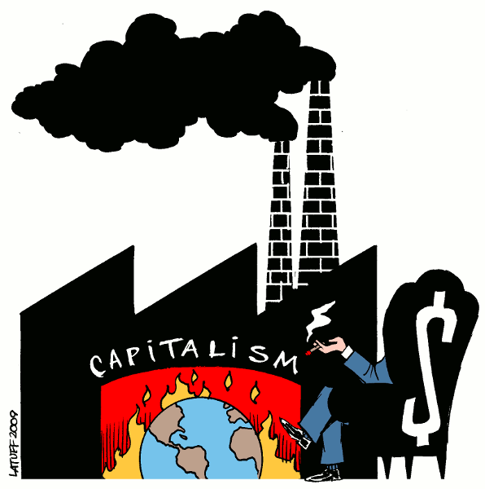
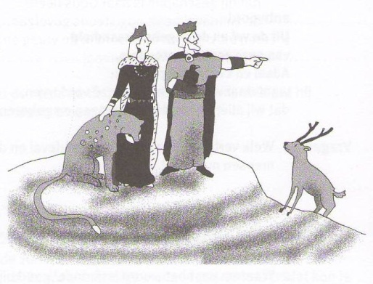
Three views of creation
Capitalism and industrialism
Creation exists for man
Man is king: exploitation
Environmentalism
Creation exists for itself
Man is a part: conservation
Christianity
Creation exists for the glory of God
Man is vice-regent: utilization

Slide 13

When to ban
In 1997, while completing a science fair presentation, 14-year-old Nathan Zohner devised a way to test for bad environmen- talists. The first part of his presentation was on the dangers of dihydrogen monoxide. This chemical is a major component of acid rain, can cause severe burns in its gaseous form, and is often lethal when accidentally inhaled. After explaining these risks, Nathan surveyed 50 listeners and asked who would support a ban of this hazardous chemical.
Ban: 43 Unsure: 6 Do not ban: 1
Dihydrogen monoxide is H₂O – water!

Slide 14
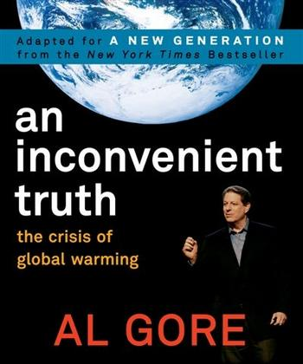
Whom do you trust?
Scientists dispute and debate what is happening today, and especially, who caused it.
Exercise caution when it comes to using data that extrapolate.
But we should not be blind either.
Climate change is a natural phenomenon and humans do influence it.
Note: Al Gore’s predictions
(like no Arctic sea ice today)
have not proven true.

Slide 15


What can I do?
Be informed: www.reformedperspective.ca
Energy consumption: fuel, electricity, go/buy local
Commodity consumption: clothing & gadgets for endurance (how new is your cell phone)
Paper consumption: flyers, printing
Waste management: sort your garbage
Well-being: pay more for food (free range eggs)

