Slide 1
Catechism
The Substance of Faith
Lesson 19 – LD 13
God’s Son and Our Lord

Slide 2
Hymn 3:3,4
O Christ, our glorious King, the victory you have won.
You, Lord, are God the Father’s everlasting Son.
Yet you did not despise the Virgin’s womb, O Saviour,
when you came from on high to free mankind forever.
You then defeated death and Satan’s power infernal;
you opened up the way that leads to life eternal.

Slide 3
Hymn 3:3,4
You are enthroned in glory at God’s own right hand,
till you from there as judge will on the clouds descend.
O Lord, we therefore pray, grant help and vindication
to those who thru your precious blood have gained salvation.
In everlasting glory add them to the number
of all your saints, O Lord. Your heritage remember!

Slide 4

The Trinity
Our Triune God is one in essence, consisting in three Persons. This is something we cannot comprehend.
With respect to the Trinity there are two aspects:
- Being, essence. All three Persons are equal.
- Work, activity. There is an order.

Slide 5
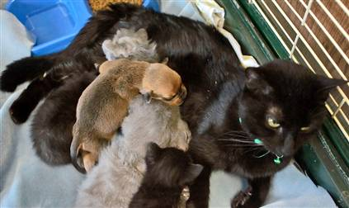
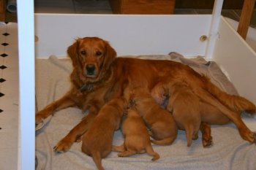
God’s only-begotten Son

For God so loved the world that He gave His only Son,[a] that whoever believes in Him shall not perish but have eternal life.
[a] Or his only begotten Son
John 3:16
Only-begotten: Jesus is the only one to share in the being of the Father.
Cats have kittens
Dogs have puppies.
Jesus alone is God’s natural son.

Slide 6

Bible Study: John 1:1-3, 14
1. The Word was in the beginning
2. The Word was with God:
separate from God
3. The Word was God:
same as God.
4. The Father and the Son
5. All things were made through Him
6. He Himself has not been made
7. He became flesh
8. He existed already before He became flesh.

Slide 7
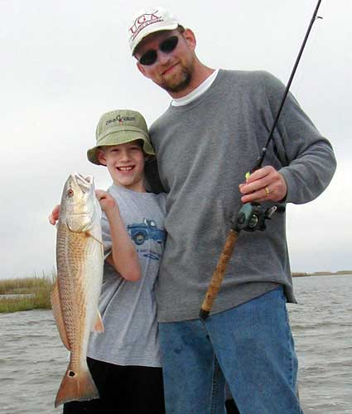

God’s children

Jesus is the natural Son of God:
He is divine like the Father, He is God.
We are children of God by adoption:
we are not divine, but are called to be like God

Slide 8
Catechism
33. Q. Why is He called God’s only-begotten Son, since we also are children of God?
A. Because Christ alone
is the eternal, natural Son of God.
We, however, are children of God by adoption,
through grace, for Christ’s sake.

Slide 9
Lord

The word ‘lord’ describes anyone who has authority over another person.
In the Bible, lords were:
- people who owned slaves
- kings who ruled peoples
- parents in relation to their children
- husbands in relation to their wives
Lords could abuse their power or be of good will.

Slide 10
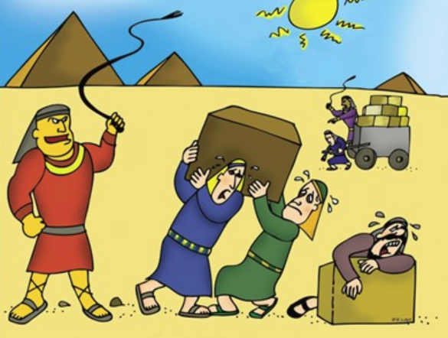
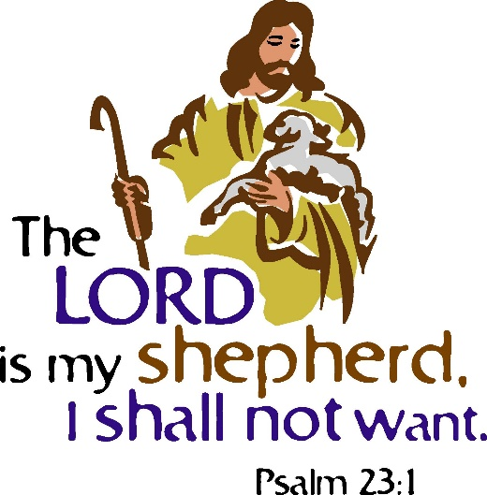
Discussion
Is having a lord a good thing or a bad thing?

Slide 11
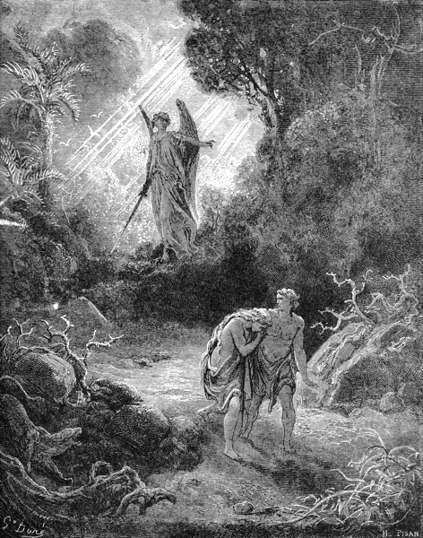
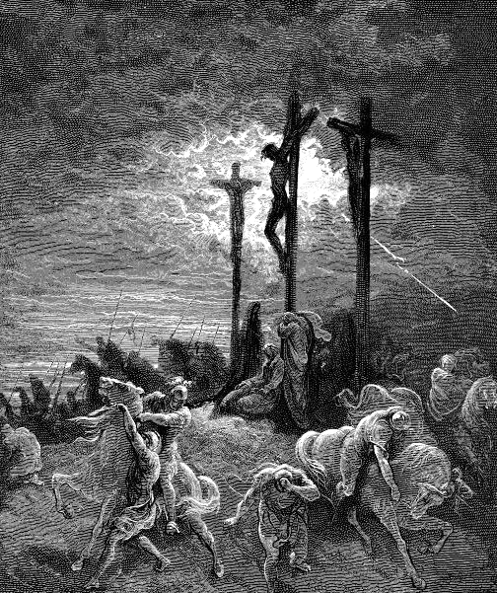
Two lords

Basically this world knows two lords:
(1) God and His Christ & (2) Satan
Satan is an evil lord, demanding the lives of people for his own ends, not caring what happens to them.
Christ is a good lord, even giving His life for God’s people while they were God’s enemies.

Slide 12
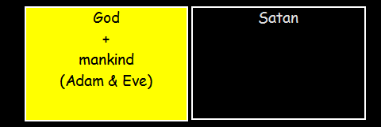
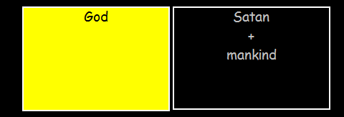
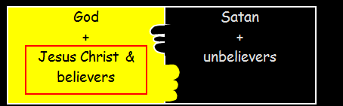
Before the Plunge
Right after the Plunge
After the promise and the Cross

Slide 13

From one lord to the other

To go from being slave to being free, a price has to be paid.
Slaves could earn their freedom.
We cannot pay the price for freedom:
- we sin daily, increasing our debt
- the price is eternal death
Christ paid with His blood on a day
we now call Good Friday.

Slide 14
Catechism
34. Q. Why do you call Him our Lord?
A. Because He has ransomed us,
body and soul,
from all our sins,
not with silver or gold
but with His precious blood,
and has freed us
from all the power of the devil
to make us His own possession.
Our debt has been paid
We have a new lord

Slide 15
Belonging is doing
Belonging to a lord means wanting to do what he wants.
To belong to Satan means: wanting to be self-centred, to sin.
To belong to Christ means: wanting to be other-centred, to be loving and loyal.
To have Jesus as Lord is to obey God’s will.
Not everyone who says to me, ‘Lord, Lord,’ will enter the kingdom of heaven, but the one who does the will of my Father who is in heaven.
Matthew 7:21

Slide 16

Notes:
From “Two Ways To Live” (part of the Catechism course in Year 6). 3:17. (Only do if it’s before 7:47pm)

Slide 17
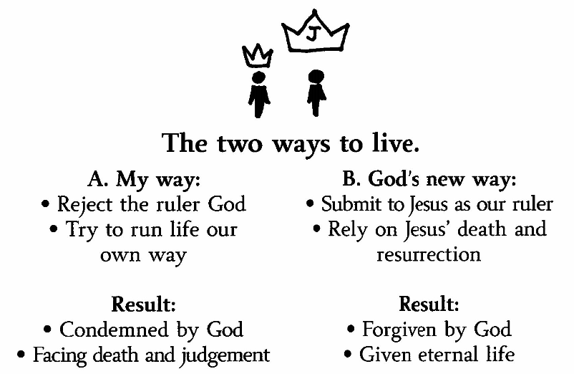

Slide 18
Belonging is doing

Satan as lord
People live self-centred lives.
They continually sin.
People owe God their lives and will be punished for their rebellion: eternal death is their lot.
Christ as lord
People live other-centred lives.
They avoid sin.
We no longer owe God our lives, as Christ has paid the debt for us: eternal life is our lot.

