Slide 1
Catechism The Contents of Faith
Lesson 21
…He Suffered, Was Crucified…

Slide 2
Hymn 25:1,3
Who has believed our message from on high
that God’s own Son, who laid his glories by,
came down from heav’n to suffer and to die
for our transgression?
Who saw revealed in him God’s pow’r and favour –
the mighty arm of him who sent our Saviour,
that we, his people, might be free forever
from sin and shame?

Slide 3
Hymn 25:1,3
Our suff’rings and infirmities he bore;
our sorrows he was willing to endure,
while we thought he was being punished for
his own wrongdoing.
But he was pierced because of our transgression,
bruised for our sin: his punishments and passion
procured our peace; his scourgings and oppression
healed us again.

Slide 4
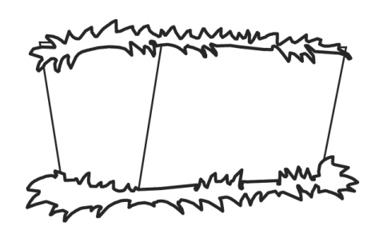
Humiliation - Exaltation
Divine glory
Incarnation
Suffering

Slide 5
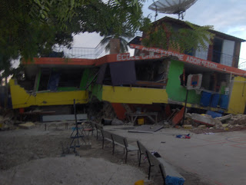
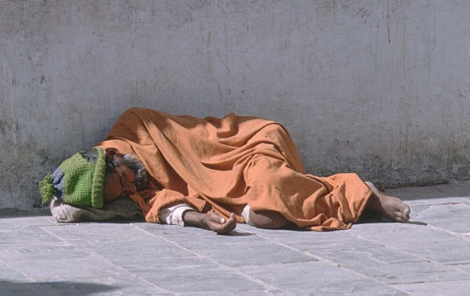
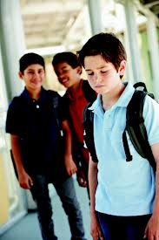
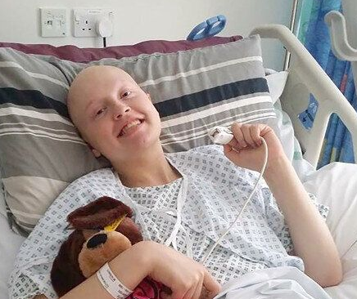
Terrible suffering

Many people suffer terrible things
Jesus suffered similar things.
Yet: there is a dimension to His suffering that makes it unique
For we do not have a high priest who is unable to sympathize with our weaknesses, but one in every respect has been tempted as we are—yet without sin. Hebrews 4:15

Slide 6

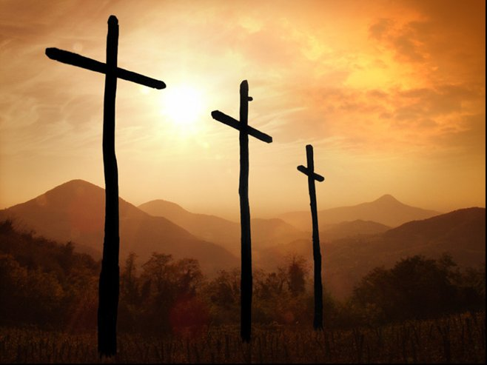
Bible Study: Isaiah 52:13-53:12

Slide 7
Bible Study: Isaiah 52:13-53:12
1. Positive
2. the suffering of the Servant of the LORD
3. He suffered what we deserved to suffer
4. For the transgression of the people
5. The LORD Himself
6. He will account many righteous
7. God will honour Him with royal glory
Note: regarding verse 12: to bear sin = to forgive

Slide 8
The Servant of the LORD

Isaiah 52:13-53:12 is about Jesus Christ
Luke 22:37: Jesus said so Himself
Acts 8:34,35: It was taught thus in the Church
The word “servant” here is a title for someone serving the king.
The word “minister” is actually the Latin word for a servant
A government minister = servant of the queen
A church minister = servant of the Christ
Jesus was a ruler whose rule began with suffering.

Slide 9
Jesus suffered all His life
Son of God becomes a human
The people are impressed but don’t believe
Denied by Peter
Ridiculed
Born in a stable
Betrayed by Judas
Birth
Ministry
Death
Opposition from the Pharisees
Crucified
Forsaken by His God
Sentenced by the high priest
Threatened with death; flees to Egypt
Unfairly condemned by Pilate

Slide 10
Catechism
37. Q. What do you confess when you say that He suffered?
A. During all the time He lived on earth, but especially at the end, Christ bore in body and soul the wrath of God against the sin of the whole human race.
Thus, by His suffering, as the only atoning sacrifice, He has redeemed our body and soul from everlasting damnation, and obtained for us the grace of God, righteousness, and eternal life.

Slide 11
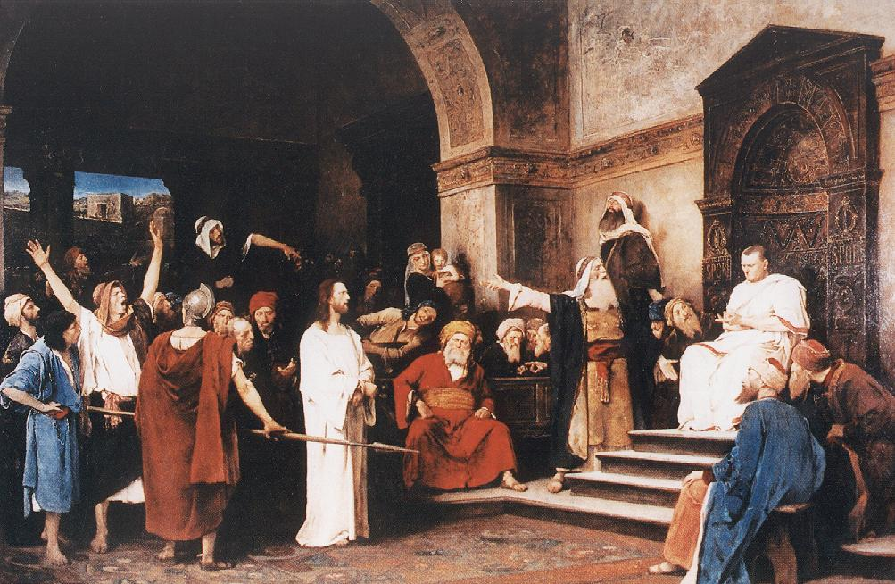
Under Pontius Pilate

The name Pontius Pilate dates the crucifixion as an historic event.
The condemnation by the high priest (Church) and Pilate (State) is symbolic for the condemnation by the Judge over everything, the LORD God.

Slide 12
It was the will of the LORD
the LORD has laid on him the iniquity of us all. Isaiah 53:6
Yet it was the will of the LORD to crush him and cause him to suffer Isaiah 53:10
And going a little farther he fell on his face and prayed, saying, “My Father, if it be possible, let this cup pass from me; nevertheless, not as I will, but as you will.” Matthew 26:39
(Peter to the Jews) this Jesus, delivered up according to the definite plan and foreknowledge of God, Acts 2:23

Slide 13
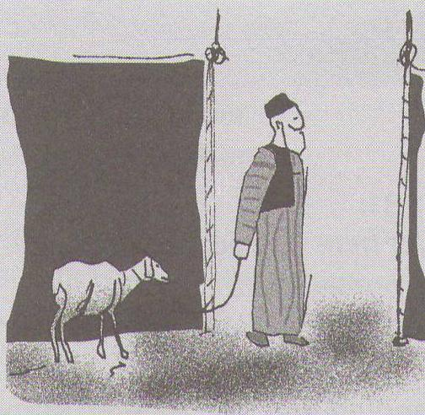
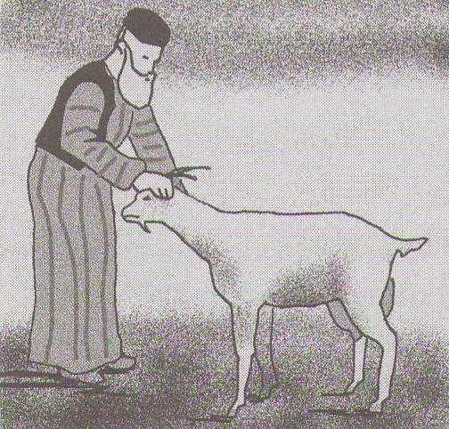
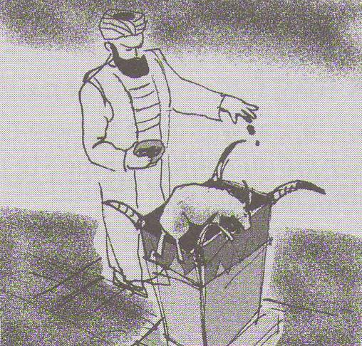
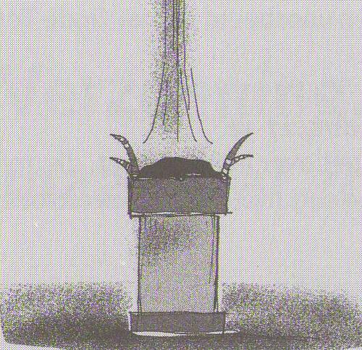
Why?

The Lord Jesus suffered for our sins.
He suffered in our place.
We should have been hanging on the cross.
This is called: substitutionary atonement.

Slide 14
Why?

The Lord Jesus suffered for our sins.
He suffered in our place.
We should have been hanging on the cross.
This is called: substitutionary atonement.

Slide 15
Why?

Thus the Lord Jesus brings us peace and healing.
Peace with God: no punishment for sin
Forgiveness, justification
Healing: the removal of sin from our lives
Renewal, sanctification

Slide 16
Catechism
39. Q. Does it have a special meaning that Christ was crucified and did not die in a different way?
A. Yes.
Thereby I am assured
that He took upon Himself the curse which lay on me,
for a crucified one was cursed by God.

Slide 17

Crucifixion
Those hung on a tree to die are cursed.
Earth does not want them, heaven does not want them. They are forsaken.
Heaven
Earth

Slide 18
Terrible suffering
Many people suffer terrible things
- Life-altering illnesses
- Abuse and violence
- Natural disasters
- Poverty
Jesus suffered similar things.
Yet: there is a dimension to His suffering that makes it unique
For we do not have a high priest who is unable to sympathize with our weaknesses, but we have one who has been tempted in every way, just as we are—yet was without sin. Hebrews 4:15

Slide 19
Terrible suffering
Many people suffer terrible things
- Life-altering illnesses
- Abuse and violence
- Natural disasters
- Poverty
Jesus suffered similar things.
Yet: there is a dimension to His suffering that makes it unique
For we do not have a high priest who is unable to sympathize with our weaknesses, but we have one who has been tempted in every way, just as we are—yet was without sin. Hebrews 4:15

Slide 20
Unique Suffering

1. The Son of God was forsaken by God the Father.
2. The Lord Jesus suffered what He in no way deserved.
3. The suffering of the Lord Jesus is sufficient to pay for all sins ever committed.

