Slide 1
Catechism The Substance of Faith
Lesson 22 – LD 16
He Died, was Buried, Descended into Hell

Slide 2
Psalm 22:1 & 6
My God, O why have you forsaken me?
When I to you, O God, for refuge flee,
why do you grant no help and fail to see
my tribulation?
I groan by day, but you are far from heeding
the mournful cries that I have been repeating;
by night also you do not hear my pleading.
I find no rest.

Slide 3
Psalm 22:1 & 6
Dried like a potsherd, all my strength is gone;
my tongue sticks to my palate as I moan,
and in the dust of death you lay me down.
Dogs here surround me.
I’m skin and bones, and gloating foes are staring;
they’ve pierced my hands and feet, no cruelty sparing,
and they divide the garments I was wearing
by casting lots.

Slide 4
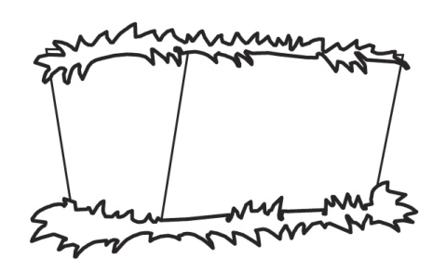

Humiliation - Exaltation
Divine glory
Incarnation
Suffering
Died

Slide 5
What is death? (1)

Humans became subject to death after their Plunge into Sin.
God’s judgment determines that sin gets us death.
Dust you are and to dust you will return.
Genesis 3:19b
The wages of sin is death.
Romans 6:23a

Slide 6
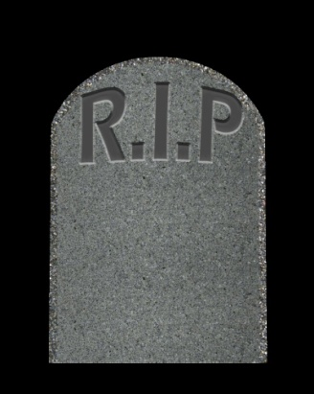

What is death? (2)

Death has two sides to it:
Physical: stop breathing, become dust
Spiritual: separated from God, do evil
Death can be:
Temporary: body in the grave, soul with Christ
Eternal: forever dying in body and soul
The Lord Jesus died both.

Slide 7

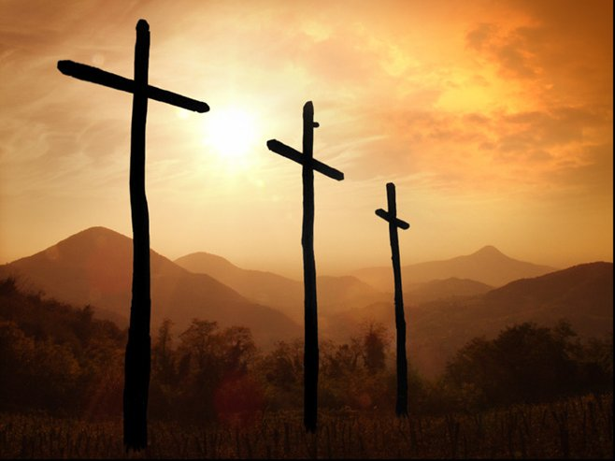
Bible Study: John 19:28-42

Slide 8

Bible Study: John 19:28-42
1. So that everybody would realize He was indeed the promised Saviour
2. “It is finished”
3. That he was already dead.
4. The spear thrust caused blood and water to flow.
5. The Apostle John
6. That his readers might believe
7. Joseph of Arimathea and Nicodemus

Slide 9
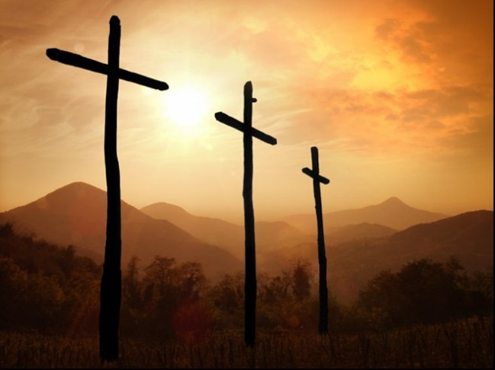
Bible Study: John 19:28-42
8. 75 pounds
Clearly they thought Jesus dead. And if He wasn’t , the amount of ointment would have suffocated Him.
9. No contact with a dead body was allowed on the Sabbath (and a day ended at sunset).
Note: “Preparation Day” was a common name for the day we call “Friday”

Slide 10
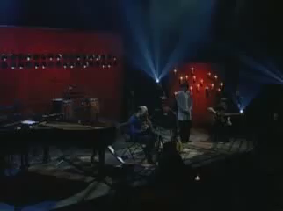
Why?
Notes:
2:54

Slide 11
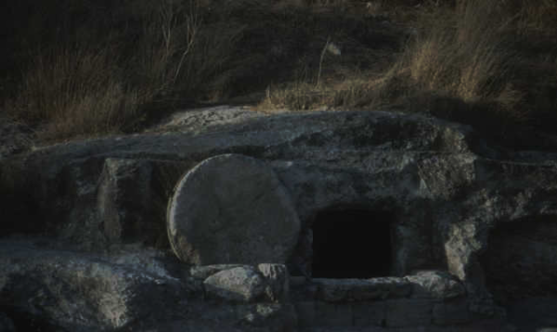
Dead and buried

Christ died, the blood and water coming out of His side proved it.
Christ was buried as proof that He had indeed died.
Christ had begun returning to the dust.

Slide 12
Descended into Hell

The article “descended into Hell” is understood in 2 ways
It could be a reference to
1. being in the realm of the dead (see Hymn 2)
2. being increasingly and totally forsaken by God (see Catechism)
If (1), the articles of the Apostles’ Creed are in chronological order.
If (2), this article is a summary statement of the suffering of Christ.

Slide 13
Catechism
44. Q. Why is there added: He descended into hell?
A. In my greatest sorrows and temptations
I may be assured and comforted
that my Lord Jesus Christ,
by His unspeakable anguish, pain, terror, and agony,
which He endured throughout all His sufferings
but especially on the cross,
has delivered me from the anguish and torment of hell.

Slide 14
Benefit

Christ’s death does three things for us:
1) It is the payment for our sin
- this implies God will not condemn us
- relates to “justification” (forgiveness)
2) It is the liberation from the power of sin
- this implies we can do good again
- relates to “sanctification” (good works)
3) It is the liberation from hell
- this implies we can dwell with God
- relates to “glorification” (perfect everlasting bliss)

