Slide 1
Catechism The Substance of Faith
Lesson 20 – LD 14
…Conceived and Born…

Slide 2
Hymn 20:1 & 2
A great and mighty wonder
upon the earth was done
when Mary, virgin mother,
gave birth to God’s own Son.
Repeat the song again:
“To God on high the glory,
and peace on earth to men!”

Slide 3
Hymn 20:1 & 2
The Word became incarnate –
made flesh, yet very God.
The angels hailed his coming
with songs o’er fields abroad.
Repeat the song again:
“To God on high the glory,
and peace on earth to men!”

Slide 4
Miraculous start to life

Jesus has always been: for He is God.
Then came the moment when Eternity stepped into time.
The eternal Son of God also became a time-bound human being.
This happened in a miraculous way:
- Jesus was not begotten by a human father, but conception came through the Holy Spirit
- Roughly nine months later Jesus was born from a virgin.

Slide 5

Humiliation - Exaltation
Divine glory
Incarnation

Slide 6

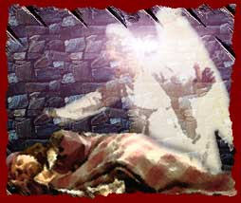
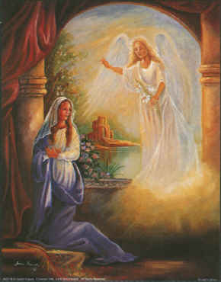
Bible Study:

Slide 7
Bible Study:
1. The angel Gabriel
2. To indicate that something very special will be happening.
3. The Son of the Most High
4. The throne of His father David
5. He will be king forever
6. The Holy Spirit will come upon you
7. Know each other (= have sex).
8. It is clear that Joseph is not the biological father of Jesus.
9. God; Mary

Slide 8
Joseph

Joseph was heir to the throne of David.
Joseph was not the biological father of Jesus.
For Jesus to become heir to the throne of David, He would have to become the acknowledged first-born son of Joseph.
By naming Jesus, Joseph adopts Jesus as his first-born son.
Hence Jesus is also the legal son of David.

Slide 9
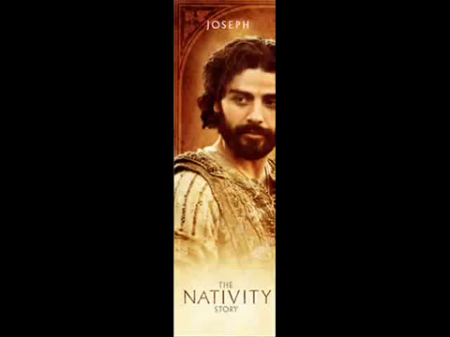
How can a man be father to the Son of God?

Slide 10
True God

When Jesus became a human being, He did not stop being God.
Proof that Jesus was God while on earth:
Matthew 7:29: He spoke with divine authority
Matthew 8:23-27: He controls creation
Mark 2:5-7: He forgave sins
John 8:58: He called Himself “I AM”
In fact, He was put to death for claiming to be God, and Jesus did not dispute this.

Slide 11
A human being like any of us

People have fantasized about the childhood of Jesus. But the Bible suggests Jesus growing up was not a huge sensation.
One day Jesus preaches in Nazareth, his hometown.
“Where did this man get this wisdom and these mighty works? Is not this the carpenter's son? Is not his mother called Mary? And are not his brothers James and Joseph and Simon and Judas? And are not all his sisters with us? Where then did this man get all these things?” And they took offense at him.
Matthew 13:54b-57a

Slide 12
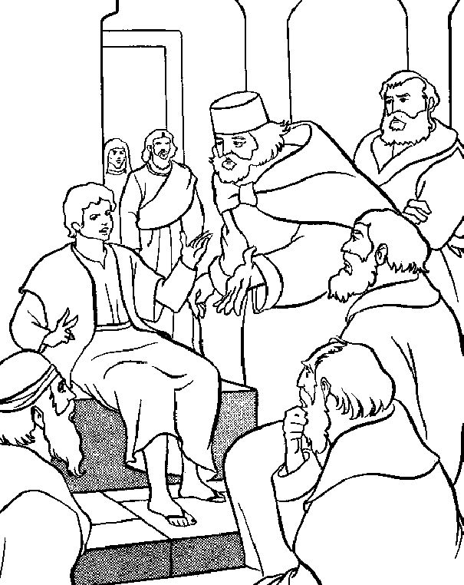
A human being like any of us
Yet, Jesus was special in some ways.
- He was without sin (Hebrews 4:15)
- He was smart (Luke 2:47)

Slide 13
A human being like any of us

But in every other respect, He was just like us.
John 19:28: Jesus could get thirsty
John 11:35: Jesus could be sad
Matthew 8:24: Jesus could be tired
Mark 11:12: Jesus could be hungry
Matthew 26:37 Jesus could be scared

Slide 14
Catechism
35. Q. What do you confess when you say: He was conceived by the Holy Spirit, born of the virgin Mary?
A. The eternal Son of God,
who is and remains true and eternal God,
took upon Himself true human nature
from the flesh and blood of the virgin Mary,
through the working of the Holy Spirit.
Thus He is also the true seed of David,
and like His brothers in every respect,
yet without sin.

Slide 15
The reason for the incarnation

In-carn-ation = to become flesh
carnal = of the flesh
carnivore = flesh eating
carnage = corpses everywhere
The Son of God became a human being for the sake of our salvation.
Man sinned, therefore man had to pay for sin and defeat evil.

Slide 16
Catechism
36. Q. What benefit do you receive from the holy conception and birth of Christ?
A. He is our Mediator,
and with His innocence and perfect holiness
covers, in the sight of God,
my sin, in which I was conceived and born.

Slide 17
Why in a special way?
1) The incarnation proves that Jesus is indeed God Himself.
2) As Jesus did not descend from human parents, He was born without original sin (a sinful nature).
- Thus Jesus is acceptable to God.
- Thus Jesus is able to take our sins upon Himself and pay for our sins.

