Slide 1
Catechism
The Contents of Faith
Lesson 21
…He Suffered, Was Crucified…

Slide 2
Hymn 25:1,3
Who has believed our message from on high
that God’s own Son, who laid his glories by,
came down from heav’n to suffer and to die
for our transgression?
Who saw revealed in him God’s pow’r and favour –
the mighty arm of him who sent our Saviour,
that we, his people, might be free forever
from sin and shame?

Slide 3
Hymn 25:1,3
Our suff’rings and infirmities he bore;
our sorrows he was willing to endure,
while we thought he was being punished for
his own wrongdoing.
But he was pierced because of our transgression,
bruised for our sin: his punishments and passion
procured our peace; his scourgings and oppression
healed us again.

Slide 4
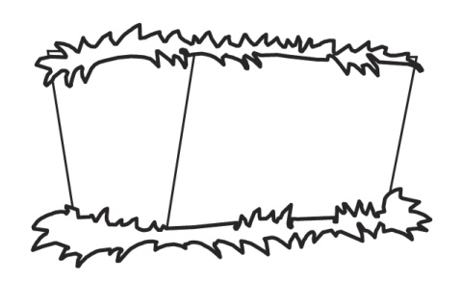
Humiliation - Exaltation
Divine
glory
Incarnation
Suffering

Slide 5
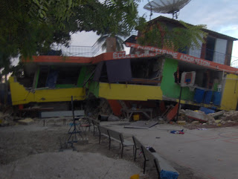
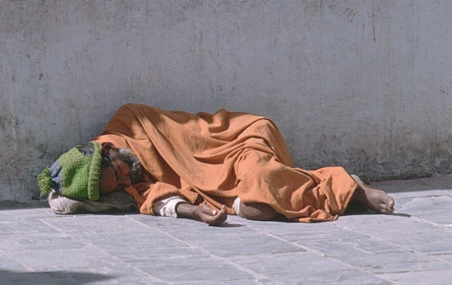
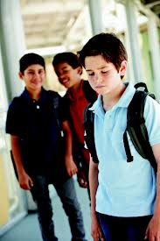

Terrible suffering

Many people suffer terrible things
Jesus suffered similar things.
Yet: there is a dimension to His suffering that makes it unique
For we do not have a high priest who is unable to sympathize with our weaknesses, but one in every respect has been tempted as we are—yet without sin. Hebrews 4:15

Slide 6

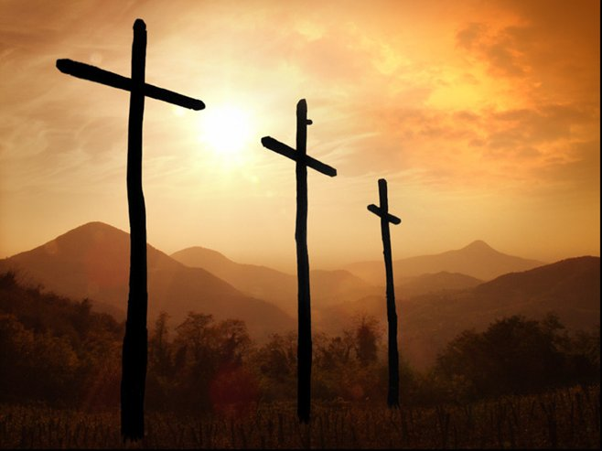
Bible Study: Isaiah 52:13-53:12

Slide 7
Bible Study: Isaiah 52:13-53:12
1. Positive
2. the suffering of the Servant of the LORD
3. He suffered what we deserved to suffer
4. For the transgression of the people
5. The LORD Himself
6. He will account many righteous
7. God will honour Him with royal glory
Note: regarding verse 12: to bear sin = to forgive

Slide 8
The Servant of the LORD

Isaiah 52:13-53:12 is about Jesus Christ
Luke 22:37: Jesus said so Himself
Acts 8:34,35: It was taught thus in the Church
The word “servant” here is a title for someone serving the king.
The word “minister” is actually the Latin word
for a servant
A government minister = servant of the monarch
A church minister = servant of the Christ
Jesus was a ruler whose rule began with suffering.

Slide 9
Jesus suffered all His life
Son of God becomes a human
The people are impressed but don’t believe
Denied by Peter
Ridiculed
Born in a stable
Betrayed by Judas
Birth
Ministry
Death
Opposition from the Pharisees
Crucified
Forsaken by His God
Sentenced by the high priest
Threatened with death; flees to Egypt
Unfairly condemned by Pilate

Slide 10
Catechism
37. Q. What do you confess when you say that He suffered?
A. During all the time He lived on earth, but especially at the end, Christ bore in body and soul the wrath of God against the sin of the whole human race.
Thus, by His suffering, as the only atoning sacrifice, He has redeemed our body and soul from everlasting damnation, and obtained for us the grace of God, righteousness, and eternal life.

Slide 11
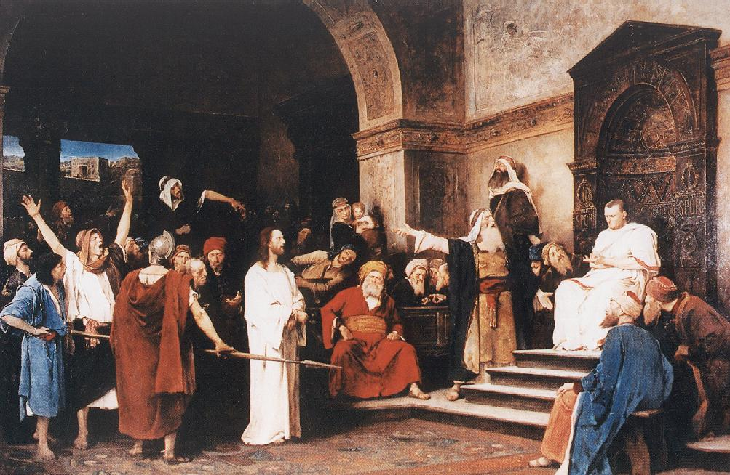
Under Pontius Pilate

The name Pontius
Pilate dates the
crucifixion as an
historic event.
The condemnation by the high priest (Church) and Pilate (State) is symbolic for the condemnation by the Judge over everything, the LORD God.

Slide 12
Catechism
38. Q. Why did He suffer under Pontius Pilate as judge?
A. Though innocent,
Christ was condemned by an earthly judge,
and so He freed us
from the severe judgment of God
that was to fall on us.

Slide 13
It was the will of the LORD
the LORD has laid on him the iniquity of us all. Isaiah 53:6
Yet it was the will of the LORD to crush him and cause him to suffer Isaiah 53:10
And going a little farther he fell on his face and prayed, saying, “My Father, if it be possible, let this cup pass from me; nevertheless, not as I will, but as you will.” Matthew 26:39
(Peter to the Jews) this Jesus, delivered up according to the definite plan and foreknowledge of God, Acts 2:23

Slide 14
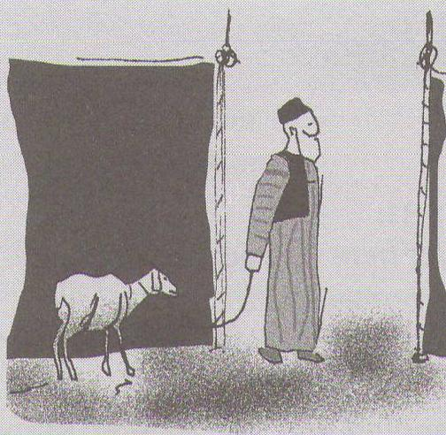
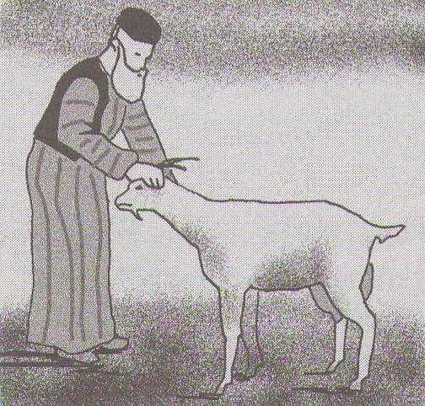
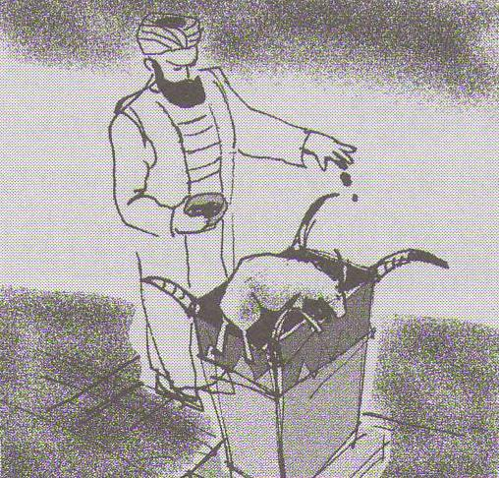
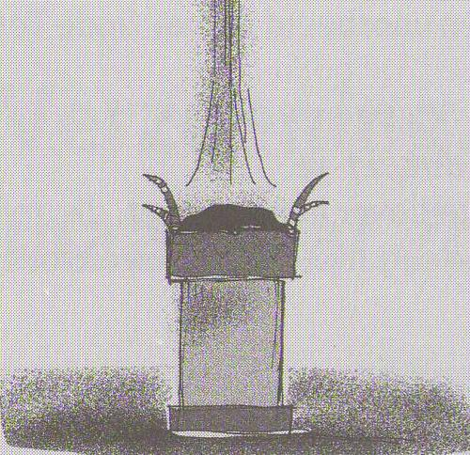
Why?

The Lord Jesus suffered for our sins.
He suffered in our place.
We should have been hanging on the cross.
This is called: substitutionary atonement.
Aka: vicarious satisfaction

Slide 15
Why?

The Lord Jesus suffered for our sins.
He suffered in our place.
We should have been hanging on the cross.
This is called: substitutionary atonement.
Aka: vicarious satisfaction

Slide 16
Why?

Thus the Lord Jesus brings us peace and healing.
Peace with God: no punishment for sin
Forgiveness, justification
Healing: the removal of sin from our lives
Renewal, sanctification

Slide 17

Crucifixion
Those hung on a tree to die are cursed.
Earth does not want them, heaven does not want them. They are forsaken.
Heaven
Earth

Slide 18
Catechism
39. Q. Does it have a special meaning that Christ was crucified and did not die in a different way?
A. Yes.
Thereby I am assured
that He took upon Himself the curse which lay
on me,
for a crucified one was cursed by God.

Slide 19
Atonement challenged
Some churches allow ministers to not teach substitutionary atonement
  Some don’t want to, usually because it is considered beneath human dignity that someone else should pay for my wrongs
Such ministers then teach that Jesus is the prime example of faith and dedication
  Usually this is combined with the conviction that Jesus is only a human being, and not God.
However, Scripture clearly teaches that Jesus’ death is a payment for sin.
For even the son of Man came not be served but to serve, and to give his life as a ransom for many Mark 10:28

