Slide 1
Catechism The Workshop of Faith
Lesson 17
The Church: Ministries

Slide 2
Hymn 52:1
The church’s one foundation
is Jesus Christ her Lord;
she is his new creation
by water and the Word.
From heav’n he came and sought her
to be his holy bride;
with his own blood he bought her
and for her life he died.

Slide 3
Aspects to the Church
With respect to the Church we distinguish these aspects:
The attributes of the Church
Attributes describe what the church is
The ministries of the Church
Ministries describe what the church does
The marks of the Church
Marks describe whether the church measures up to the standard.

Slide 4
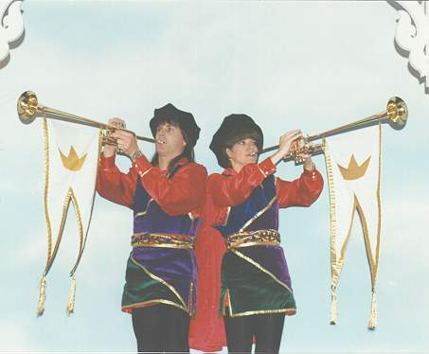

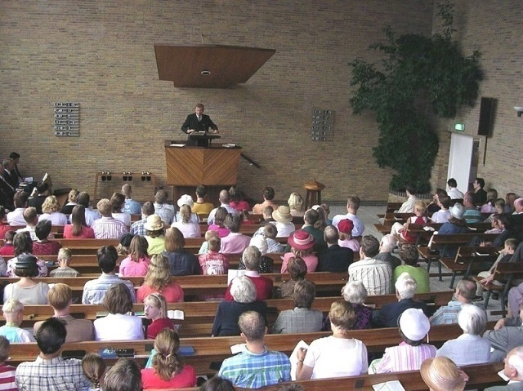

What the church does

Slide 5
The 4 ministries of the Church
The 4 ministries are not listed in a confessional statement. Commonly the following 4 are named by their Greek names.
Kerygma: proclaim, herald The church preaches the Gospel message
Koinonia: fellowship, communion The church cares for God’s people.
Leitourgia: worship The church serves God communally with praise
Diakonia: service The church serves creation with help

Slide 6
Kerygma - Proclaim
Christ gave His church the command to spread the Gospel of His love.
The Church must thus always be into outreach
This is the work of teaching and outreach.
E.g. Catechism classes, Burnaby Reading Room, Mission in Brazil
Go therefore and make disciples of all nations, baptizing them in the name of the Father and of the Son and of the Holy Spirit, teaching them to observe all that I have commanded you.
Matthew 28:19-20a

Slide 7
Koinonia - Fellowship
Christ loved His own people and sought them out.
The Church will follow Christ’s example
This is the work of supervision and mutual care.
E.g. home visits, deacon visits, Meal Train, Bible Studies, Pancake Breakfast
We urge you, brothers, admonish the idle, encourage the faint-hearted, help the weak, be patient with them all. See that no one repays anyone evil for evil, but always seek to do good to one another and to everyone.
1 Thessalonians 5:14-15

Slide 8

Leitourgia - Worship
The Church is a people living for the praise of God.
This is the work of worshipping God communally.
E.g. Sunday worship services
Therefore let us be grateful for receiving a kingdom that cannot be shaken, and thus let us offer to God acceptable worship, with reverence and awe, for our God is a consuming fire.
Hebrews 12:28-29

Slide 9
Diakonia - Service
Christ cared about all people and all creation.
The Church is to express God’s love and care in this broken world.
This is the work of charity.
E.g. CRWRF, Word & Deed, the Gateway of Hope,
And let us not grow weary of doing good, for in due season we will reap, if we do not give up. So then, as we have opportunity, let us do good to everyone, and especially to those who are of the household of faith.
Galatians 6:9-10

Slide 10
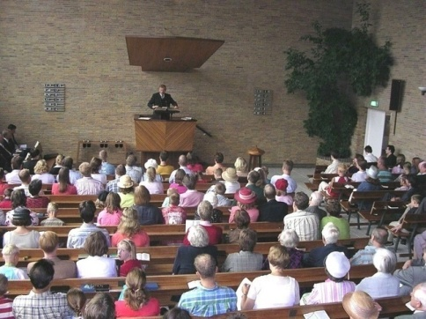
Which should have priority?
Proclaim Fellowship Worship Service
What should have the main focus in our church?
In terms of: time & energy
finances

Slide 11
Which should have priority?
The four tasks are: proclaim, fellowship, worship, and service.
All four require the attention of the Church
One task should not be played out against the other.
Proclaiming (outreach) is as important as fellowship
Worship is as important as service.

Slide 12
Focus on the tasks
Focus on the tasks individually and together
Individual members of the church may be focused more on one task than another, according to their gifts,
The Church as a body will be equally involved in all.

Slide 13
Focus on the tasks
Individuals specialize, the church does all.
What would this mean in a congregation like ours with ~150 members aged roughly 0 – 85?

Slide 14
Focus on the tasks
Individuals specialize, the church does all.
The church should not require of all its members that each member does all four things excellently.
Never forget Romans 12:3-8!
For by the grace given to me I say to everyone among you not to think of himself more highly than he ought to think, but to think with sober judgment, each according to the measure of faith that God has assigned. For as in one body we have many members, and the members do not all have the same function, so we, though many, are one body in Christ, and individually members one of another. Having gifts that differ according to the grace given to us, let us use them: if prophecy, in proportion to our faith; if service, in our serving; the one who teaches, in his teaching; the one who exhorts, in his exhortation; the one who contributes, in generosity; the one who leads, with zeal; the one who does acts of mercy, with cheerfulness. Romans 12:3-8

