Slide 1
Catechism The Workshop of Faith
Lesson 18
The Church: Marks (Finding the Right One)

Slide 2
Psalm 133:1
How good it is when brothers are united,
with one another’s company delighted,
and live in pleasant harmony.
It’s like the precious oil on Aaron’s head
when down his beard and priestly robe it spread,
that he might God’s anointed be.

Slide 3
Aspects to the Church
With respect to the Church we distinguish these aspects:
The attributes of the Church
Attributes describe what the church is
The ministries of the Church
Ministries describe what the church does
The marks of the Church
Marks describe whether the church measures up to the standard.

Slide 4
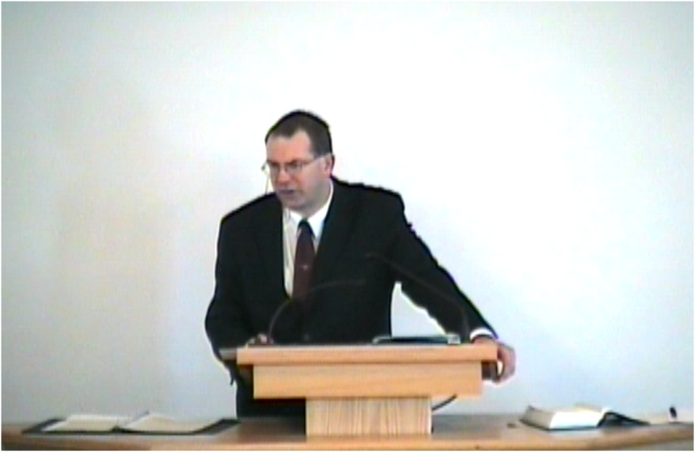
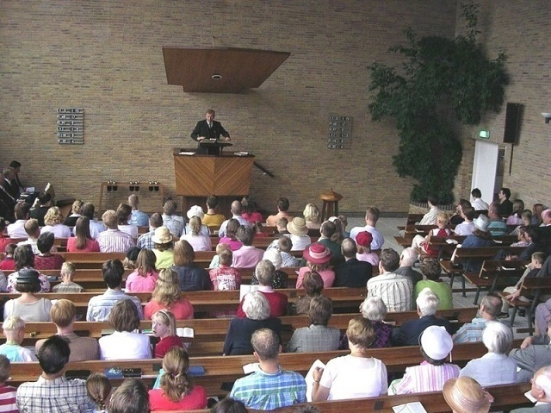
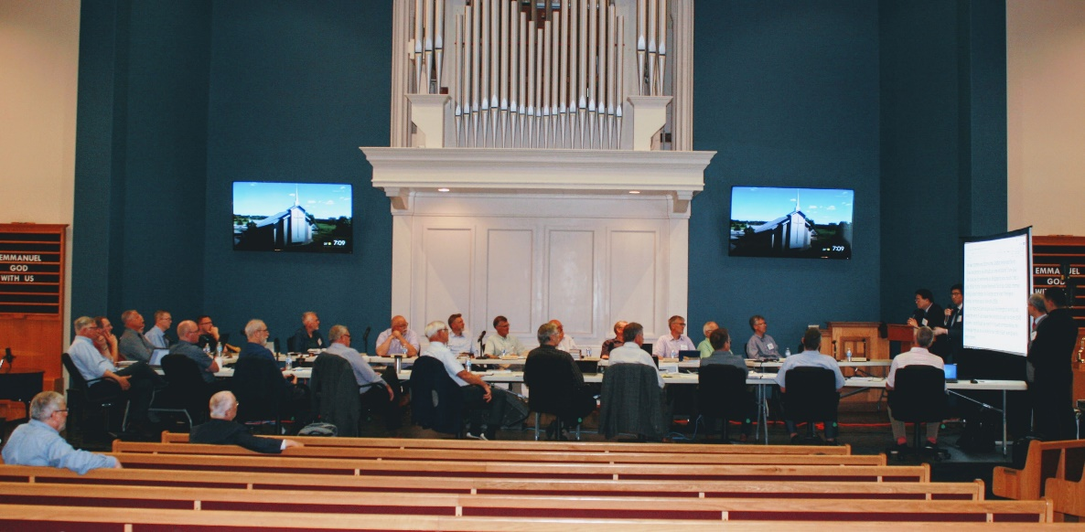
How do you tell if a church is good?
Doctrine
Worship
Governance

Slide 5

How do you tell if a church is good?

Slide 6
The 3 marks of the Church
At bottom there is only one mark:
The Church is faithful to her God and His Word.
This becomes evident on three points
Doctrine: Pure and faithful in preaching
Relates to Confessions
Worship: Pure and faithful in sacraments
Relates to Book of Praise matters
Government: Pure and faithful in discipline
Relates to the Church Order

Slide 7
The Church - in short
Four attributes
One, holy, catholic, and apostolic.
Four ministries
Proclamation, fellowship, worship, service.
Three marks
Pure in doctrine, in worship, in government.

Slide 8











Many churches
We read BC article 28-29.

Slide 9
Distinctions - Rev. 3:1-13
True church - false church
(The church of God and the synagogue of Satan)
False churches
True churches

Slide 10
Distinctions - Rev. 3:1-13
True church - false church
(The church of God and the synagogue of Satan)
More pure - less pure
Churches of God that are more or less faithful in doctrine and life (compare Philadelphia and Sardis )
False churches
True churches

Slide 11
Distinctions
True church - false church
(The church of God and the synagogue of Satan)
More pure - less pure
Churches of God that are more or less faithful in doctrine and life (compare Sardis and Philadelphia)
false church
true church
false church
true church
false church
true church

Slide 12
Churches are different
Churches are to be identified by:
Doctrine (preaching)
Worship (sacraments)
Government (discipline)
Only if a church seeks to be Scriptural with respect to all three, is it a real, a proper church.
It is in such a church that God wants His children to be.

Slide 13

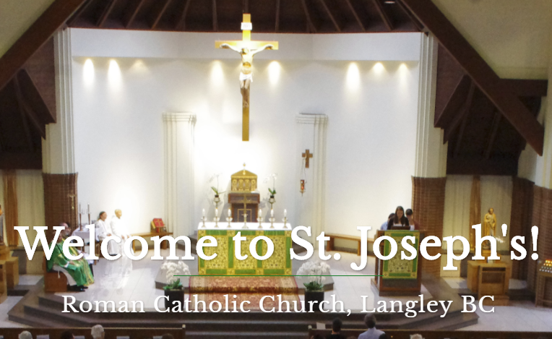

Illustrations
Doctrine?
Worship?
Government?

Slide 14



Choosing a church
Adolescence is the period in your life where you make choices that effect the rest of your life.
The three main ones are: faith, career, and being single/spouse.
For a spouse, you should listen to the wisdom of parents.
For a career, you should listen to the wisdom of your educators.
For faith, you should listen to the wisdom of your elders (includes minister).

Slide 15
Choosing a church
No church is perfect. So it’s not hard to find fault with any church, including our own.
The standard for judging a church is God’s Word.
Not you. (I like..., I don’t like...)
The points to look at are:
doctrine, worship, government.
And remember, God has already put you in a church. No one should ever walk away from the church God has put them in, unless they have a very good reason to do so and are convinced they are obeying God’s will.

