Slide 1
Catechism
The Substance of Faith
Lesson 24 – LD 18
Gone to Heaven

Slide 2
Hymn 40:1,2
The Lord ascended up on high,
the Lord has triumphed gloriously,
in pow’r and might excelling.
The grave and hell were captive led
when he went up, our glorious Head,
to his eternal dwelling.

Slide 3
Hymn 40:1,2
The heav’ns with joy received their Lord,
by saints, by angel hosts adored.
O day of exultation!
O earth, adore your glorious King!
Let us of his ascension sing
with joy and adoration.

Slide 4


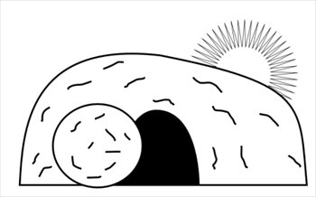
Humiliation - Exaltation
Divine
glory
Incarnation
Ascension
Suffering
Died
Resurrection

Slide 5
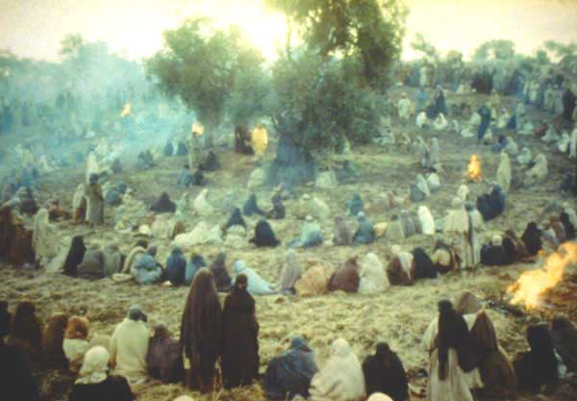
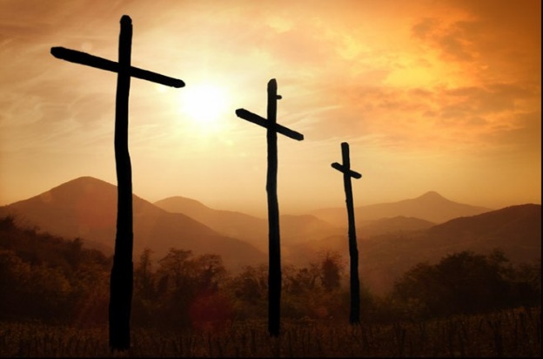
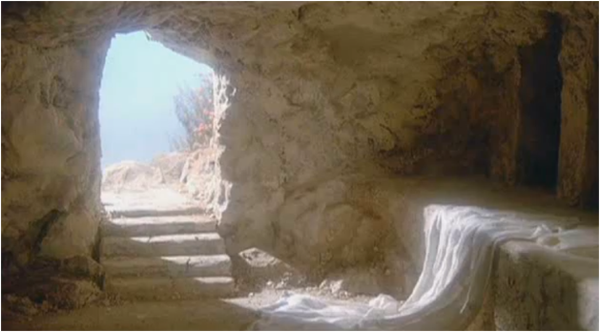
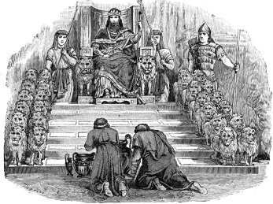
What would be next?
The experience of the disciples:
- The ministry in Israel
- Suffering and death
- Resurrection
What would follow next?
Read: Acts 1:6-8
Answer: questions

Slide 6
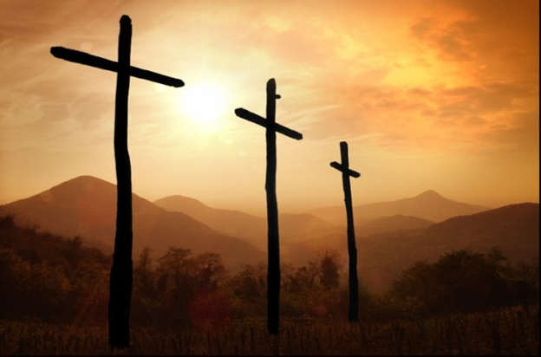

Witnesses

Acts 1:6-8
1. Whether the kingdom would be restored to Israel now.
2. That’s for God to know, not for people.
3. Through the power of the Holy Spirit.
4. His witnesses.

Slide 7

Christians are witnesses

Witness: a person who sees something happen and is able to describe it to other people.
In a legal setting: someone who testifies to the truth of happenings and situations
The Greek word for witness is
marturos, from which our word
martyr comes. A martyr is a
witness who pays dearly for his
testimony.

Slide 8

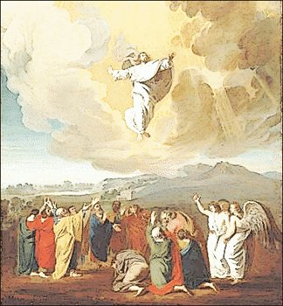
Bible Study: Ascension

Slide 9
Bible Study: Ascension
1. Blessing the disciples
2. Priest
3. Worship him (and only God is to be worshiped)
4. They were very joyful

Slide 10
Bible Study: Ascension
5. Yes
6. A cloud came and picked Him up.
7. The cloud is the glory of God, it is God’s vehicle, his mode of transport.
8. It showed that God approved of
Jesus and would grant him glory.
9. He would return the same way
they had seen him leave.
10. He would return on the cloud,
the vehicle of God.

Slide 11
Left Alone?

Jesus said: And behold, I am with you always, to the end of the age.
Matthew 28:20b
Jesus is a human being. Humans cannot be in two places at once. If Jesus was in heaven, He cannot be on earth.
So, did Jesus not keep his promise? Yes, He did.
Jesus is also God. God can be in many places at once. As God, Jesus is always with us.

Slide 12
Catechism
47. Q. Is Christ, then, not with us until the end of the world, as He has promised us?
A. Christ is true man and true God.
With respect to His human nature
He is no longer on earth,
but with respect to
His divinity, majesty, grace, and Spirit
He is never absent from us.

Slide 13
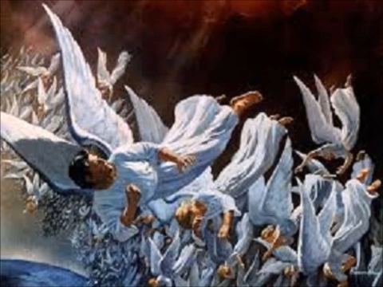
The Dragon

Slide 14
Back in heaven

HEAVEN
Son of God
Son of God and
Son of Man
Conceived by the Spirit
Born of the Virgin Mary
Ascension of
Jesus Christ
EARTH
When Jesus returned to heaven, he was not only God, he was also a man of flesh and blood.
We have our flesh in heaven!

Slide 15
Catechism
46. Q. What do you confess when you say, He ascended into heaven?
A. That Christ,
before the eyes of His disciples,
was taken up from the earth into heaven,
and that He is there for our benefit
until He comes again
to judge the living and the dead.

Slide 16
In heaven to work
Romans 8:34: He speaks to God the Father in our favour, pleading for us.
John 14:2&3: He is preparing a place for us to be in the future
John 16:7: He is sending the Holy Spirit to the church
Hebrews 1:3-4: He sits in heaven as ruler
Revelation 5:6-7, 6:1ff: He controls the unfolding of history

Slide 17
Catechism
49. Q. How does Christ’s ascension into heaven benefit us?
A. First, He is our Advocate in heaven before His Father.
Second, we have our flesh in heaven as a sure pledge that He, our Head, will also take us, His members, up to Himself.
Third, He sends us His Spirit as a counter-pledge, by whose power we seek the things that are above, where Christ is, seated at the right hand of God, and not the things that are on earth.

Slide 18

The Christ in heaven

As prophet
He sends the Holy Spirit into the church, and the church into the World, to proclaim the Kingdom of God.
As priest
He pleads our case before the Father, ensuring that we will receive forgiveness and God’s grace
As king
He governs your life, placing you in a church community where you will be protected and taken care of.

