Slide 1
Catechism
The Substance of Faith
Lesson 25 – LD 19
He Comes to Judge

Slide 2
Hymn 67:1
“Come, Lord Jesus! Maranatha!”
pray the Spirit and the Bride.
Come upon the clouds of heaven
with your angels at your side.
Maranatha! Come, Lord Jesus!
Evermore with us abide.

Slide 3


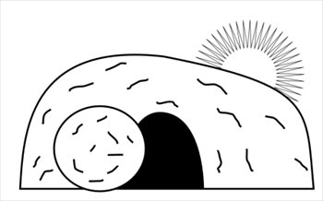
Humiliation - Exaltation
Divine
glory
Divine
& Human
glory
Return
Incarnation
Ascension
Suffering
Died
Resurrection

Slide 4

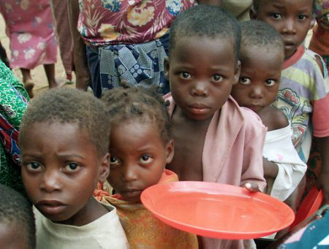
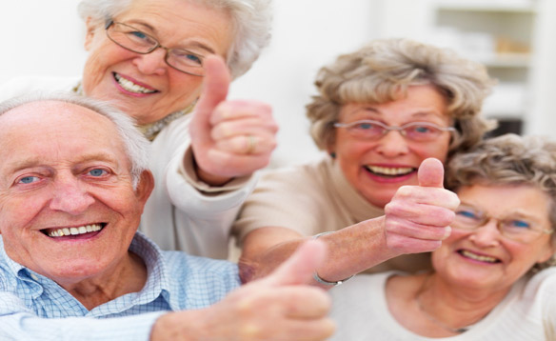
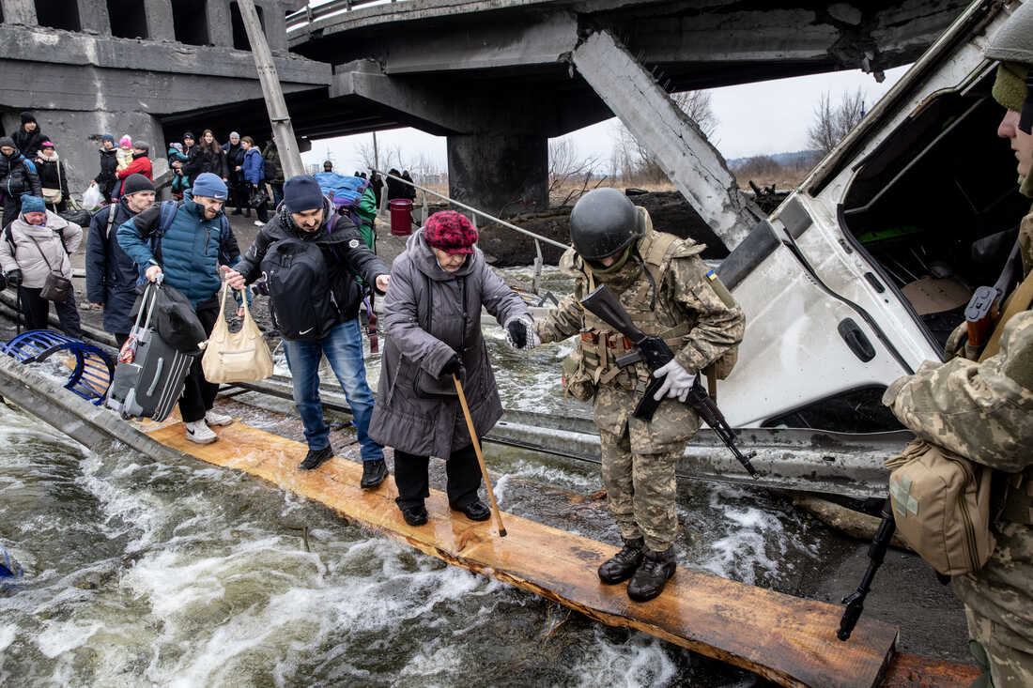
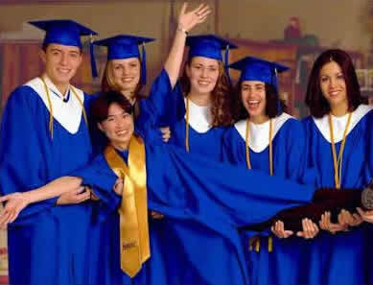
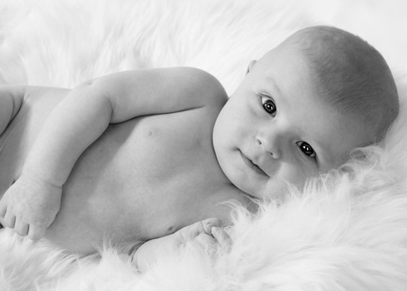
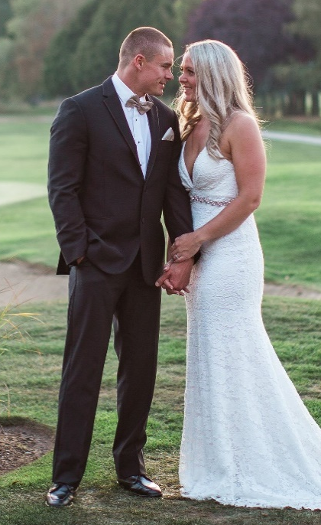
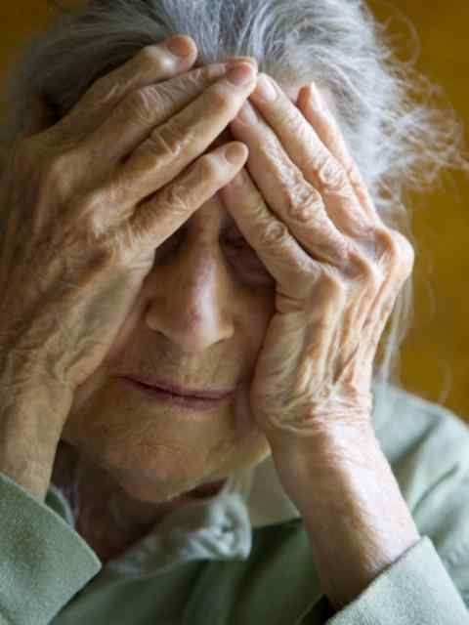
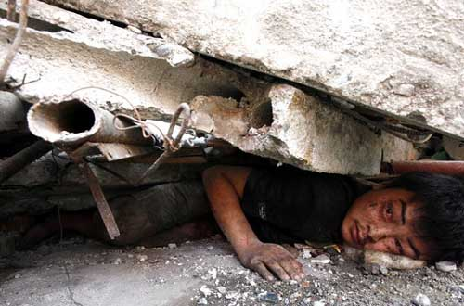
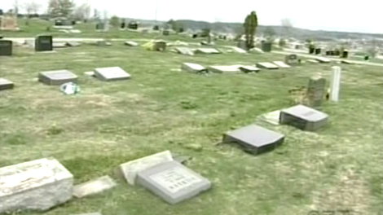
Coming?
Would you like the Lord Jesus to come back soon?

Slide 5
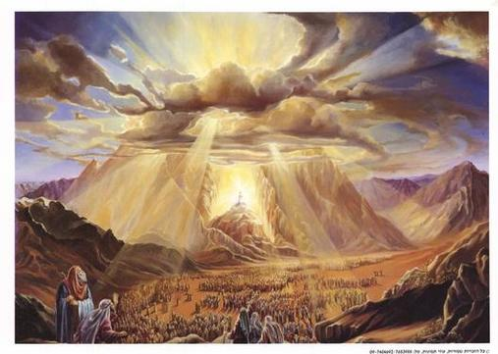
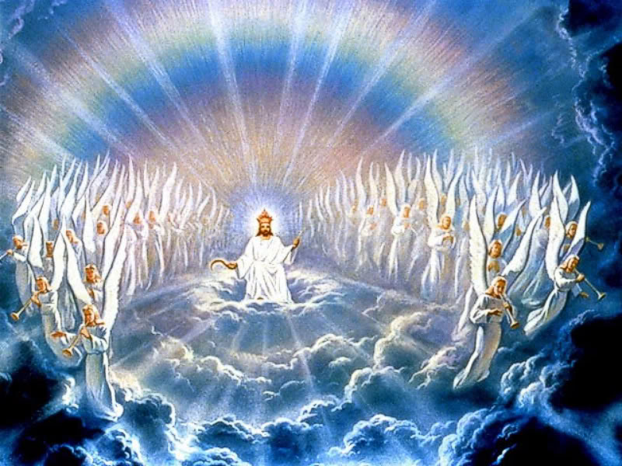
The appearance of the Lord
1. Thunders, lightnings, a thick cloud, a very loud
trumpet blast, and fire.
The people trembled.
2. He trembled with fear, was terrified
3. A trumpet and the voice of the archangel
4. The shock was so great, he fainted

Slide 6
When the Lord appears

When Christ returns in judgement, His return will be frightening for all.
- those who believe will be glad
- those who do not believe will seek to flee

Slide 7

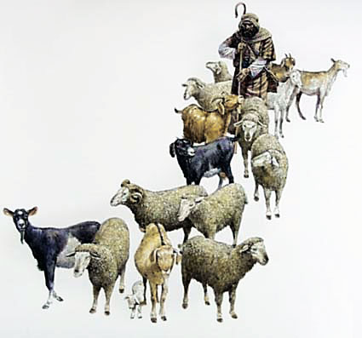
Bible Study: Matthew 25:31-46

Slide 8
Bible Study: Matthew 25:31-46
1. “glory / glorious throne” and “Before Him all the nations will be gathered”
2. Believers
3. Unbelievers
4. Sheep tend to be docile creatures that are obedient; goats tend to be head-strong creatures that
do their own (usually destructive) thing.
5. The kingdom of God
6. Eternal life in a new creation

Slide 9
Bible Study: Matthew 25:31-46
7. Because they showed their love for Christ by showing love for fellow human beings
8. To hell
9. Because they lived self-centred lives and did not show love for others.

Slide 10
The basic question

When Christ judges us, He will look at how we have interacted with God and with fellow human beings.
We were made in God’s image.
This means, we to interact with creation in love and loyalty.
The basic question in our lives is: do we show love and loyalty to God and to fellow man?

Slide 11
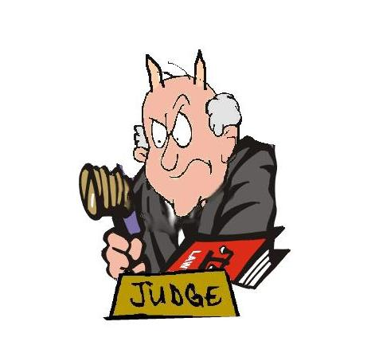
Being sure
You can’t always trust a judge, certainly
not in the society of Jesus’ time.
So how can we be sure of Christ’s
judgement?
1. Christ is our Lord: He loves us for He owns us
2. Christ Himself paid the penalty, He has permission from the Father to clear us of all guilt.

Slide 12
Catechism
52. Q. What comfort is it to you that Christ will come to judge the living and the dead?
A. In all my sorrow and persecution I lift up my head and eagerly await as judge from heaven the very same person who before has submitted himself to the judgment of God for my sake, and has removed all the curse from me.
He will cast all his and my enemies into everlasting condemnation, but he will take me and all his chosen ones to himself into heavenly joy and glory.

Slide 13
The final judgement
The Bible gives us a number of glimpses into how the final judgement will be.
Revelation 20:11-15
- the books: the ‘histories’ of individual persons
- Book of life: List of citizens
- Second death = eternally dying (absolute loneliness and pain)

Slide 14
The final judgement
Is your name in
the Book of Life?
No
Yes
Are your deeds
perfectly good?
Are your deeds
perfectly good?
Justice
Yes
Grace
No
No
Yes
Eternal death
Eternal life

Slide 15
The final judgement
Is your name in
the Book of Life?
No
Yes
Are your deeds
perfectly good?
Are your deeds
perfectly good?
Justice
Yes
Grace
No
No
Christ
Yes
Eternal death
Eternal life

Slide 16
The final judgement

Revelation 20 indicates the final outcome is based on our names being in the Book of Life.
Matthew 25 relates it to our activities in life.
If your name is in the Book of Life, you will be showing love and loyalty in this earthly life. (why?)
- our works are not perfect, hence, we cannot
earn eternal life
- they are what we long for and strive after, and do
through the power of the Spirit, hence they are
an indication of our status before God

Slide 17
Coming?
Would you like the Lord Jesus to come back soon?

