Slide 1
Catechism
The Workshop of Faith
Lesson 20
The Church: Government (2)

Slide 2
Psalm 122:2
Jerusalem, designed so well,
built as a close-knit unity –
there flock together joyfully
the tribes and clans of Israel.
They to Jerusalem ascend,
according to the Lord’s command,
to thank him with their adoration.
For there are set the royal thrones
of David’s house, and there his sons
with righteous judgments rule the nation.

Slide 3

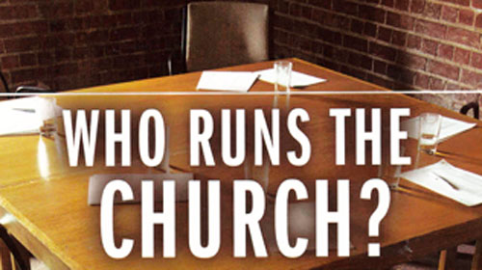
Belgic Confession 30-32
We read together BCoF articles 30-32.
And then we’ll discuss the questions

Slide 4
Discussion
Relationship between the congregation and eldership:
The eldership hears the congregation and then decides on the issue.
Issue of women voting
Women are not to have authority in the church
(1 Timothy 2:12).
Hearing the congregation is not the same as
granting the congregation authority
Who is the “congregation”?
Those assembled as representing households (families, pastoral units).

Slide 5
Government organized
The basic document for the government of our church is known as the Church Order.
The form of our Church Order goes back to the Reformed Churches in the Netherlands. It is commonly referred to as the Church Order of Dort, after the Synod of Dort 1618-19, which adopted it.
The Church Order can be found in the back of a Book of Praise. It can also be viewed at www.canrc.org & www.officebearers.com. As it can change every general synod (once every 3 years), the ones published at the end of the Acts of General Synod and on the web-sites will be the most up-to-date version.

Slide 6
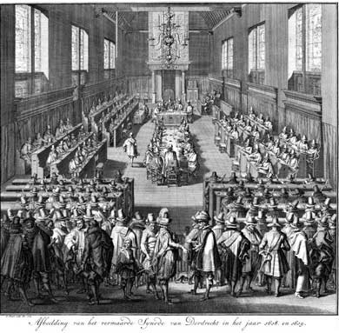
Introducing the Church Order
See Book of Praise, page 629
If you have questions about
something relating to the CO
email Rev. J. and it will be
dealt with in a coming lesson.

Slide 7
The offices
On many issues of church government, the New Testament is vague.
Most concrete information is found in the Pastoral Epistles.
Hence, the way churches are run today can vary from place to place and culture to culture, without being unbiblical.
Discussion:
Why might the NT be vague on church government?

Slide 8
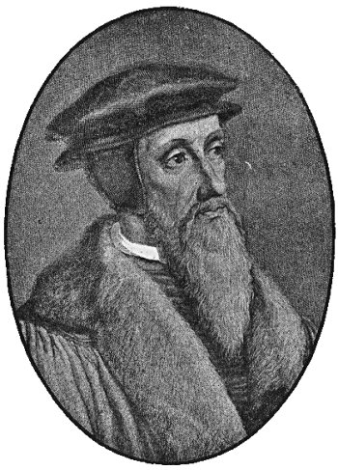
From Calvin to CanRC
Ministers
Teachers
Elders
Deacons
Visitors

Slide 9
From Calvin to CanRC
Ministers
Professor
Ministers
Teachers
Catechizer
Elders
Elders
Deacons
Deacons
Visitors
Meal Train

Slide 10
Tasks
The tasks which the three office bearers have in our churches are described in BC article 31, in the Church Order and in the forms for ordination:
Ministers:
- preach and teach + supervise faith matters
Elders:
- supervise faith matters
Deacons:
- facilitate material matters
- (just charity or also Committee of Administration?)

