Slide 1
Catechism
The Workshop of Faith
Lesson 21
The Church: Government (3)

Slide 2
Psalm 68:10
10. The solemn throngs are gathered here;
to God my King do they draw near.
They come with sounding cymbals,
the singers first, the minstrels last,
and in among them, filing past,
the maidens play their timbrels.
In this great congregation’s throng
let God be praised in joyful song,
O Jacob’s generation!
There Benjamin, the smallest clan,
leads Naphtali and Zebulun,
Judah and all the nation!

Slide 3
Church Structure
General Synod
Regional Synod
Classis
Classis
church
church
church
church
church
church
church
church
church
church
church
church
church
church
church
Classis
church
Regional Synod
church
Classis
church
church
church
church
church
church
church
church
church
church

Slide 4

Regional Church Structure
Every local church is a complete church
  6-12 local churches meet in a classis
  2-6 classes meet in a regional synod
  All regional synods meet in a general synod
And federations of churches meet once every four years in a conference called the International Conference of Reformed Churches.

Slide 5

Willoughby Heights CanRC
The Willoughby Heights Canadian Reformed Church
- belongs to Classis Pacific-West
with: Cloverdale, Houston, Langley, Refuge, Smithers, & Surrey
- which belongs to Regional Synod West
with: Classis Pacific-East, Classis Alberta,
and Classis Manitoba
- which belongs to the general synod of the
Canadian Reformed Churches
with: Regional Synod East

Slide 6
New Westminster URC
The New Westminster United Reformed Church
- belongs to Classis Western Canada
      with: Abbotsford, Surrey, Kelowna, Smithers, Telkwa, Grande Prairie, Neerlandia, Edmonton, Lacombe, Leduc, Ponoka, Calgary, Lethbridge, Regina, Winnipeg, Thunder Bay
- which belongs to the synod of the
United Reformed Churches
      with: classis Southwest Ontario, classis Ontario east, classis central US, classis Eastern US, classis Michigan, classis Pacific Northwest, classis Southwest US

Slide 7
Broader assemblies
A classis, regional synod, and general synod are not higher assemblies but broader assemblies.
  At a classis, all churches are equal.
  At a regional synod, all churches are equal.
  At a general synod, all churches are equal.
At a CanRC broader assembly, the members speak and vote according to conscience, not instruction.
Thus the members of a broader assembly are not representatives of their churches or classes.
In many other churches it works a little differently.

Slide 8
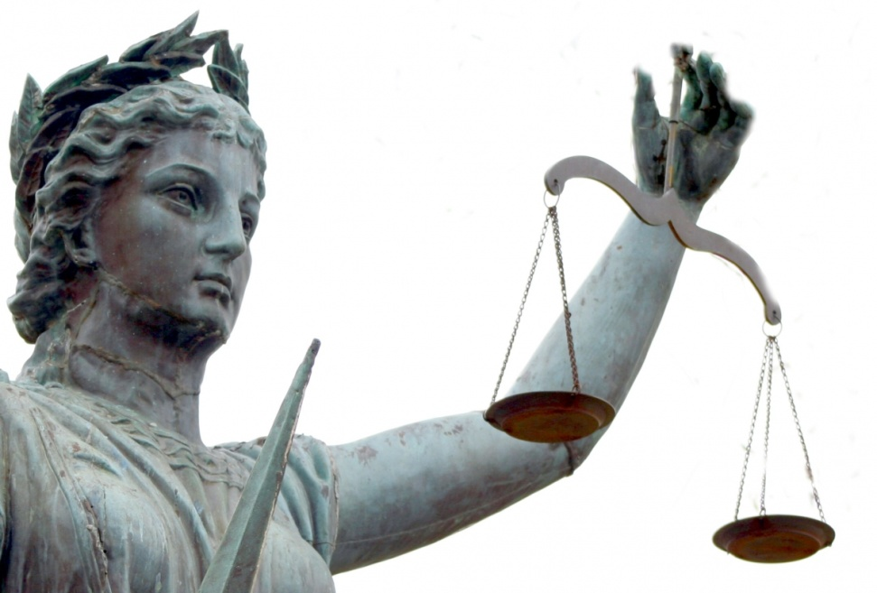
Acts 10 & 11; Acts 15
Accountability is the reason for church government.

Slide 9
Acts 10 & 11; Acts 15
The men from Cornelius and some of the brothers from Joppa.
The believers from among the circumcised who had come with Peter (Jews)
It is not absolute; Peter involves others in deciding the question.
The circumcision party in the Jerusalem church
That even an apostle is accountable to the church
These six brothers from Joppa
Silence. (Peter’s actions receive approval.)

Slide 10
Acts 10 & 11; Acts 15
The church in Antioch through its elders
The apostles and elders
Simeon Peter’s experience in Caesarea
The Bible (Amos 9:11-12)
Churches always need to communicate with each other and be accountable to each other
NO.

Slide 11
Broader Assemblies
The broader assemblies are
- conferences where churches assist each other
- bodies with jurisdiction in those areas in which
churches give them jurisdiction by
agreement
Note: these assemblies can legislate, judge, and execute as determined by the local churches.

Slide 12
Main Tasks
A classis:
- assists local churches and holds them accountable to each other
- serve as first court of appeal
- examines ministers-to-be
A regional synod:
- serves as second court of appeal
- assists classes in matters relating to ministers

Slide 13
Main Tasks
A general synod:
serves as final court of appeal
deals with issues pertaining to churches in common
- doctrine (e.g. women voting)
- worship (e.g. Book of Praise)
- government (e.g. Church Order)
deals with relationships with other groups of Churches & the government
deals with things best done together (e.g. Seminary)

