Slide 1
Catechism
The Substance of Faith
Lesson 27 – LD 21a
The Church of Jesus Christ

Slide 2
Hymn 52:1,2
The church’s one foundation
is Jesus Christ her Lord;
she is his new creation
by water and the Word.
From heav’n he came and sought her
to be his holy bride;
with his own blood he bought her
and for her life he died.

Slide 3
Hymn 52:1,2
Elect from every nation,
yet one o’er all the earth,
her charter of salvation
one LORD, one faith, one birth.
One holy name she blesses,
partakes one holy food,
and to one hope she presses,
with every grace endued.

Slide 4
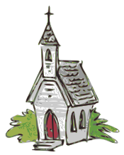
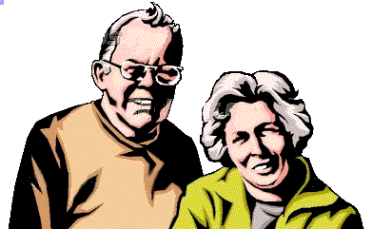
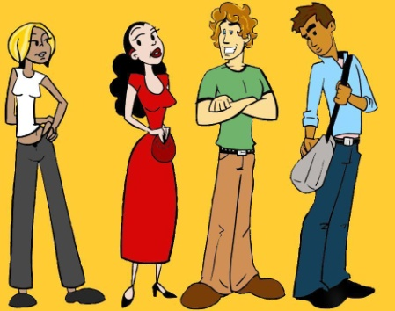
Be a church member?
It is a sad fact, the number of people in churches is dropping. Churches are said to be turning grey: there are more seniors than any other age group.
Why is it that young people are leaving churches in droves?
One line of reasoning is: you can serve God however you want, and you can listen to a sermon on the Internet.
So who needs church?

Slide 5
Belonging to a church

What are some of the benefits of being a member of the church? Write down three you can think of.
- communal worship (e.g singing, prayer)
- instruction (e.g. catechism)
- supervision by elders (spiritual coaches)
- a sense of belonging (fellowship)
But there’s something else we need to realize…

Slide 6
The church is the Lord’s

The word “church” is from the Greek word “kuriakos”
“Kuriakos” is the adjective that goes with “kurios”
Kurios = Lord
Kuriakos = Lord-ly, that which belongs to the Lord.
You don’t belong to a church because you choose to. You belong to a church because you belong to the Lord.
God chose you!
Note: in the Greek Bible the word for church is “ekklesia”. This means “called out” and should be translated with “assembly” or “congregation”.

Slide 7

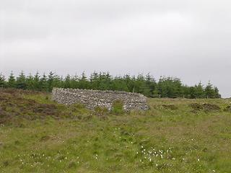
Bible Study: Christ’s flock
Wall (note,
no roof!)
“Door”

Slide 8
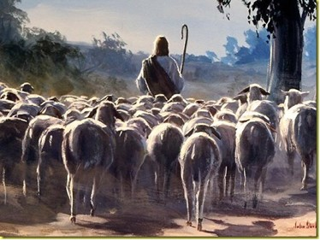
Bible Study: Christ’s Flock
1. But he who enters by _________ is the shepherd of the sheep. To him the gatekeeper opens. The sheep hear __________, and he calls his own sheep _________ and leads them out. When he has brought out all his own, he goes __________, and the sheep _________, for they ____________.
the door
his voice
by name
before them
follow him
know his voice
2. The door.
3. That access to the flock
comes only via Jesus;
anyone serving in the church
must serve through Christ.

Slide 9
Bible Study: Christ’s Flock
4. The good shepherd.
5. That Jesus will take good care of the sheep that are His.
6. Lay down His life.
7. The people of Israel.
8. Non-Jews (like us) who are
part of God’s people.
9. The church

Slide 10
Catechism
54. Q. What do you believe concerning the holy catholic Christian church?
A. I believe that the Son of God, out of the whole human race, from the beginning of the world to its end, gathers, defends, and preserves for Himself, by His Spirit and Word, in the unity of the true faith, a church chosen to everlasting life.
And I believe that I am and forever shall remain a living member of it.

Slide 11
Catechism
54. Q. What do you believe concerning the holy catholic Christian church?
A. I believe that the Son of God, out of the whole human race, from the beginning of the world to its end, gathers, defends, and preserves for Himself, by His Spirit and Word, in the unity of the true faith, a church chosen to everlasting life.
And I believe that I am and forever shall remain a living member of it.

Slide 12
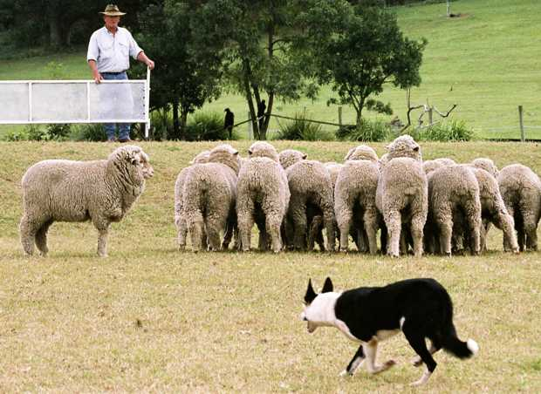
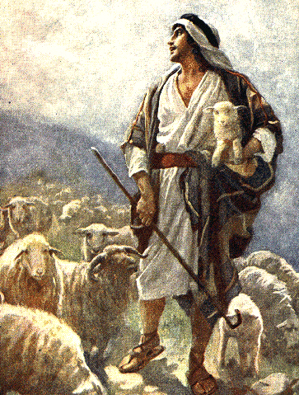
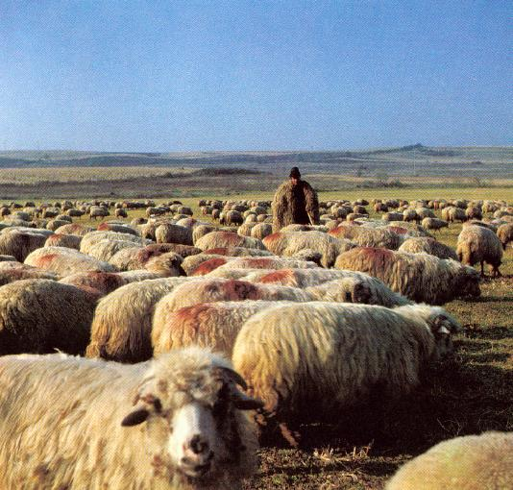
This is how
A shepherd and his flock
Calls the sheep together
Can use a sheepdog
Against wild animals using a stick or slingshot (or gun)
Brings the sheep to places where there is food; takes care of them if they get sick.

Slide 13
This is how

Strengthen faith through worship services, catechism classes, special meetings
Calls people to worship, speaks through the sermon.
Sends ministers, elders and deacons
Brings the sheep to places where there is food; takes care of them if they get sick.
The Lord Jesus and his church
Calls the sheep together
Can use a sheepdog
Prayer to ward off and conquer evil;
Use discipline to keep members faithful to the Lord.
Against wild animals using a stick or slingshot (or gun)

Slide 14
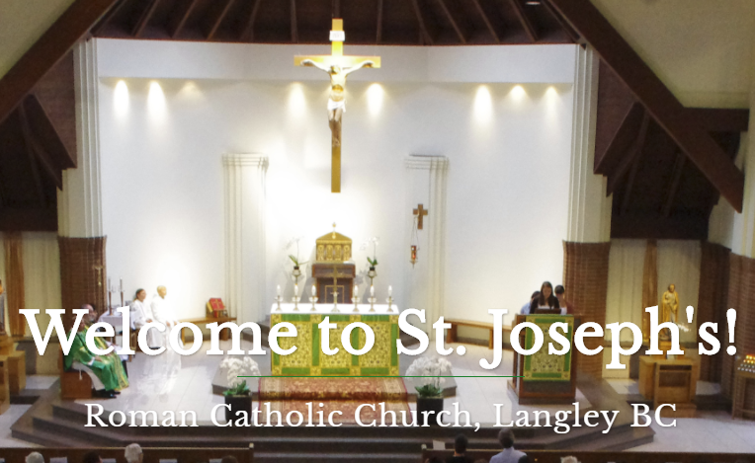


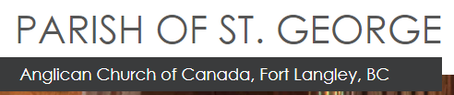




All sorts of churches
Langley is part of BC’s “Bible belt”. There are lots of churches in Langley (Abbotsford has most).
Can you name some of them?

Slide 15

Whole Church – Whole Gospel – Whole World
Notes:
2:51

Slide 16
A good church

What makes for a good church?
  Church = “the Lord’s”.
  Hence, where everything is done as the Lord wants it.
How do we know how the Lord wants it?
  He tells us in the Bible.
A good church is one that obeys God’s Word:
  - in preaching (outreach, sermons)
  - in worship (sacraments, songs)
  - in practice (government, discipline)

Slide 17
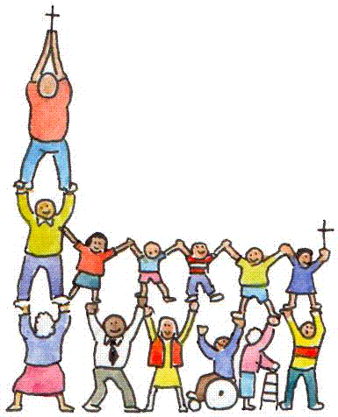
Join the Right Church

There are true churches and false churches.
  True churches: ones that are real, proper, good churches
  False churches: ones that are pretend, counterfeit
Those who belong to Christ,
belong to the church.
Hence all who belong to Christ
must join themselves to a
true church.

Slide 18
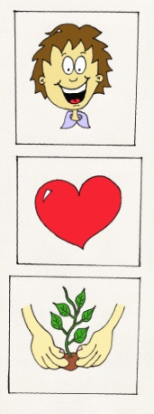
Join the Right Church

Truthful Teaching (preaching)
Proper Worship (sacraments)
Loving Government (discipline)
When choosing a church, choose one that meets these three criteria: true and faithful to God’s Word in preaching, in worship, and in discipline.

Slide 19
Be a living member
55. Q. What do you understand by the communion of saints?
A. First, that believers, all and everyone, as members of Christ have communion with him and share in all his treasures and gifts.
Second, that everyone is duty-bound to use his gifts readily and cheerfully for the benefit and well-being of the other members.
What gifts is God giving you that you can use for the benefit of other church members?

