Slide 1
Catechism
The Substance of Faith
Lesson 26 – LD 20
The Holy Spirit

Slide 2
Hymn 50:1
The Spirit came, as promised, in God’s appointed hour;
and now to each believer he comes in love and power.
And by his Holy Spirit, God seals us as his own,
and through the Son and Spirit makes access to his throne.

Slide 3


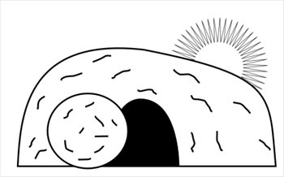
Humiliation - Exaltation
Divine
glory
Divine
& Human
glory
Return
Incarnation
Ascension
Suffering
Died
Resurrection

Slide 4
The Apostles’ Creed
The Apostles’ Creed consists of 3 sections, with a total of 12 articles.
The Heidelberg Catechism deals with the individual articles of the Apostles’ Creed in LD 9-22.
1 God the Father Our Creation LD 9-10
2 God the Son Our Redemption LD 11-19
3 God the Spirit Our Sanctification LD 20-22

Slide 5
The Spirit is a Person

The church was commanded to baptize into the Name of the Father, the Son and the Holy Spirit.
The fullest blessing (2 Corinthians 13:14) speaks of Jesus Christ, of God (the Father), and of the Holy Spirit.
Clearly, the Spirit is the same sort of being as the Father and the Son.
The Spirit is not an it but a He.
He is an individual Person within the Trinity of God.

Slide 6
The Spirit is a Person

Those who deny that Jesus is God will have an issue with the doctrine of the Trinity.
Logic forces them to deny the individual personality of the Holy Spirit.
Among such people are the Jehovah’s Witnesses.
Their Bible is the New World Translation:
Genesis 1:2 Now the earth proved to be formless and waste and there was darkness upon the surface of [the] watery deep; and God’s active force was moving to and fro over the surface of the waters.

Slide 7
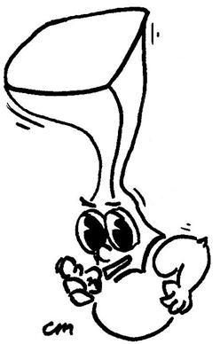
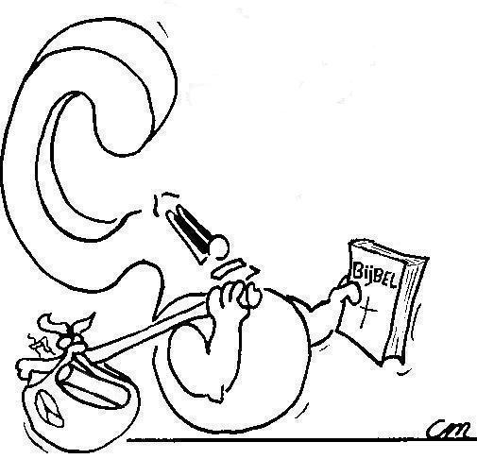
What does the Holy Spirit actually do?
Three things…

Slide 8
(1) The Holy Spirit and Creation
God the Father created all things: He designed and commanded, He sustains and provides.
God the Son is the means by which all things were made and continue to exist.
God the Holy Spirit is the agent by which all things were and are made, He is the life-giving Spirit.
O Lord, how manifold are your works! In wisdom have you made them all; the earth is full of your creatures.
When you send forth your Spirit,they are created,
and you renew the face of the ground.
Psalm 104:24 & 30

Slide 9
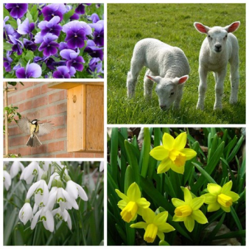
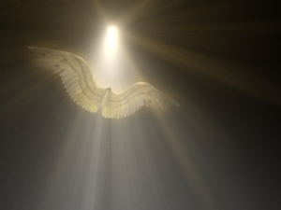
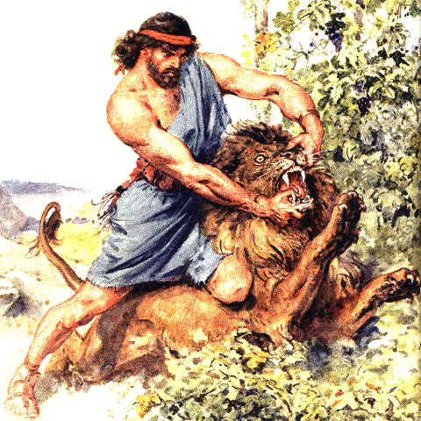
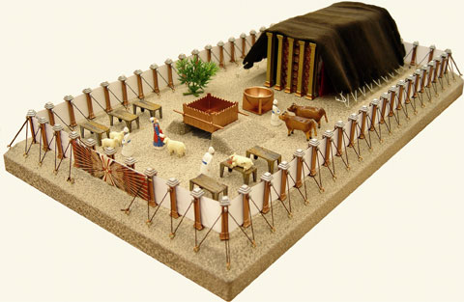
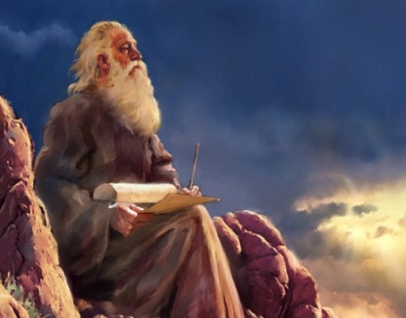
The Holy Spirit and Creation

1. Hovering over the waters
2. Made Samson strong.
3. Giving skill, intelligence, knowledge, and craftmanship to make things
4. Filled Micah with power to speak.
5. He gives life and energy/power to live and act.

Slide 10
Nicene Creed
I believe …
in the Holy Spirit,
the Lord and Giver of Life.

Slide 11
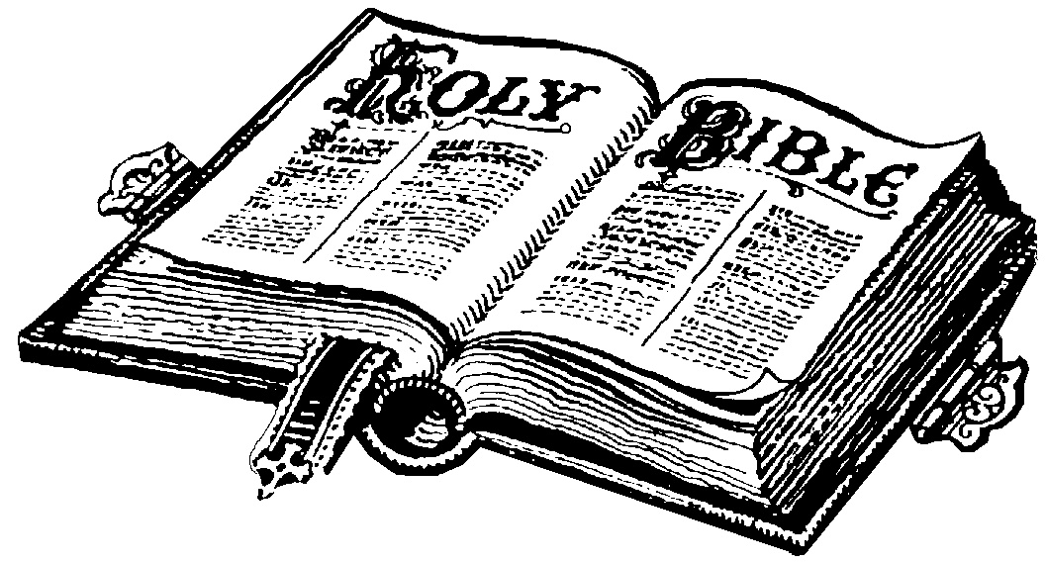
A second task
For no prophecy was ever produced by the will of man, but men spoke from God as they were carried along by the Holy Spirit.
2 Peter 1:21
All Scripture is breathed out by God and profitable for teaching, for reproof, for correction, and for training in righteousness,
2 Timothy 3:16
The Holy Spirit is also the Person responsible for having revelation of God reach man.
He had people speak God’s Word.
He had the Bible written.

Slide 12
A second task
Literally: God-spirited
All Scripture is breathed out by God and profitable for teaching, for reproof, for correction, and for training in righteousness,
2 Timothy 3:16
The Holy Spirit is also the Person responsible for having revelation of God reach man.
He had people speak God’s Word.
He had the Bible written.

Slide 13
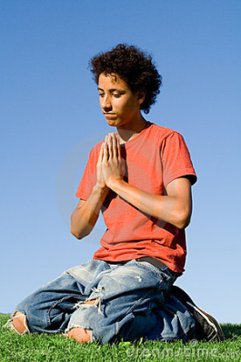
A third task
Therefore, by his Holy Spirit, Christ
also assures me of eternal life and
makes me heartily willing and ready from now on to live for him.
This faith the Holy Spirit works in my heart by the gospel.
Only the blood of Jesus Christ and the Holy Spirit cleanse us from all sins.
Lord’s Day 1
Lord’s Day 7
Lord’s Day 27

Slide 14
A third task
The Holy Spirit is also the one who
- infuses faith into the hearts of God’s children
= He makes them believe
- purifies their lives to conform to God’s will
= He makes them do good works
Therefore I want you to understand that no one speaking in the Spirit of God ever says “Jesus is accursed!” and no one can say “Jesus is Lord” except in the Holy Spirit.
1 Corinthians 12:3

Slide 15

The Work of the Spirit
The Spirit has three duties:
1. He gives life and existence to all things
  Psalm 104:30: “When you send your Spirit, they are created”
2. He communicates the truths of God and existence
  2 Peter 1:21: “Men spoke from God as they were carried along by the Holy Spirit”
3. He makes men serve God, granting faith and good works
  1 Corinthians 12:3: “No one can say ‘Jesus is Lord’ except by the Holy Spirit

Slide 16

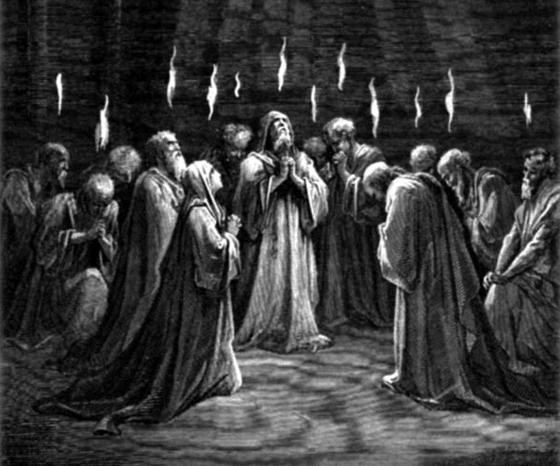
Bible Study: Pentecost

Slide 17
Bible Study: Pentecost
1. Tongues of fire and the sound of a wind
2. Fire: purifying force; Wind: unstoppable power
3. The mighty works of God declared in their native
language.
4. Joel.
5. Prophesy
6. So that the gospel might be
preached throughout the
whole world.
7. Revelation (Preaching)

Slide 18
Before and After Pentecost
Confusion regarding the work of the Spirit.
Both before and after Pentecost the Spirit is there:
- to give life and power
- to give faith and renew people
Before Pentecost the Spirit is only given to a few of God’s people to speak authoritatively on God’s behalf (see Numbers 11:29).
After Pentecost, the Spirit of God is given to every church member.

Slide 19
The Spirit gives life to all creation, makes God known, and re-creates God’s people, making them fit for God’s Kingdom.
What does the Holy Spirit actually do?

Slide 20
Catechism
53. Q. What do you believe concerning the Holy Spirit?
A. First,
He is, together with the Father and the Son,
true and eternal God.
Second,
He is also given to me,
to make me by true faith share in Christ and all His benefits
to comfort me, and
to remain with me forever.

Slide 21
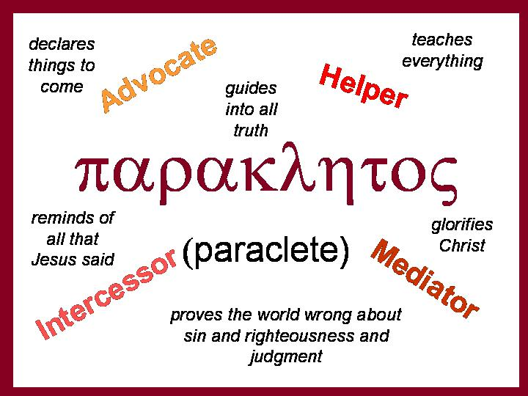
A special Greek name

Slide 22
The Name of the Spirit

In Greek, the Spirit is referred to as the Paraclete.
A paraclete is someone who speaks to someone words suited to the occasion.
- Encouragement if the person is timid
- Admonishment if the person does wrong
- Comfort if the person is down.
Common translations of “paraclete” include “Comforter”, “Counsellor”, “Helper”, and “Advocate”.
It’s a name with a very broad range
of meanings!

