Slide 1
Catechism The Substance of Faith
Lesson 28 – LD 21b-22
Your Future is Safe

Slide 2
Hymn 68:5,8
God his own shall glorify
in a wondrous transformation.
Though not all of us may die,
all shall gain their full salvation
in the twinkling of an eye
when the Lord comes from on high.

Slide 3
Hymn 68:5,8
To our God be thanks and praise:
he through Christ made us victorious.
Be then steadfast all your days;
see how death’s defeat assures us
that in him who comes again
all your toil is not in vain.

Slide 4
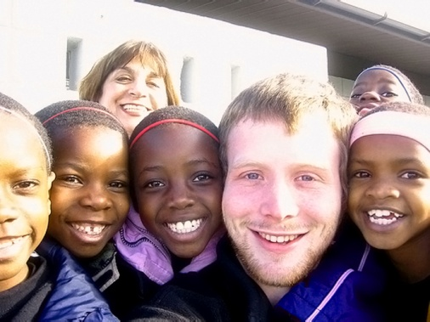
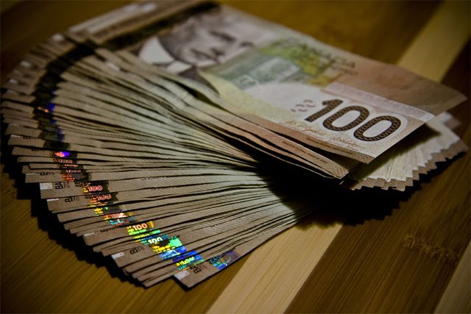
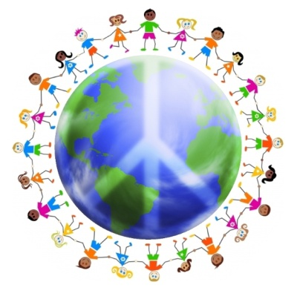
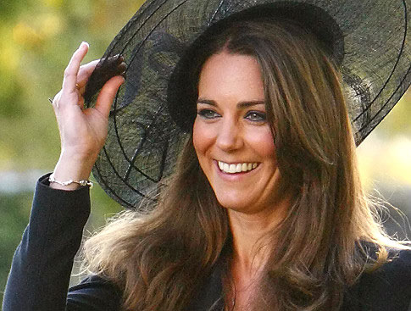
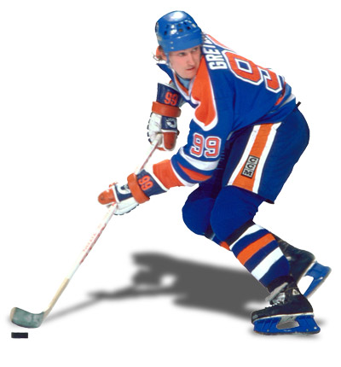
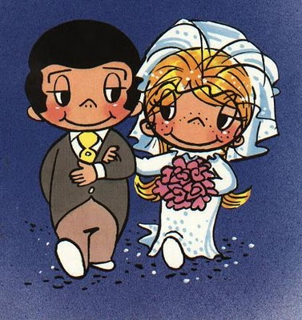
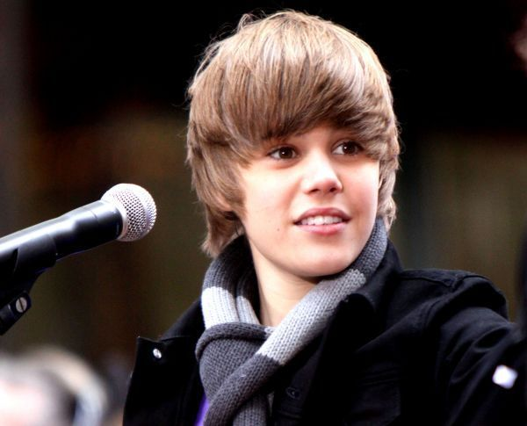
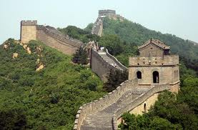
Thoughts on the purpose of life and existence
What is important to you in life? What is the purpose of your life? What are your goals in life?

Slide 5
What God has promised

The last three articles of the Apostles’ Creed are:
I believe…
the forgiveness of sins,
the resurrection of the body, and
the life everlasting.
Those who believe have been promised much: a never ending life, in the body, in God’s presence!

Slide 6
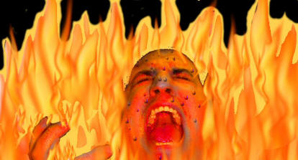
The Ravine
Jesus Christ
God
Us
sin

Slide 7
Forgiveness of sins

In Christ, God and man are reconciled.
Contact and communion between God and man are possible again.
Forgiveness of sins allows us to live with God and God to live with us.
And I heard a loud voice from the throne saying, “Now the dwelling of God is with men, and he will live with them. They will be his people, and God himself will be with them and be their God.
Revelation 21:3

Slide 8
Catechism
56. Q. What do you believe concerning the forgiveness of sins?
A. I believe that God,
because of Christ’s satisfaction,
will no more remember my sins,
nor my sinful nature,
against which I have to struggle all my life,
but will graciously grant me
the righteousness of Christ,
that I may never come into condemnation.

Slide 9
God of the Living
Levirate marriage
With a view to the coming Messiah, it was important to Jews that their name not die out.
Hence, if a man died married but childless, a relative would marry his wife and their first child would be heir to the deceased man.
In Jesus’ days there were basically two religious factions among the Jews. Sadducees, who did not believe in the resurrection, and Pharisees who did.

Slide 10

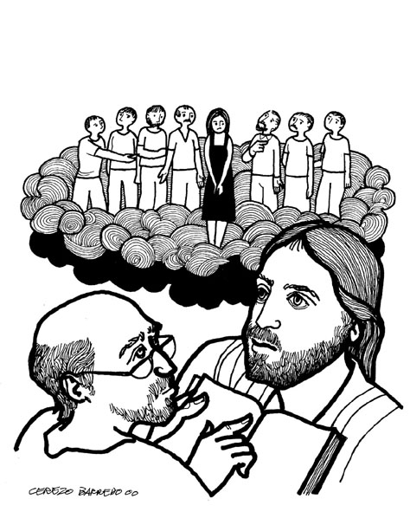
Bible Study: Matthew 22:23-33

Slide 11
Bible Study: A resurrection?
1. Present tense (I am not I was)
2. That they still exist.
3. From the fall into sin.
4. The power of God
5. Thinking that after the resurrection everything will be exactly the same as it is now.

Slide 12
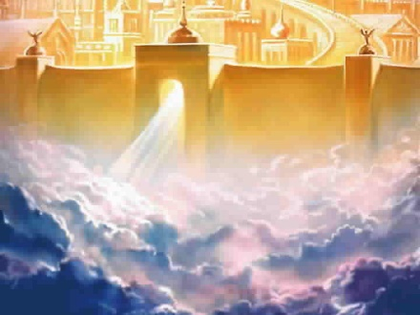

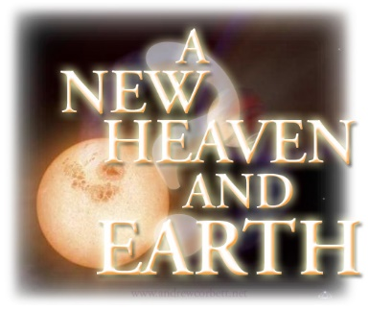
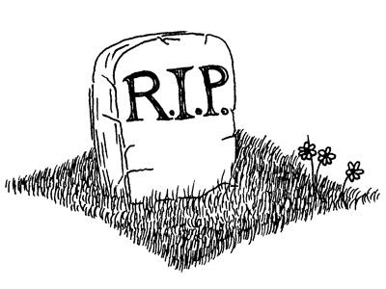
Life has three stages
Present
Intermediate
Final
soul
soul
body
body
Death
Resurrection

Slide 13
Life has three stages

Present: Soul and body are together, sin is present.
Intermediate: Soul and body are separate, no sin.
Final: Soul and body are together, no sin.
Which stage would you most prefer to be in?
Which stage would you least prefer to be in?

Slide 14
Soul sleep

Some Christians believe that when a person dies, they completely “fall asleep”.
Just like the the moment you fall asleep in the evening and the moment you awake in the morning feel like immediately after each other, so for them dying and Christ’s return will feel like being immediately after each other.
This view of things is called “soul sleep”.
This view is held by Seventh Day Adventists and, to an extent, by Jehovah’s Witnesses.
However, the Bible is clear that those who have died continue to exist either in hell or with Christ in heaven.

Slide 15
Catechism
57. Q. What comfort does the resurrection of the body offer you?
A. Not only shall my soul after this life immediately be taken up to Christ, my Head,
but also this my flesh, raised by the power of Christ,
shall be reunited with my soul
and made like Christ’s glorious body.

Slide 16
Death and Resurrection

Upon dying, a person’s body is buried to return to dust, while a believer’s soul goes to be with Christ.
Your soul = everything that makes you the individual person you are: your desires, memories, thoughts, character etc.
Life in heaven is good – there’s no sin! – but it’s not perfect – you have no body.
Hence also people in heaven look forward to the last day, the day of the resurrection, when the body is reunited with the soul.

Slide 17
Catechism
58. Q. What comfort do you receive from the article about the life everlasting?
A. Since I now already feel in my heart
the beginning of eternal joy,
I shall after this life possess perfect blessedness,
such as no eye has seen,
nor ear heard,
nor the heart of man conceived –
a blessedness in which to praise God forever.

Slide 18
A New Creation

When Christ returns, those who belong to him and have believed in him will join him in a new creation.
This will be a real creation: for we will have bodies.
It will be different, for it will be creation as it should be in all its glory.
It will be a fulfilling and happy life without end in THIS renewed creation.
We will be loving and loyal, to the glory of God!

