Slide 1

Growing in Faith: LD 25-31
Sacraments in general
Lesson 1 – LD 25b

Slide 2
Prov. 4:10-15,18
Melody: Psalm 25
1. Listen now, o sons and daughters,
For a life that’s long and blessed.
God will be your guide in wisdom
Lead you in the way that’s best.
All God’s paths are straight and true,
Follow them, be ever humble.
When you walk you will not fall,
When you run you will not stumble
Author: Mrs. LML

Slide 3
Prov. 4:10-15,18
Melody: Psalm 25
2. Hold on tight to God’s instruction,
Guard it, for it is your life.
Watch your footsteps, watch your pathways;
Choosing wrong will bring you strife.
But the path of righteousness –
Like a new day dawning brightly –
Is the path that you should take;
Follow it and walk uprightly
Author: Mrs. LML

Slide 4
Catechism Curriculum
6 years of catechism taught in cycles of two years
  Junior - Grade 7-8
  Middle - Grade 9-10
  Senior - Grade 11-12
  Pre-Con - during or after grade 12
First and Third year are on LD 1-25a
  - Faith & Sin, Bible, and Apostles’ Creed
Second and Fourth year are on LD 25b-52
  - Sacraments, Conversion, Law, Prayer
In season 2024-2025 we are doing the 2nd year

Slide 5
Church Website – whcanrc.com
You can find materials of all previous lessons on the church website:
Slide presentation
Worksheet
Homework sheet
If you miss a class, or want to review a class, you can watch the slide presentation and do the worksheet.
If you lose your homework sheet, you can download it from the website.
Materials are usually uploaded late Tuesday afternoon

Slide 6



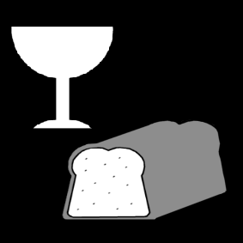
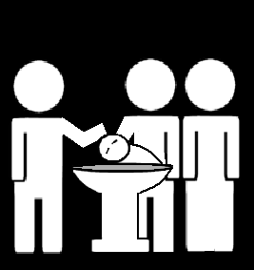

Growing in (the) faith

Slide 7
The origin of faith
Where does faith come from?
From the Holy Spirit
who works it in our hearts
by the preaching of the gospel
and strengthens it
by the use of the sacraments.
Faith has its origin with the Word.
Sacraments serve to strengthen faith.
I.e. simply being baptized or partaking of the Lord’s Supper does not save you!

Slide 8
The origin of faith

Where does faith come from?
From the Holy Spirit
who works it in our hearts
by the preaching of the gospel
and strengthens it
by the use of the sacraments.

Slide 9
The origin of faith
The Word comes first!
1
2

Slide 10
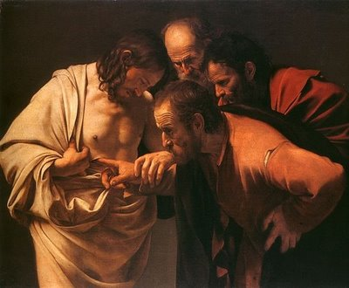
Bible Study: John 20:24-29

Slide 11
Bible Study: John 20:24-29
1. Thomas
2. We have seen the Lord!
3. No.
4. Only when he had seen Jesus himself and touched Him
5. Jesus
6. To touch Him
7. Stop doubting and believe.
8. My Lord and my God
9. Those who have not seen and yet believe

Slide 12
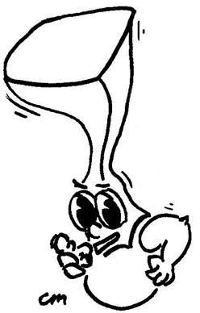
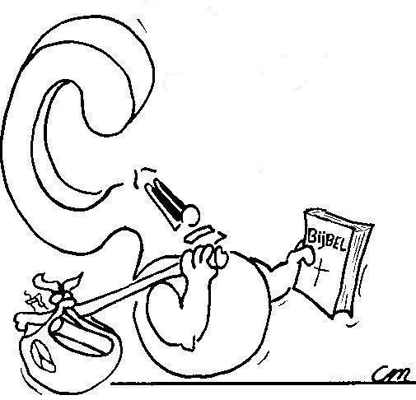

Sacraments are signs and seals of God’s promises.
So what are sacraments?

Slide 13

Sacraments: what are they?
SIGN
Help you better understand what you believe
Sacraments
Make you more convinced of what you believe
What’s the difference between sign and seal?
SEAL

Slide 14
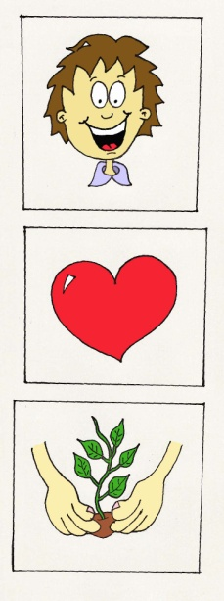
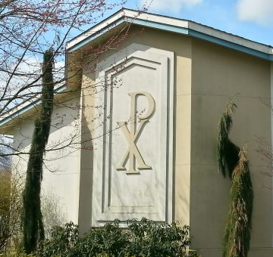

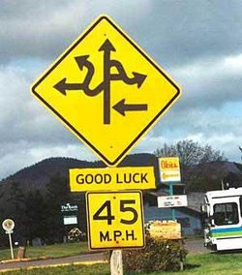

Sacraments: what are they?

SIGN
Help you better understand what you believe
Sacraments
Sacraments are like pictures, computer icons, symbols, traffic signs. They point to the essence of the Gospel.

Slide 15

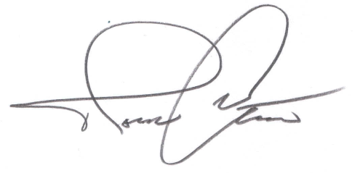
Sacraments: what are they?

Sacraments are like passwords, signatures, Personal Identi-fication Numbers (PIN). They point to the reality of the Gospel.
Sacraments
Make you more convinced of what you believe
SEAL

Slide 16
Fill in the blanks on the worksheet
Then write it in your own words.
SIGN
Help you better understand what you believe
Sacraments
Make you more convinced of what you believe
SEAL

Slide 17
Signs and Seals
Can you think of three signs in the Bible as a confirmation of God’s promise?

Slide 18
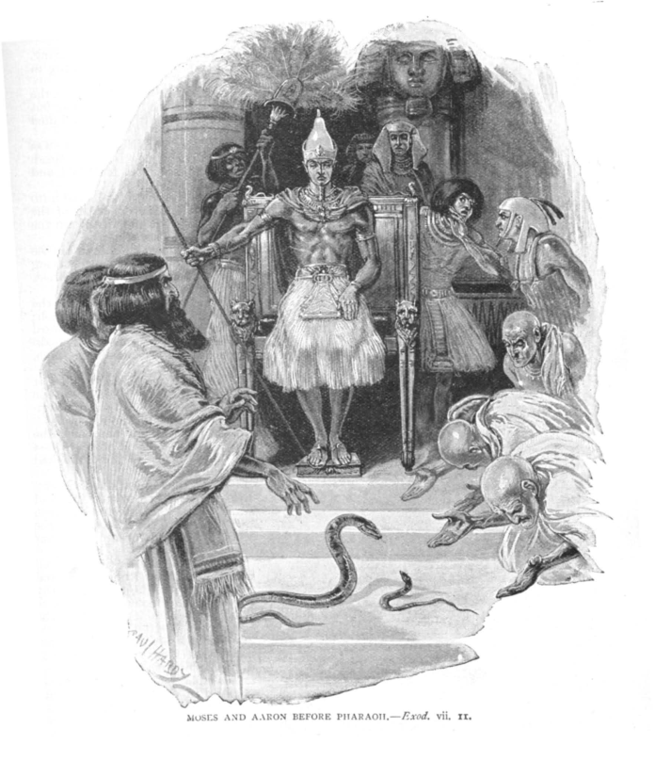
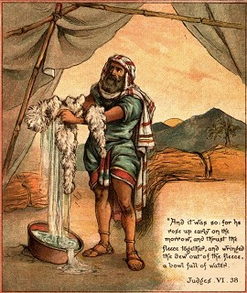
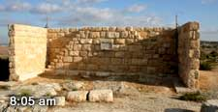
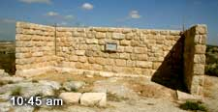
Signs and Seals
Can you think of some signs in the Bible as a confirmation of God’s promise?
Moses before Pharaoh
Gideon’s fleece
The sundial of Ahaz

Slide 19





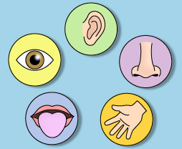
Sacraments and the Senses
Preaching
Baptism
Lord’s Supper
Hearing
Sight Smell
Taste Touch
Notes:
Animation is in sequence

Slide 20


Thank God for sacraments!
Matters of faith can be difficult.
Sometimes you’re not so sure about things.
Does God really forgive my sins? How?
Am I really becoming a new person?
God knows how weak we are.
That’s why He gave us sacraments.
To strengthen us in our faith.

Slide 21
Sacraments: How many?

Holy
Baptism
Holy
Supper
The Lord has given us two sacraments: Holy Baptism and the Holy Supper.

