Slide 1

Growing in Faith: LD 25-31
Holy Baptism
Lesson 02 – LD 26-27a

Slide 2
Psalm 90:1 (APV)
Lord, you have been for bygone generations
their dwelling place, their haven of salvation.
Also for us you are the rock of ages,
our only refuge when the tempest rages,
and you in generations yet to come
will be our children’s everlasting home.

Slide 3
Baptism

He who believes and is baptized will be saved
Mark 16:16
preaching
faith
baptism

Slide 4

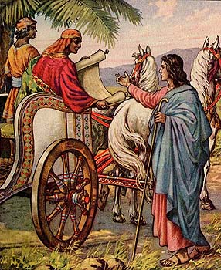
Bible Study: Acts 8:26-40

Slide 5
Bible Study: Acts 8:26-40
1. The prophet Isaiah
2. No.
3. About Jesus Christ
4. Do you believe?
5. Yes
6. He was baptized
7. Preaching, faith, baptism
8. Home

Slide 6

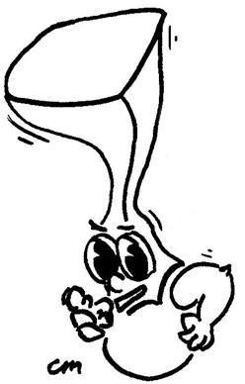
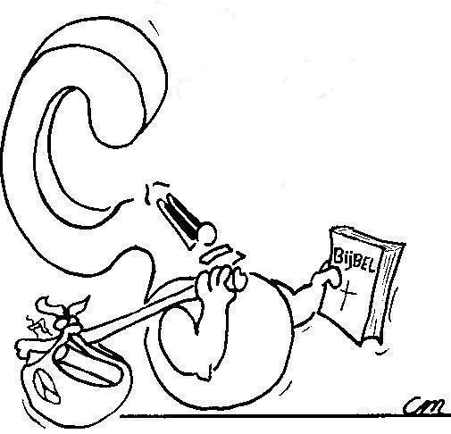
From the Greek ‘baptizo’ meaning: to immerse, to submerge, to cover with a liquid.
Where does ‘to baptize’ come from?

Slide 7
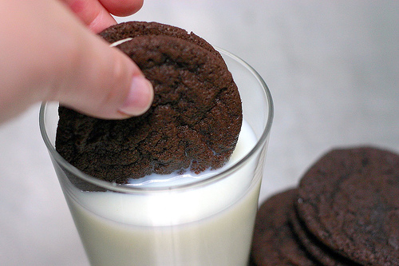
Baptizing is like Dunking an Oreo Cookie

As milk surrounds the cookie, so Father and Son surround a person.
As milk soaks the cookie, so the Spirit is in a person.
Baptism = surrounded by and soaked in the Trinity.

Slide 8
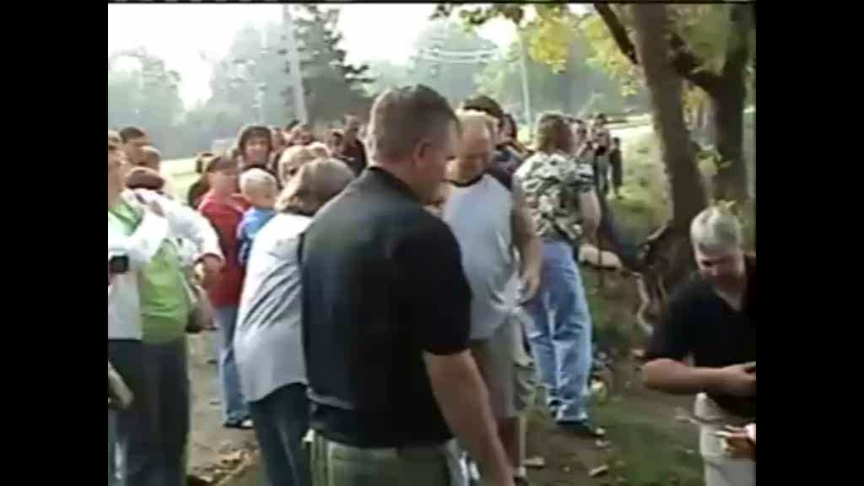
Baptism in a river

Slide 9

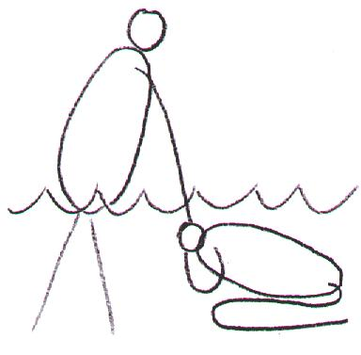
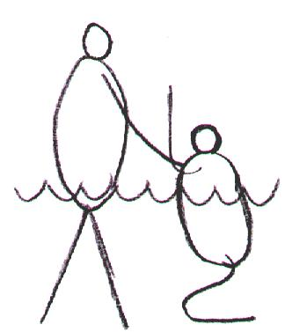
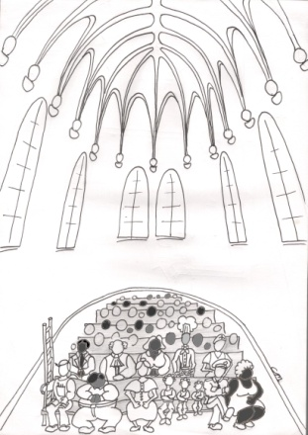
Sign and Seal of
Being washed
Dying and coming to life
Being incorporated

Slide 10
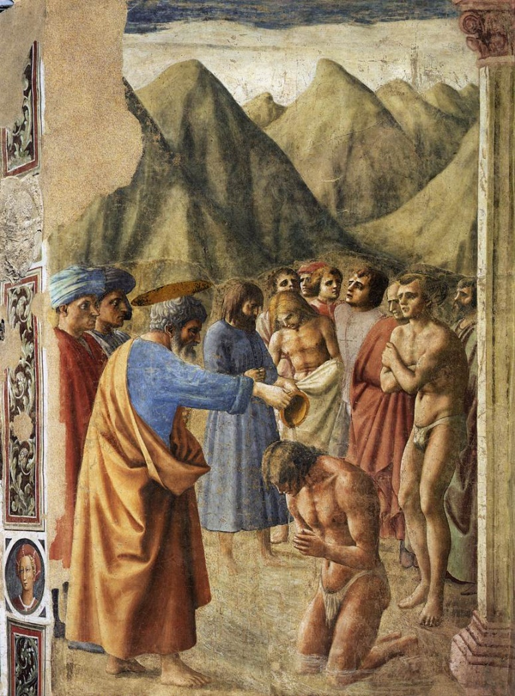
Being Washed

Water washes away stains and dirt
Christ’s blood and Spirit cleanse us from all sins

Slide 11
Dying and Coming to Life

Under water you’re dead and above water you’re alive
Baptism is
  - dying of the old nature that only wants to sin
  - coming to life of the new nature that lives in good works

Slide 12

Being Incorporated
Your name and God’s name are mentioned
You are part of the family of God!
Robby Vanderblack, I baptize you into the Name of the Father, the Son, and the Holy Spirit
To put in a body (corpse)

Slide 13
Being Incorporated

Your name and God’s name are mentioned
You are part of the family of God!
Robby Vanderblack, I baptize you into the Name of the Father, the Son, and the Holy Spirit

Slide 14
Sign and Seal of
Being washed
Dying and coming to life
Being incorporated

Slide 15
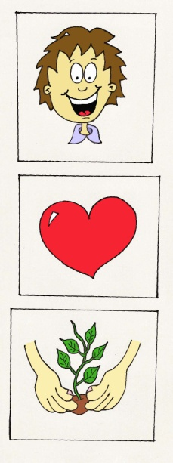
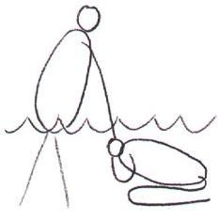
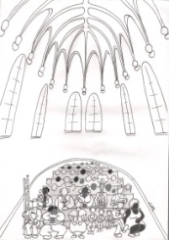
Baptism as a sign

SIGN
Helps us better understand how we are forgiven, renewed & belong
Baptism
Baptism makes clear to everyone:
how sins, how we become that we
are forgiven new people, and belong to God

Slide 16
Baptism as a seal

The person being baptized may be certain of
forgiveness, renewal, and belonging
Baptism
Convinces you all the more: sins are gone, the old is dying and the new is coming to life, and you belong
SEAL

Slide 17
displays and confirms
SIGN
Helps us better understand how we are forgiven, renewed & belong
Baptism
Convinces you all the more: sins are gone, the old is dying and the new is coming to life, and you belong
SEAL

