Slide 1

Growing in Faith: LD 25-31
Lord’s Supper
Lesson 04 – LD 28-29

Slide 2
Hymn 59:1
Come, take by faith the body of the Lord,
and drink the blood of Christ, for us outpoured.
Praise and confess the wonders of his grace:
to rescue us, he suffered in our place.
Led to the slaughter as the Lamb of God,
our Saviour bought us with his precious blood.
Remember how he bore our curse and shame;
until he comes, let us his death proclaim.

Slide 3
Lord’s Supper

I tell you the truth, he who believes has everlasting life. I am the bread of life. … If anyone eats of this bread, he will live forever. This bread is my flesh,...
John 6:47,48,51
Lord’s Supper
preaching
faith

Slide 4

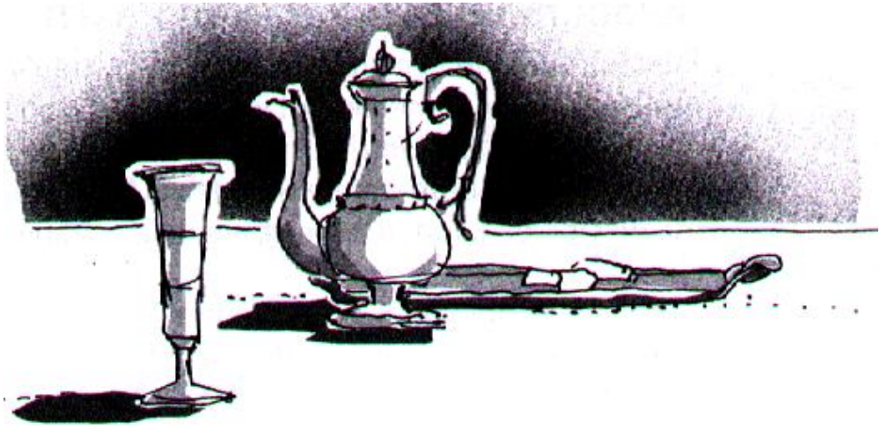
Bible Study: Matthew 26:26-29

Slide 5
Bible Study: Matthew 26:26-29
1. During the last Passover
2. My body
3. My blood of the covenant
4. For the forgiveness of sins
5. In His Father’s Kingdom

Slide 6

Passover: The Jewish feast of liberation
Notes:
Watch the video twice as it goes very fast.

Slide 7


Video questions
1. To remember the exodus, when they fled Egypt with dough to which they had yet not added yeast
2. To remember the bitterness of slavery
3. To recall the tears the Jews shed as slaves
4. To reflect freedom and relaxation in contrast to slavery
5. Both
(and so is the Lord’s Supper…)

Slide 8

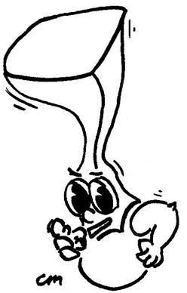
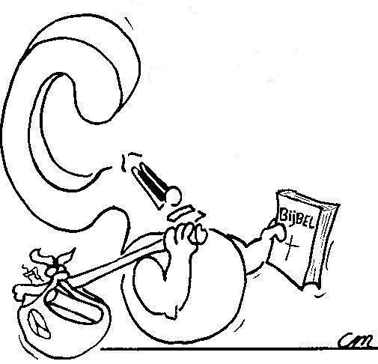
Because the Lord “passed over” the houses of the Israelites when all the first born were killed in Egypt.
Why is the Jewish feast of liberation called “Passover”?

Slide 9
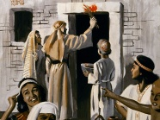
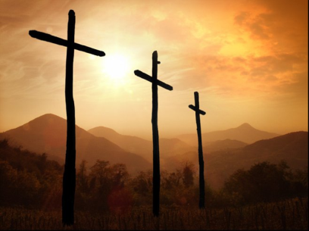
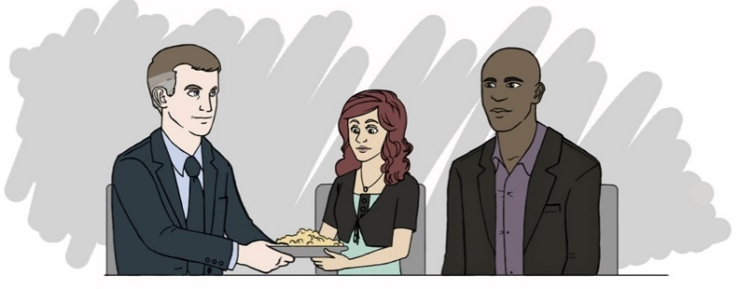
From Passover to Lord’s Supper

Baptism replaces circumcision as a sign and seal of entry into the covenant
Similarly, the Lord’s Supper replaces Passover as a sign of covenant liberation
Passover: liberation from Egypt and oppression
Lord’s Supper: liberation from sin and devil’s power

Slide 10
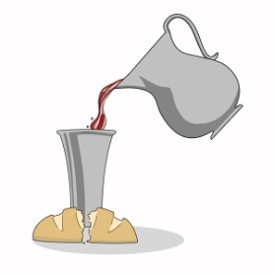
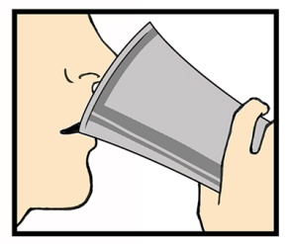

Signs and Seals of being
Sins forgiven
New life
Belong to God’s family

Slide 11

Forgiven

Bread is broken and wine is poured. It is “destroyed”, it dies. The death of man is the true payment for sin.
Christ died the death we had to die.
Thus we are set free from what comes from all our sins.

Slide 12
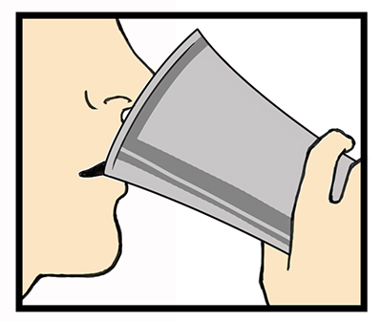
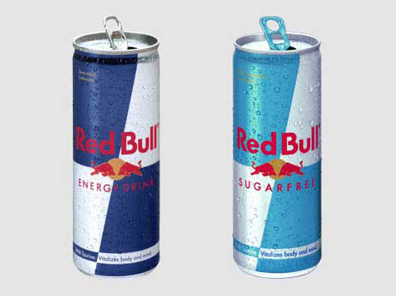
Renewed

Food and drink give you the energy to live.
We share in the Spirit of Christ.
And thus we have the strength to live the new, perfect life.

Slide 13

Part of the Church

We celebrate together as community, not as individuals
This expresses the unity with the body of Christ, connected to Christ and in Him connected to each other

Slide 14

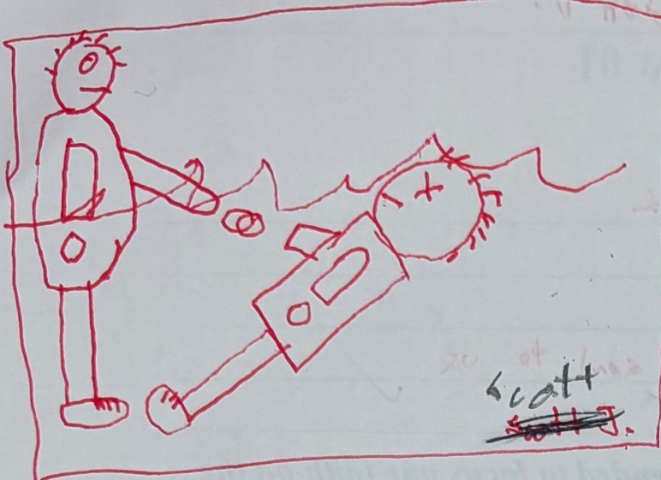
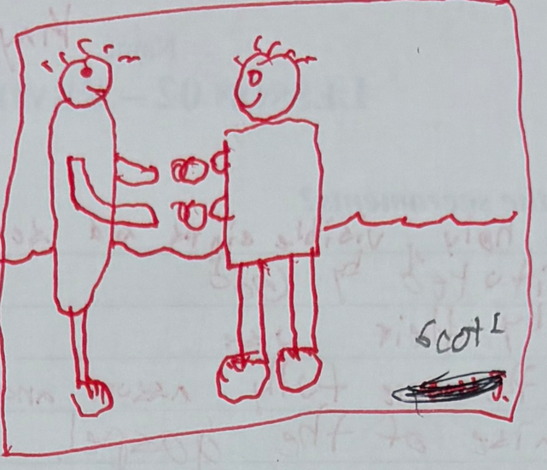
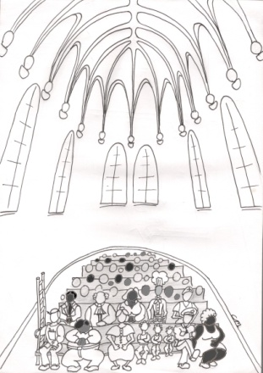
Baptism Lord’s Supper

Sins forgiven
New life
Part of the Church

Slide 15
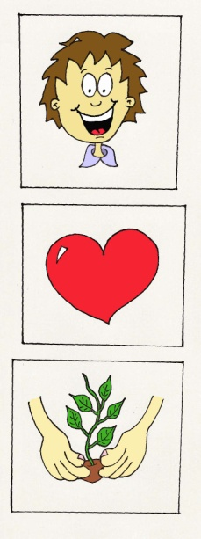

Lord’s Supper as a sign

SIGN
Helps us better understand how we are forgiven, renewed and belong
Lord’s Supper
The Lord’s Supper makes clear to everyone:
how sins, how we become that we belong to
are forgiven new people, and God & each other

Slide 16
Lord’s Supper as a seal

The person partaking of the Lord’s Supper may be certain of
forgiveness, renewal, belonging to Christ and
His body, the Church
Lord’s Supper
Convinces you all the more: sins are gone, I can live the new life, I belong to Christ and His body
SEAL

Slide 17
displays and confirms
SIGN
Helps us better under-stand how we are forgiven, renewed and belong
Lord’s Supper
Convinces you all the more: sins are gone, I can live the new life, I belong to Christ and His body
SEAL

