Slide 1

Growing in Faith: LD 25-31
Holy Baptism
Lesson 02 – LD 26-27a

Slide 2
Psalm 90:1 (APV)
Lord, you have been for bygone generations
their dwelling place, their haven of salvation.
Also for us you are the rock of ages,
our only refuge when the tempest rages,
and you in generations yet to come
will be our children’s everlasting home.

Slide 3
Baptism

He who believes and is baptized will be saved
Mark 16:16
preaching
faith
baptism

Slide 4

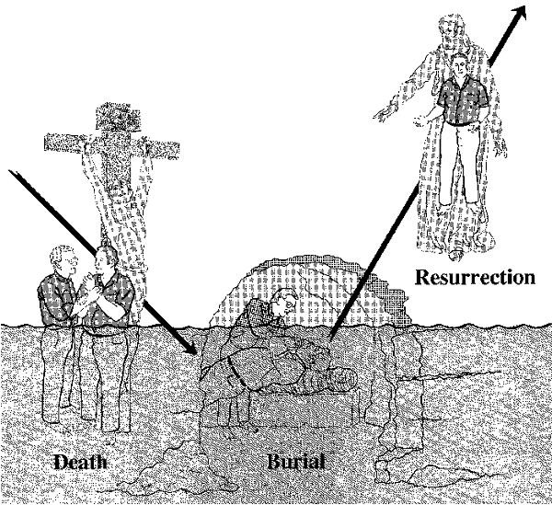
Bible Study: Romans 6:1-14

Slide 5
Bible Study: Romans 6:1-14
1. Sin
Do whatever we want, without regard for God
2. His death.
3. Buried.
4. Raised to a new life.
5. So that we might no longer be slaves to sin.
6. Die.
7. Dead to sin and alive to God.
8. Sin.

Slide 6


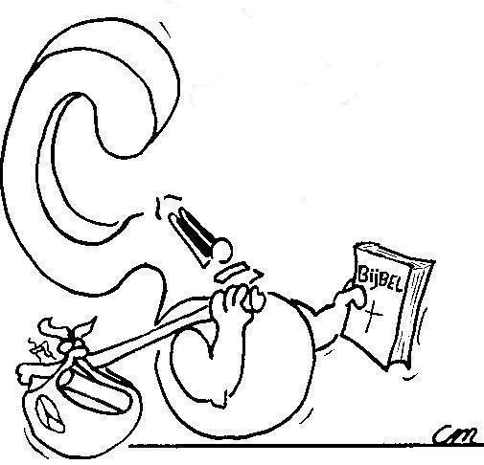
From the Greek ‘baptizo’ meaning: to immerse, to submerge, to cover with a liquid.
Where does ‘to baptize’ come from?

Slide 7
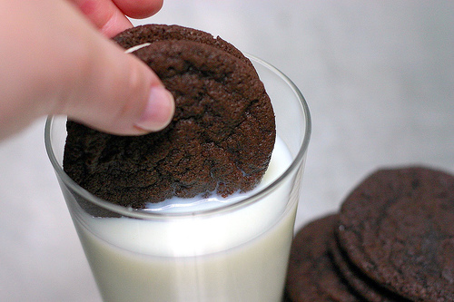
Baptizing is like Dunking an Oreo Cookie
As milk surrounds the cookie, so Father and Son surround a person.
As milk soaks the cookie, so the Spirit is in a person.
Baptism = surrounded in and soaked in the Trinity.

Slide 8
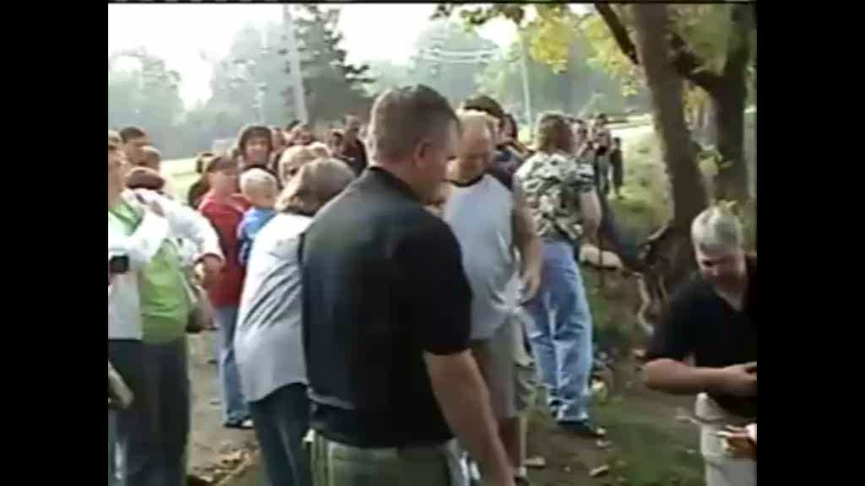
Baptism in a river

Slide 9
Immerse or sprinkle?

Many Christians hold that immersion is the only proper way of baptizing.
Reason: the original meaning of “baptizo”
However, right from the start, the church practised both immersion and sprinkling.
Thus, over time, “baptizo” came to mean more than just “submerge”, it could also mean “sprinkle”
Our Form for Baptism says: this is what the immersion in or sprinkling with water teaches us
Thus BOTH are fine

Slide 10
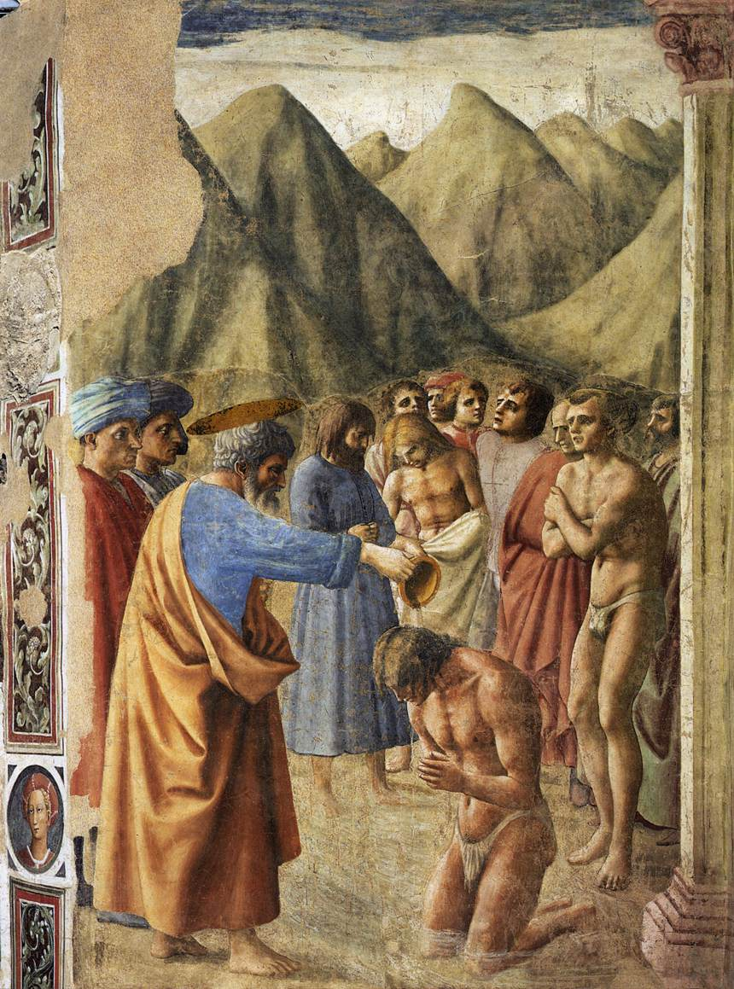
Immerse or sprinkle?

Slide 11
Baptism in the ancient church
Concerning Baptism. And concerning baptism, baptize this way: Having first said all these things, baptize into the name of the Father, and of the Son, and of the Holy Spirit, in living water. But if you have no living water, baptize into other water; and if you cannot do so in cold water, do so in warm. But if you have neither, pour out water three times upon the head into the name of Father and Son and Holy Spirit. But before the baptism let the baptizer fast, and the baptized, and whoever else can; but you shall order the baptized to fast one or two days before.
Didache chapter 7 (around 200 AD)

Slide 12

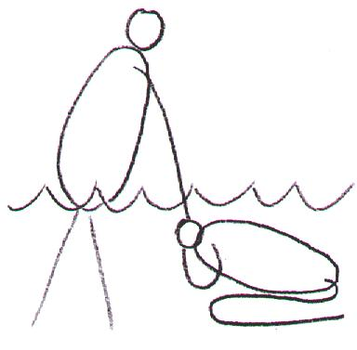
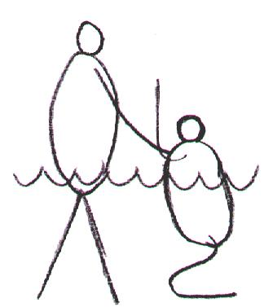
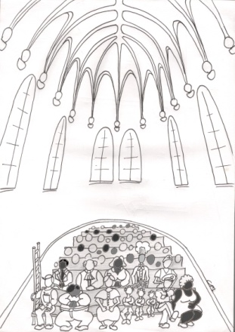
Sign and Seal of
Being washed
Dying and coming to life
Being incorporated

Slide 13
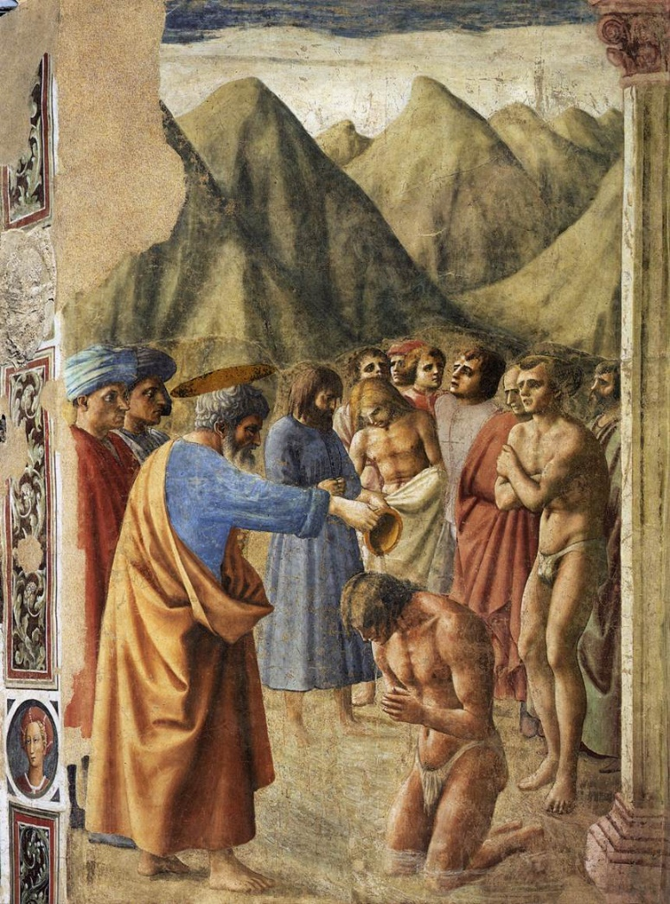
Being Washed

Water washes away stains and dirt
Christ’s blood and Spirit cleanse us from all sins

Slide 14
Dying and Coming to Life

Under water you’re dead and above water you’re alive
Baptism is
  - dying of the old nature that only wants to sin
  - coming to life of the new nature that lives in good works

Slide 15

Being Incorporated
Your name and God’s name are mentioned
You are part of the family of God!
Robby Vanderblack, I baptize you into the Name of the Father, the Son, and the Holy Spirit
To put in a body (corpse)

Slide 16
Being Incorporated

Your name and God’s name are mentioned
You are part of the family of God!
Robby Vanderblack, I baptize you into the Name of the Father, the Son, and the Holy Spirit

Slide 17
Sign and Seal of
Being washed
Dying and coming to life
Being incorporated

Slide 18

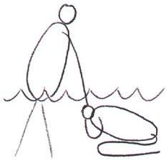
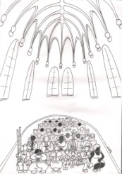
Baptism as a sign

SIGN
Helps us better understand how we are forgiven, renewed & belong
Baptism
Baptism makes clear to everyone:
how sins, how we become that we
are forgiven new people, and belong to God

Slide 19
Baptism as a seal

The person being baptized may be certain of
forgiveness, renewal, and belonging
Baptism
Convinces you all the more: sins are gone, the old is dying and the new is coming to life, and you belong
SEAL

Slide 20
displays and confirms
SIGN
Helps us better understand how we are forgiven, renewed & belong
Baptism
Convinces you all the more: sins are gone, the old is dying and the new is coming to life, and you belong
SEAL

